Slide 1

Universal Screening Webinar
Presented by the VTPBIS State Team
Notes:
Please make sure you have copies of the materials so you and your team can familiarize yourself with them.

Slide 2
Webinar Logistics
Orient to webinar screen
2 ways to interact:
  Use the icons on the top of your screen
  Type a question into the text box
This webinar will be recorded.
Please note, your microphone will be muted unless otherwise indicated.

Slide 3

Why is this webinar only one hour?
http://www.ci3t.org/screening
_

Slide 4

Another amazing resource!
https://smhcollaborative.org/wp-content/uploads/2019/11/universalscreening.pdf
_
Notes:
Nate (940-945)

Slide 5
Agenda
What is screening?
Why would you want it?
What does it look like?
Can we try?
How do we get started?

Slide 6
Poll
Do you have a screening process/procedure in place at your school to assess for social/emotional/behavioral risks?
  Yes, we have a formal process/procedure.
  Yes, we have an informal process/procedure.
  No, what is social/emotional/behavioral screening?

Slide 7
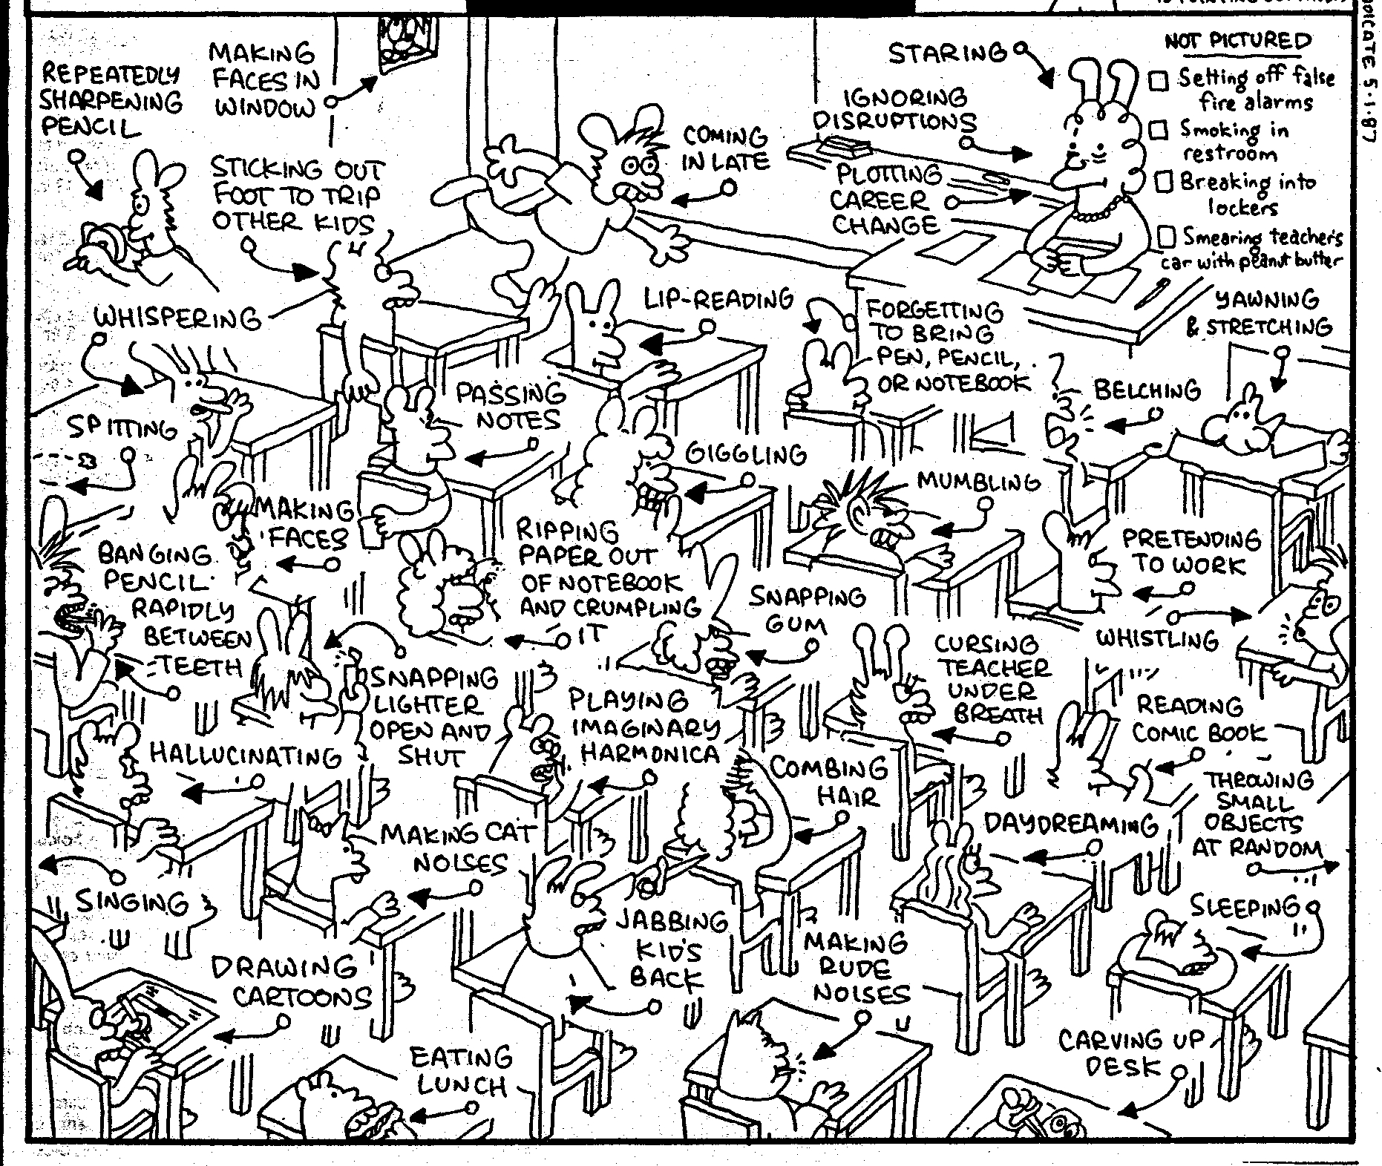
Notes:
With the number of behaviors that occur in the classroom on a daily basis, it can sometimes be difficult to formulate an accurate measure of the real challenges and needs if we rely solely on anecdotal, gut reactions. It can also sometimes be a challenge to figure out where to start when there can be so many variations in the types of behaviors.
Role of educator challenging to meet differentiated needs of students.

Slide 8
Poor Outcomes for Unidentified and Untreated Youth
Poor grades
Impaired personal relationships
High school dropout
Unemployment
Incarceration
Substance abuse
Suicide
Notes:
More students labeled ED are not eligible for special ed (1% nationally).
But EBD still have needs must be identified and addressed for academic success.
“Untreated emotional problems have the potential to create barriers to learning that interfere with the mission of schools to educate all children.” (Adelman & Taylor, 2002)
“Without early intervention, children who routinely engage in aggressive, coercive actions, are likely to develop more serious anti-social patterns of behaviors that are resistant to intervention.” (Walker, Ramsey, & Gresham, 2004)
Youth who are the victims of bullying and who lack adequate peer supports are vulnerable to mood and anxiety disorders (Deater-Deckard, 2001; Hawker & Boulton, 2000)
“Depressive disorders are consistently the most prevalent disorders among adolescent suicide victims (Gould, Greenberg, Velting, & Shaffer, 2003)
WHAT DO WE KNOW!
Academic Success is linked with social and behavioral skills
Early identification with intervention can decrease the likelihood of academic failure
Preventive supports reduce the need for more intensive supports later
.

Slide 9
What is emotional/behavioral screening?
Early identification of students at risk of school failure due to social, emotional, and/or behavior problems.
Mechanism for targeting students who need additional supports after receiving evidenced-based universal behavior supports (i.e. PBIS)
Notes:
“At risk of” is a big category. We would like to know if there are any warning signs that we can easily address by matching student need with interventions. Taking on Universal screening for behavior is best done within the context of a school that is already providing Universal supports with fidelity.

Slide 10
Why Universal Screening?
To find students whose problems are not immediately obvious.
To identify problems with a high degree of accuracy.
Early identification leads to early intervention.
To select interventions based on results of rating scales on the screening tools. This is most effective and efficient.
Notes:
As we already said, we’re doing a multitude of screenings in schools anyway. Just like with our other screenings, early identification leads to early intervention. Using formalized screening measures allows schools to select interventions that are based on results of rating scales rather than guesses.
Screening allows us to be objective.
Matching interventions to what is going on with the student. A simplistic example would be supporting a shy, withdrawn student with a standard CICO intervention

Slide 11
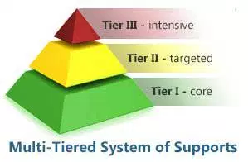
Designing School-Wide Systems for Student Success
Notes:
How many of you are familiar with the term MTSS?
Universal screening fits into MTSS is intended to support students where they are at starting with:
Whole school best instruction. Selecting the evidence based practices that have the best chance of student success.
MTSS also includes screening in academics and social/emotional/behavioral strengths and weaknesses along with rigorous progress monitoring.
MTSS also focuses on professional knowledge and practices that the adults in a school need to implement the best practices to meet students’ needs wherever they are at.

Slide 12
Universally Accepted Types of Screening in School
Readiness
Academic
Vision
Hearing
Dental
Why not?
Behavior
Notes:
We already do regular screenings throughout the school year. Universal Screening for behavior should be planned for the same times of year as other benchmark and progress monitoring assessments. At least two to three times per year.

Slide 13
Poll:
How does your school determine which interventions to use with students?
We look at what’s available and provide that intervention to the student
We use data collected about the student to match student to an appropriate, existing intervention
We develop individualized interventions based on student’s specific needs
We develop an inventory of supports based on risks identified through a systematic screening of all students
Notes:
Take 5 minutes as your team to discuss with each other.
At the Targeted Level your schools should be implementing CICO. Remember, CICO works exceptionally well for students who are motivated by adult attention. Screenings will allow you to more accurately determine which students would benefit from CICO or may need another type of targeted intervention or something even more intensive.

Slide 14
Interventions with an Evidence Base
Advance organizers
Anger Management Skills Training
Behavioral Interventions
Choice
Class Wide Peer Tutoring
Cognitive organizers
Cognitive Restructuring
Cognitive-Behavioral Therapy
Computer-Assisted Instruction
Contingency Management
Daily Behavior Report Cards
Exposure-Based Techniques
Family Therapy
Functional Assessment
Functional Communication Training
Integrated Cognitive-Behavioral Therapy
Interdependent Group-Oriented Contingency Management
Interpersonal Therapy for Adolescents
Milieu Language Teaching
Mnemonics
Modeling
Modified Task Presentation Strategies
Moral Motivation Training
Multimodal Interventions
Multisystemic Therapy
Opportunities to respond
Pacing
Parent Training
Peer Mediated Interventions
Peer tutoring
Peer-Mediated Conflict Resolution and Negotiation
Picture Exchange Communication System
Pivotal Response Training
Pre-correction
Presentation Strategies
Problem Solving
Procedural prompts and behavioral momentum
Replacement Behavior Training
Self instruction
Self mediated strategies
Self monitoring
Self-Management
Social Skills Training
Task Modification
Task Selection Strategies
Token Economy System
Verbal Mediation
Video Modeling
TARGETED INTERVENTIONS
Vannest K, Reynolds CR, Kamphaus RW. BASC-2 intervention guide for emotional and behavioral problems. Bloomington, MN: Pearson Assessments; 2009.
Notes:
How do we know which intervention to use for each child? We need to have a formalized way to determine what type of intervention is most appropriate for each student. Just like in an RTI model where we use Universal academic assessments to identify students at risk and to provide early intervention. We need to do the same behaviorally and ensure that we are being more intentional with our intervention selection.

Slide 15
Three Pathways
Nomination
Traditional referrals
Behavioral Indicators
ODRs
Attendance
Suspensions/Expulsions
Systematic Screening
SRSS
SSBD
BESS BASC 2
SDQ
SSIS
SAEBRS
Notes:
We use the term nomination instead of Referral because the word referral is often connected with special education. We’re not referring students for special education and we certainly aren’t intending to identify students as having a disability. We’re merely seeking early identification of “risk” factors. Using the term nomination is far more sensitive to potential parents, who by the way we will be seeking consent to do the screenings from.

Slide 16

Student Outcome Data:
Use SWIS as Universal Screener
Proportion of students with:
0-1 Office Discipline Referrals (ODRs)
2-5 ODRs
6+ ODRs
Screen two times per year and compare across time
Last 2 weeks of October/first 2 weeks of November
Last 2 weeks of February/first 2 weeks of March
Notes:
SWIS also assists schools in the decision making process by serving as a universal screening tool. Using the data-based decision rules of 0-1 ODRs, 2-5 ODRs, and 6+ ODRs schools can quickly identify those students to watch; those students who may benefit from targeted, small group services and Tier II supports; as well as those students who may benefit form more individualized and intensive supports.
By regularly reviewing SWIS graphs and reports, schools/facilities can progress monitor their efforts and be proactive in their actions and decisions.

Slide 17
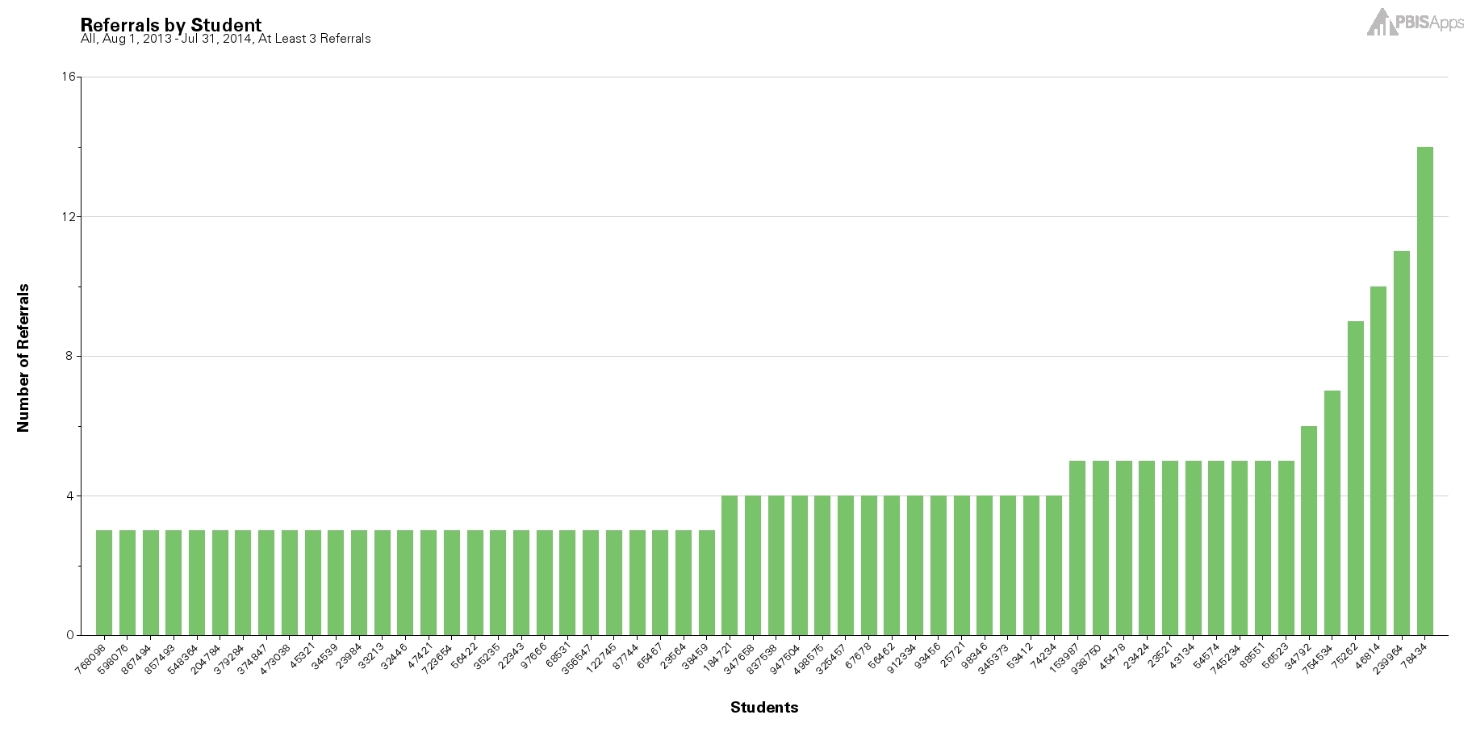

Universal, Tier I
Notes:
SWIS also assists schools in the decision making process by serving as a universal screening tool. Using the data-based decision rules of 0-1 ODRs, 2-5 ODRs, and 6+ ODRs schools can quickly identify those students to watch; those students who may benefit from targeted, small group services and Tier II supports; as well as those students who may benefit form more individualized and intensive supports.
By regularly reviewing SWIS graphs and reports, schools/facilities can progress monitor their efforts and be proactive in their actions and decisions.

Slide 18
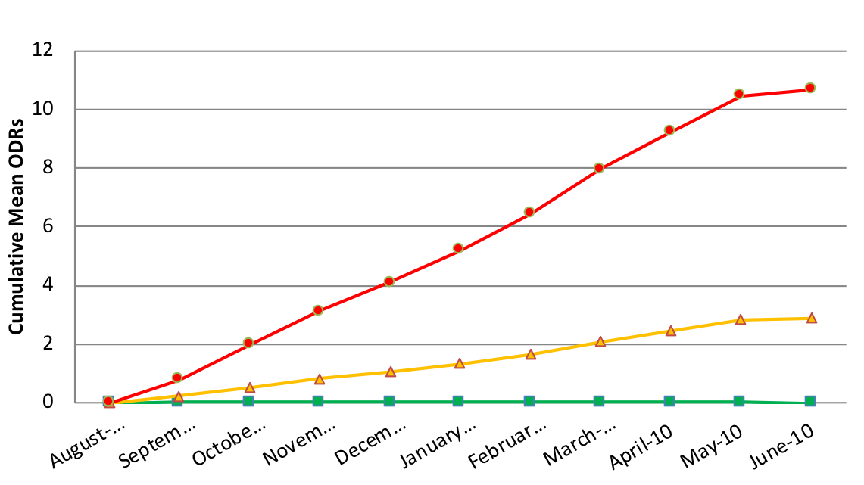
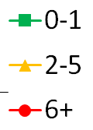
When should schools start screening?
Cumulative Mean ODRs Per Month for Elementary Schools
Differences become clear in October
McIntosh et al (2010)
Notes:
Based on research using SWIS data across hundreds of U.S. schools, we know that screening should start in or around October so that by November we are providing students with the level or tiers of support they need to be successful.

Slide 19
The “October Catch” Possibilities
30%
In a school of 500 students this could mean
150 less referrals
25-75 hours staff time
per school year!
20%
Notes:
In actively screening we are trying to reduce the number of total referrals, , the number of minutes a student is out of their instructional environment, the number of referrals individual students receive, and staff time spent on addressing problem behavior across the school.
PBISApps recommends screening about 6 weeks after each major break.. The October Catch, (click) the February Catch, (click) and the April Catch for example.
If we hypothesize a 20% decrease for students who would have ended the year with 2-5 referrals and a 30% decrease for students who were on target to receive 6+ referrals then some simple math tells us that a school with 500 students can reduce overall referrals by 150 and regain approximately 25-75 hours of staff time.

Slide 20

Great Article on the “October Catch”: https://www.pbisapps.org/community/Pages/The-October-Catch.aspx
_
Notes:
https://www.pbisapps.org/community/Pages/The-October-Catch.aspx

Slide 21
Tracking Indicators of Risk
Student | GPA | Course Failures | Days Absent | ODRs
Josh | 3.1 | 0 | 2 | 0
Mary | 4.1 | 0 | 0 | 0
Kelly | 2.8 | 1 | 0 | 1
Jacob | 1.4 | 3 | 11 | 12
Susan | 3.5 | 0 | 3 | 0
Mark | 1.9 | 1 | 5 | 7

Slide 22
Tracking Positive Behavior Expectations
Student | ODRs | Be Safe | Be Kind | Be Responsible
Josh | 0 | 3 | 3 | 2
Mary | 0 | 3 | 2 | 3
Kelly | 1 | 3 | 3 | 3
Jacob | 12 | 1 | 3 | 2
Susan | 0 | 3 | 2 | 3
Mark | 7 | 2 | 3 | 1
Notes:
School created simple 3-point scale for each of the school-wide expectations
Teachers given instructions for rating students and they provide overall rating to each expectation
How would this work in your school?

Slide 23
Aren’t ODRs Enough?
Students with externalizing problems?
Students with internalizing problems?
Notes:
Students exhibiting anxiety, depression or other internalizing behaviors are not as easily recognizable. Although ODRs give descriptions of behavior incidents that occurred, they do not assess the motivating factors behind behavior and often times miss the less externalizing student who don’t typically “Act Out.”
Bristol: n some cases, students were scoring extremely high risk on BESS but were not referred to the Tier II team and had no referral data. Others were considered normal risk but they had received many referrals, either major or minor. We thought it would be helpful for teachers to see this and be able to reflect on their students needs.

Slide 24
Features of Good
Universal Screening
Accurate
Cost efficient
Acceptable
Useful
Notes:
As far as accuracy, whenever using any screening or assessment tool you want to make sure it is normed based on the student population that you work with. So you’ll want to select an evidence based, norm-referenced screening tool in order to get the most accurate results.
Efficiency, Effectiveness.

Slide 25
Multi-Stage & Multi-Gate Approach to Screening
Universal Screen
Elevated? Screen #2
Elevated? Refer to team
Not elevated? Done.
Not elevated? Done.
Stage 1
Stage 2
Stage 3

Slide 26
What Screening Tools are out There?
http://www.ci3t.org/screening
_

Slide 27

SSBD
https://pacificnwpublish.com
_
Evidence-based
Pre-K – 9th grade
Internalizing & Externalizing
Three gate systematic process
Cost: $225 + $30 / 100 students

Slide 28
SSBD Multi-Stage or
Multi-Gate Process
Teacher Screening
Review class roster
Rank order top 5 students in each group
Teacher Rating
Complete two rating scales for top 3 externalizers and top 3 internalizers
Direct Observation
In class & playground
Code academic engaged time & peer social behavior

Slide 29
Multiple Gating Procedure
(Adapted from Severson et al. 2007)
Teachers Rate Top 3 Students in Each Dimension on (Externalizing & Internalizing) Behavior Criteria
Gate 1

Slide 30
Externalizing refers to all behavior problems that are directed outwardly by the student toward the external social environment.
Externalizing behavior problems usually involve behavioral excesses (i.e., too much behavior) and are considered inappropriate by teachers and other school personnel.

Slide 31
Externalizing Examples
Aggression to others/things
Hyperactivity
Non-compliance
Disruptive
Arguing
Defiance
Stealing
Not following directions
Calling out

Slide 32
Nominate 5 Students & Rank 3
Class Roster
Josh | JoAnne
Mary | Laura
Kelly | Helen
Jacob | Mike
Susan | Dave
Sam | Ben
Chuck | Michelle
Liz | Courtney
Beth | Jesse
Karen | Leonard
Justin | Amanda
Externalizing
Josh
Mary
Kelly
Jacob
Susan
Externalizing Top 3
1. Susan
2. Jacob
3. Kelly

Slide 33
Internalizing refers to all behavior problems that are directed inwardly (i.e., away from the external social environment) and that represent problems with self.
Internalizing behavior problems are often self-imposed and frequently involve behavioral deficits and patterns of social avoidance.

Slide 34
Internalizing Examples
Exhibits unusual sadness
Sleeps a lot
Is teased or bullied by peers
Does not participate in games
Very shy or timid
Acts fearful
Does not stand up for self
Withdrawn
Avoids social interactions

Slide 35
Nominate 5 Students & Rank 3
Class Roster
Josh | JoAnne
Mary | Laura
Kelly | Helen
Jacob | Mike
Susan | Dave
Sam | Ben
Chuck | Michelle
Liz | Courtney
Beth | Jesse
Karen | Leonard
Justin | Amanda
Internalizing
Helen
Chuck
Amanda
Sam
Liz
Internalizing Top 3
1. Liz
2. Chuck
3. Amanda

Slide 36
Multiple Gating Procedure
(Adapted from Severson et al. 2007)
Gate 1
Teachers Rank Order, then Select Top 3 Students on Each Dimension (Externalizing & Internalizing)
Pass Gate 1
Teachers Rate Top 3 Students in Each Dimension
(Externalizing & Internalizing) on Critical Events Index and Combined Frequency Index
Gate 2
Tier 2
Intervention
Pass Gate 2

Slide 37
Scoring
Teachers complete Critical Events Index checklist and Combined Frequency Index for top three internalizers and externalizers
  Internalizers with 4+ and externalizers with 5+ critical events immediately pass gate two and are eligible for a simple targeted intervention (i.e. CICO)

Slide 38
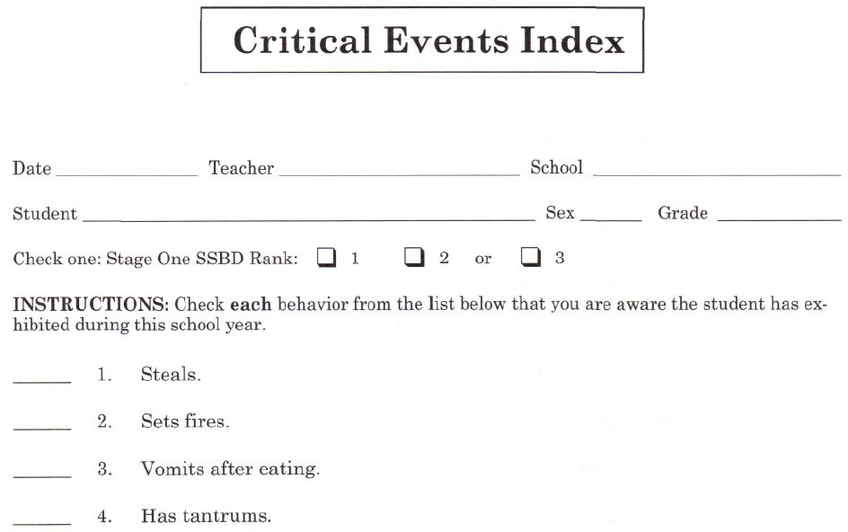
Sample of SSBD Critical Events Form

Slide 39
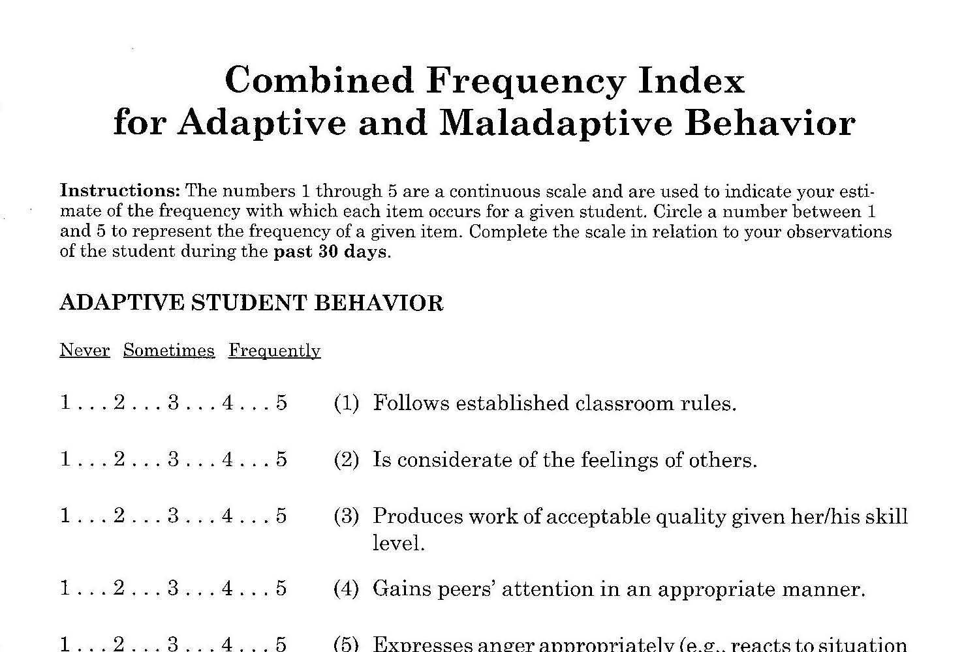
Sample of SSBD CFI Form

Slide 40
SSBD Screening Process
Pool of Regular Classroom Students
TEACHER SCREENING
on Internalizing and Externalizing Behavioral Dimensions
3 Highest Ranked Pupils on Externalizing and on Internalizing Behavior Criteria
PASS GATE 1
TEACHER RATING
on Critical Events Index and Combined Frequency Index
Exceed Normative Criteria on CEI of CFI
PASS GATE 2
DIRECT OBSERVATION
of Selected Pupils in Classroom and on Playground
Exceed Normative Criteria on AET and PSB
PASS GATE 3
Pre-referral Intervention(s)
Child may be referred to Intensive Level
Team for Individualized Supports
Notes:
The system closely aligns with the three-tier service delivery system of RTI.
Advantages: Strong reliability and validity evidence, as well as endorsements from experts in the field
Identifies students who may be under-identified (i.e., students with internalizing behaviors)
Manual provides reproducible forms
Disadvantages:
Quite complex, with the different stages, forms, raters, and observers.
Substantial training may be required
Parents are not involved in any of the stages
Does not allow teachers to identify students who display both internalizing and externalizing behaviors
May be time consuming for teachers
Does not allow for progress monitoring

Slide 41
List of Screeners
Student Risk Screening Scale http://miblsi.cenmi.org/MiBLSiModel/Evaluation/Measures/StudentRiskScreeningScale.aspx
Social Skills Improvement System http://www.pearsonclinical.com/education/products/100000322/social-skills-improvement-system-ssis-rating-scales.html
Strengths and Difficulties Questionnaire www.sdqinfo.org
Systematic Screening for Behavior Disorders http://store.cambiumlearning.com
BASC™-2 Behavioral and Emotional Screening System (BASC-2 BESS) http://www.pearsonassessments.com
Social, Academic & Emotional Behavior Risks Screener http://ebi.missouri.edu/?p=1116
_
_
_
_
_
_
Notes:
&

Slide 42
VT Example:
Mt. Abe Union Supervisory District
Use the BESS and SSIS through Aimsweb
Screen 3x per year
SEL Coordinator works with school PBIS coordinators to compile other relevant data (ODRs, nurses visits, absences)
Students with elevated risk are matched to interventions
SU Team views data from systems perspective
Grade-level teams view data for particular students

Slide 43
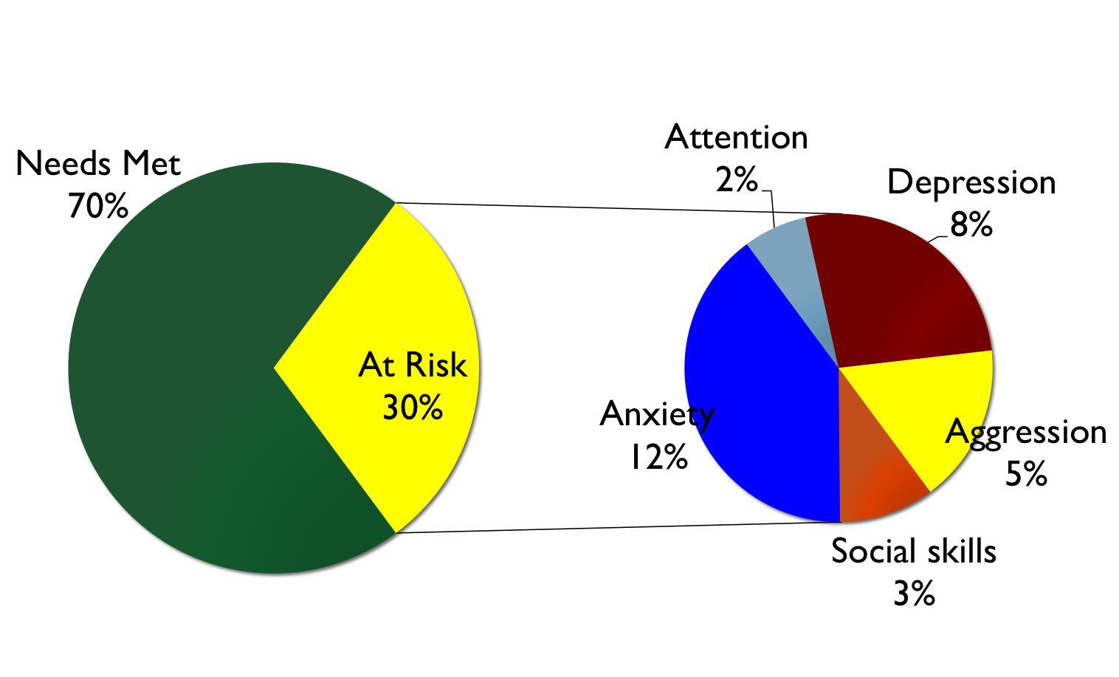
Stage 1 Stage 2
Notes:
Behavior Assessment System for Children 2 /
Behavioral and Emotional Screening System
27 Items
Externalizing = 6
Internalizing = 9
School Problems = 6
Adaptive Skills = 6

Slide 44

Results of screens helped teams choose which interventions to develop, use, or expand (4 schools)
Notes:
Research of Kimberly J. Vannest, Ph.D.

Slide 45
Screening Tips
Recommended 2-3 times/year
  October & February
Group administration of Stage 1
Teachers should have known students for at least one month
Review definitions/examples of externalizing and internalizing problems

Slide 46
So pretty simple, right? Well…
Family’s right to privacy (opt out option)
Clear & efficient systems to support process
Training & TA
Availability of supports
Policy and liability issues
What else?

Slide 47
Recommended Steps to Readiness
Need identified
Approval secured
Team formed
Supports identified
Policies for other screening reviewed
Evidence based system identified
Policies & procedures developed
P&P shared with families (opt out)
P&P for notifying families shared
Point of contact for oversight
Point of contact at SU/SD
Resources available

Slide 48
Preparation for Screening
How to Get
Started
Before actual screening––
Have a solid Targeted PBIS system (with interventions) already in place
Tie in to existing PBIS systems (integration, NOT add-on)
Identify your school’s risk factors, or other behavior indicators you will track
Create a calendar for when your screenings will occur

Slide 49
Preparation for Screening
How to Get
Started
Select a Coordinator––
Someone with strong:
Organizational skills
Leadership skills
Experience with assessment tools

Slide 50
Preparation for Screening
How to Get
Started
Before actual screening––
Provide plan for seamless transition from screening to intervention
Provide teacher training
Provide parental notification of screening and parental consent to intervene with youth identified by screener

Slide 51
What’s Next?
Review Universal Screening Steps to Readiness
Determine where is your school in this process
Review and select tools

Slide 52
Resources
Vermont PBIS: http://pbisvermont.org
Best Practices in Universal Screening for Social, Emotional, and Behavioral Outcomes: An Implementation Guide: https://smhcollaborative.org/wp-content/uploads/2019/11/universalscreening.pdf
Ci3T: http://www.ci3t.org/screening
PBIS National TA Center for PBIS: http://pbis.org
SWIFT Center: http://www.swiftschools.org/shelf
_
_
_
_
_
What questions do you have?

