Slide 1
Building Resilience: Responding to Trauma within a PBIS Framework
Kym Asam, LICSW
UVM BEST Project coach, TA and trainer

Slide 2
Webinar Objectives
Discuss the importance of adult wellness and reflective practice/work-force development
Explore the multi-dimensions of trauma
Introduce the four premises of trauma-responsive/informed schools
Discuss foundational intervention considerations
Increase understanding of alignment between trauma informed schools and PBIS
Differentiate between PTSD and developmental trauma
Understand the impact of trauma on multiple domains of functioning
Identify key skills in working with children who have experienced developmental trauma across tiers of support

Slide 3
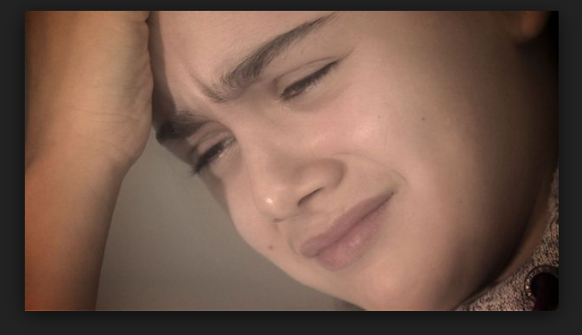
Content and Awareness
It’s not just them…

Slide 4
Taking care of ourselves and each other
Self-compassion, systems response and the contagion of stress

Slide 5
Self-Compassion Break
Notice where you are feeling the stress in your body.
Say to yourself: (choose example that seems most natural to you)
“This is a moment of suffering.” “This hurts.” “This is stressful.”
Say to yourself: (choose example that seems most natural to you)
“Suffering is a part of life.” “I’m not alone.” “Other people feel this way.”
Put your hands over your heart & feel the warmth & gentle touch.
Say to yourself: (choose example that seems most natural to you)
“May I be kind to myself.” “May I be strong.” “May I forgive myself.” “May I be patient.” “May I learn to accept myself as I am.”
Video example
Guided self-compassion break (Kristin Neff)
Guided self-compassion break (Chris Germer)

Slide 6
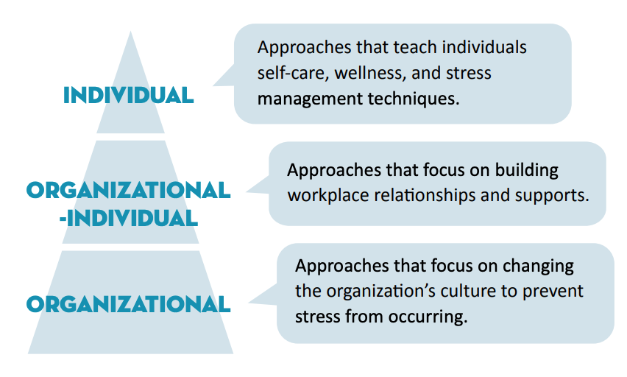
Tiered Framework for Building Resilience
https://osse.dc.gov/sites/default/files/dc/sites/osse/page_content/attachments/WNS_ApproachToEdWell_graphics%20final%20%281%29.pdf

Slide 7
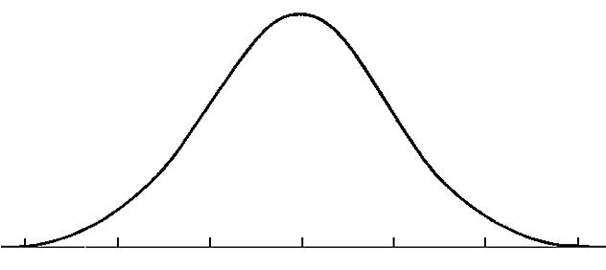
The Stress Continuum
Mild/Moderate Stress:
Optimum
Moderate/High Stress:
Overload
Stress is community property and therefore…
Everyone has some responsibility for the success of others because…
Connections moderate stress
Low/No Stress:
Rest and restore
Toxic Stress:
Breakdown
Objective > Subjective
Stress: The amount of energy in your body
Stress is Contagious…
…but so is Calm.
Implicit Bias
© NFI Vermont 2018

Slide 8
Reflective practice and relationships
Self interrogation
curiosity
Relational muscle

Slide 9
Healing Organizations: Inviting Humanity into the Work

Slide 10
Overarching Principle and Progression
Trauma informed care is “universal precaution” to stop the spread of trauma and toxic stress
(Sandra Bloom)
SAFETY AND SECURITY

Slide 11
Trauma is multi-dimensional

Slide 12
Insidious Trauma “like drops of acid falling on a stone”

Slide 13
Historical Trauma

Slide 14
Minority Stress Theory (Meyer, 2003)
➤The Minority Stress Model describes that individuals who hold minority statuses experience daily stressors above and beyond the day to day stressors that everyone experiences (Alarm doesn’t go off, flat tire, annoying coworker, etc).
➤ It is important to not only look at the individual relationships, but the systemic issues that are responsible for these added stressors.
“When someone with the authority of a teacher describes the world and you are not in it, there is a moment of psychic disequilibrium, as if you looked into a mirror and saw nothing.” (Adrianna Rich)

Slide 15
Social Injury Requires Social Healing

Slide 16
Fear of adults
hunger
abuse
Substance abuse
Racial trauma
Community violence
Sexual abuse
neglect
Poor sleep hygiene
Incarcerated parent
Difficulty in school
© NFI Vermont 2018

Slide 17
Change your mindset
from
"What is wrong with you?"
to
"What has happened to you?"
(from Wisconsin Dept. of Health Services www.dhs.wisconsin.gov/tic)
Transition from a blame model to a repair model
Asking “how can we help” and “what can we learn from you?”

Slide 18
Shifting Mindset to Shift Practices
Uninformed view
Trauma-informed view
Anger management problems
May have ADHD
Choosing to act out & disrupt classroom (e.g., disrespectful or manipulative)
Uncontrollable, destructive
Non-responsive
Uninformed response
Student needs consequences to correct behavior or maybe an ADHD evaluation
WI Department of Public Instruction Trauma-Sensitive Schools Resources http://sspw.dpi.wi.gov/sspw_mhtrauma Adapted from Daniel & Zarling (2012)
Maladaptive responses (in school setting)
Seeking to get needs met
Difficulty regulating emotions
Lacking necessary skills
Negative view of world (e.g., adults cannot be trusted)
Trauma response was triggered
Trauma-informed response
Student needs to learn skills to regulate emotions & we need to provide support

Slide 19
Four Premises of Trauma Responsive/Informed Schools:

Slide 20
1.Stress is contagious…reciprocally
students
Workforce
Building Administrators
District/SU
© NFI Vermont 2019

Slide 21
2. Stress is a primary mediator of performance…
Stress
Performance
© NFI Vermont 2019

Slide 22
3. When unregulated, stress injures people, groups and organizations
© NFI Vermont 2019

Slide 23
4. Biases, reduced self-care and blame.
4. As stress increases there is a greater focus on “what to do” with students and less focus on our beliefs and biases about kids who struggle, and ways to reduce our stress
Blame and shame (e.g. gossip, put downs, complaints)…
…which is a way to gain control, and
…A way to discharge pain/discomfort

Slide 24
Consequences of Unregulated Stress
Learned Helplessness
Lack of Creativity
Not working together
Low frustration tolerance
Ignoring the obvious
Consequence of Unregulated Stress
© NFI Vermont 2019

Slide 25
Vicarious Impact:
Vicarious Resilience/ Posttraumatic
Growth
“tragic yet inspiring”
Process
Evaluate
Reflect
Structural Support
Experiences/Emotions
Response
Traumatic Exposures
(Events)
Capacities
Dwell
Quell
Avoid
Maladaptive
Vicarious Trauma
Burnout
Empathy Fatigue
“tragic and hopeless”
Demands
Adapted from “Living on the edge” 2015
© NFI Vermont 2019

Slide 26
MTSS and Trauma Informed Care (TIC)
Integration and alignment

Slide 27
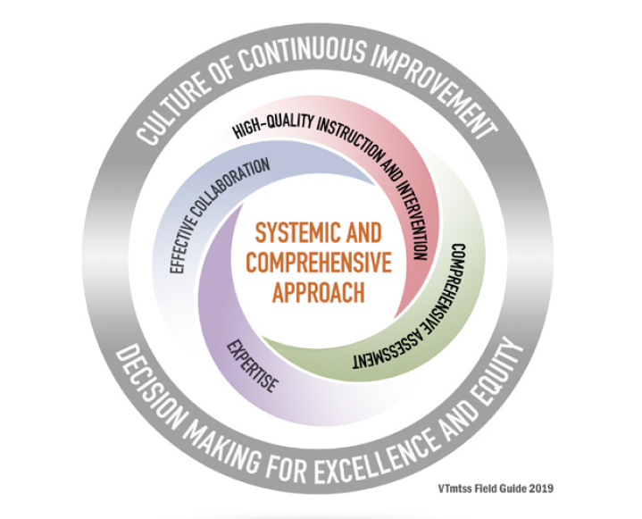
How do we think about trauma-informed practices within a Multi-tiered Systems of Support (VT MTSS)?
VT MTSS is:
Meet students where they are at and help them get to where they need to go!
Resilience is the capacity to grow despite adversity, is built through meaningful
positive relationships, social support, and the opportunity for children to meaningfully master skills.
Christopher Blodgett, Ph.D, CLEAR Trauma Center

Slide 28
WI Department of Public Instruction Trauma-Sensitive Schools Resources http://sspw.dpi.wi.gov/sspw_mhtrauma

Slide 29
Trauma
What is it?

Slide 30
What is Trauma?
Trauma is a sudden, unpredictable, physiological experience that overwhelms a person’s ability to cope. It is not just an event itself, but rather a response to a stressful experience in which a person’s ability to cope is dramatically undermined.
Direct, secondary, vicarious
Event(s)
Helplessness, isolation/loneliness, mistrust and shame
Experience
Functioning in multiple domains
Effects
© NFI Vermont 2018

Slide 31
Developmental Trauma:
Multiple events before age 5
Perpetrated from the caregiving system
Leads to developmental injuries in 7 domains
© NFI Vermont 2018

Slide 32
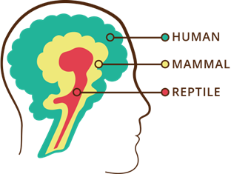
The Human Brain: Form and Function
Three interrelated, interconnected, interdependent “operating systems”…with unique functions and abilities
…that work most effectively under conditions of low to moderate stress.
Logic and Reason
Emotional
Survival
© NFI Vermont 2018

Slide 33
Trauma as a virus
Erratic
High levels of stress and adversity separate and impair the three “operating systems”
Trauma is like a virus in the operating systems of the brain (Bloom)
Healing a brain exposed to chronic adversity often requires unique interventions
Sluggish
Shuts down
© NFI Vermont 2018

Slide 34
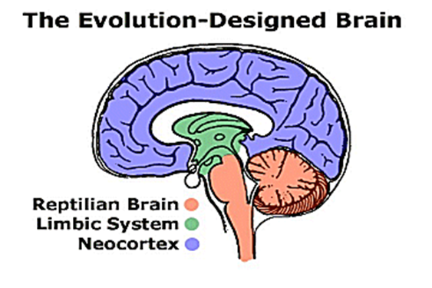
Trauma & Brain Development
Typical Development
Developmental Trauma
Cognition
Social/ Emotional
Regulation
Survival
Cognition
Social/ Emotional
Regulation
Survival
WI Department of Public Instruction Trauma-Sensitive Schools Resources http://sspw.dpi.wi.gov/sspw_mhtrauma Adapted from Holt & Jordan, Ohio Dept. of Education

Slide 35
Patterns of Stress Activation

Slide 36
“Trauma is not a story of what happened to you a long time ago, it is what is in your body.”
Bessel van der Kolk

Slide 37
Intervention Considerations
Intervention inventory and crosswalk

Slide 38
Data informed decisions for effective interventions

Slide 39
Layered Daily Progress Report (DPR)

Slide 40
PBIS Matrix with Trauma-Responsive Elements

Slide 41
Bottom up or Top Down

Slide 42
Upstream Interventions (universal)

Slide 43
SEL = Upstream intervention
SEL not only helps to prevent internalizing and externalizing problems but also increases positive social attitudes and prosocial behavior as well as academic achievement.

Slide 44
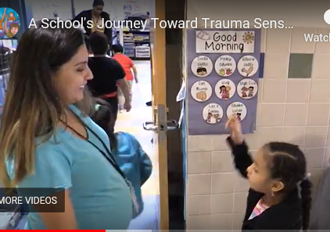
Upstream interventions (universal)
Lighting
Greetings and relational deposits
Non-contingent movement breaks
Alternative seating opportunities
PBIS
Manipulatives
Non-verbal communication
OT activities
Consistency and predictability
Matching affect
OTR
Lycra
Visual noise
Wall color
Stop and name
Community building circles
Mindfulness movements
Yoga
Prompting and pre-corrections
Wellness and reflective practices
Source: A School's Journey Toward Trauma-Sensitivity.

Slide 45
Avoid Re-traumatization

Slide 46
Reframing Motivation and Behavior
Seeking Attention
Avoid or Escape
Function of Behavior
Seeking Safety
Avoiding Danger
…and feeling behind the behavior

Slide 47
Simple but essential
Neural Networks
Slow it Down
Repetition
Dosing
Contextual teaching and learning
Neural networks
Slow it down
Repetition
Dosing
Contextual opportunities

Slide 48
Domains of Impairment
And strategies

Slide 49
T
When Neural Networks Become Abnormally Organized, There is a Cascade of Neurobiological Problems
#1
Physiology:
Body & Brain
#2
Attachment & Relationships
#3
Emotion Regulation
#4
Cognition & Learning
#5
Behavioral Control
#6
Dissociation
#7
Self-esteem & Future Orientation
Domains of Impact/Developmental Injuries
UN-REGULATED STRESS
© NFI Vermont 2018

Slide 50
#1 Physiology: Body & Brain
Developmental Injuries
Stabilize the nervous system
Structure, Routine, Rituals
Especially during transitions, discipline, saying “no”
Movement
Rhythmic activities
Regulate—Relate—Reason
Co-Regulation: Mimic early attachment needs
Addressing basic needs
ACES Study
Hypersensitive/sensitized
Hyposensitive/desensitized
Regressions and Delays
Neurodevelopmental Delays and Exaggerated Stress Response
© NFI Vermont 2018

Slide 51
#2 Attachment & Relationships
Developmental Injuries
https://www.youtube.com/watch?v=1Evwgu369Jw
Relational deposits/Relational endurance
Create congruence between internal experience and external world response
Validation not reassurance (enter the darkness)
Its not the rupture, it’s the repair—expect the rupture, work the repair
Avoid ensnarement in reenactment
5. Refine your language:
Connection seeking not attention seeking
Repair seeking
Validation seeking not manipulation
PACE
Build architecture of healthy interactions -- attunement
Maintain awareness about the impact on relationships within workforce (contagion)
Attachment is the search for protection.
“We do to others what was done to us….unless we remember our pain” (Lieberman)
Highly insecure and mistrustful of others (particularly authority figures)
Lack of congruence between internal experience and external world response (invalidation)
Broad symptoms pattern including: bossy, controlling and commanding, clingy and dependent, avoidant and detached; separation anxiety
Highly sensitized/reactive to transitions, limits, hearing “no”, working cooperatively
Difficulty attuning to others and taking perspective
Unusual self-soothing habits and patterns
Reenactments
Atypical Seeking Behaviors
© NFI Vermont 2018

Slide 52
#3 Emotion Regulation:
Developmental Injuries
Be an interpreter
Use movement, yoga, martial arts, music, OT activities, etc.
Teach affect identification and expression
Co-regulation strategies: RRR
Difficulty knowing and identifying physiological states
Incongruence between internal physiological states and external expression
Poor affect identification and affect expression
Over-dependence on behavior to reveal internal affect states
Difficulty expressing needs in socially acceptable ways
Emotions have proven to be very dangerous for child; they often reenact this with others
Sleep and eating disruptions
© NFI Vermont 2018

Slide 53
The Stress Continuum:
Typically Developing Person
Mild/Moderate Stress:
Optimum
Moderate/High Stress:
Overload
Low/No Stress:
Rest and restore
Toxic Stress:
Breakdown
Positive Tolerable Toxic
Resiliency Vulnerability
© NFI Vermont 2018

Slide 54
The Stress Continuum:
Person Exposed to Chronic Trauma (sensitized)
Mild/Moderate Stress:
Optimum
Moderate/High Stress:
Overload
Low/No Stress:
Rest and restore
Toxic Stress:
Breakdown
Positive Tolerable Toxic
Resiliency Vulnerability
© NFI Vermont 2018

Slide 55
#4 Cognition & Learning:
Developmental Injuries
Movement
Multi-sensory experiences
Targeted training in Executive Functioning
Structure and routine
Build on Competencies
Rigid/concrete thinking
Poor cause and affect thinking/consequential thinking
Language Delays, Language Use
Difficulty with Executive Functioning
Cognitive Distortions
Attention, Memory and Curiosity Deficits
Learning challenges
Intrusive memories
© NFI Vermont 2018

Slide 56
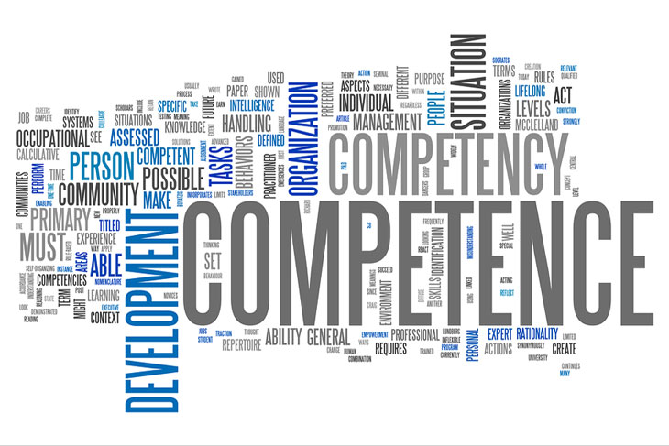
Competencies
Relational Connection
Self-Development and Identity
Executive Functioning
Delaying and Inhibiting Responses
Cognitive Flexibility
Working Memory
Margaret Blaustein and Christine Kinniburgh, ARC Model

Slide 57
Move it!
Movement is important for learning and staying calm

Slide 58
#5 Behavioral Control:
Developmental Injuries
Understanding that symptoms are a means (attempt) to self-regulate
Stress behavior versus misbehavior (psychoeducation goal)
Accountability Formula= Validation + Empathy + Co-regulation + (validate child as victim before approaching as a perpetrator of harm)
Re-framing
Restorative Practices
Reduce stress as a priority
Impulse control, disinhibited, risk taking
Sleep and eating challenges
Managing fluctuating arousal
Trauma reenactment, repetition, avoidance
Opposition, resistance
Self-destructive, self-sabotaging
“Comfort” with chaos
Compliance, collapse, helplessness, defeat
© NFI Vermont 2018

Slide 59
What Neural Pathways Does Traditional Discipline Create
Needs based vs. Compliance Based
Rule violation vs. Repair
suppress unwanted behavior, require obedience, and control another being.
does not teach new behaviors; discipline might teach or reinforce fear while suppressing behavior
negative outcomes; “…above and beyond individual, family, and community risk factors, exclusionary school discipline makes a significant contribution in and of itself to a range of negative developmental outcomes.” (Skiba et al., 2014. p. 556).

Slide 60
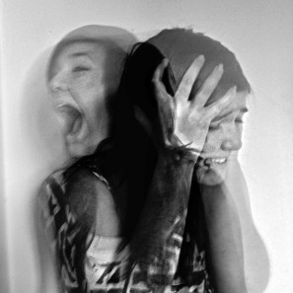
Reducing Stress Behavior: Re-Framing
Threats – I am unsafe, I need to protect myself because nobody else ever has.
Avoidance/passive – I am not competent, I am not worthy
Demanding – only I can meet my needs because nobody else has.
Attention seeking – I am insecure and uncertain.
Defiance = fear, Can’t vs. won’t
What you see on the outside…
…What is going on the inside
https://docs.google.com/document/d/1f0P30637JgaWNikfWRgc2Dp9rhAnTEAj90FHchdbaws/edit
© NFI Vermont 2018

Slide 61
But what about the consequences?
Context of caring relationships
Focus on repair vs. rule violation
Accountability and mastery
Membership vs. exclusion

Slide 62
And – what about yourselves
Take what you need…

Slide 63
Take What You Need: Take a Sip of Comfort
A cup of creation
Make something. Build. Move. Improve. Create.
A cup of patience
Wait it out. Wait for the right time. Hold feelings steady
A cup of hope
Look toward the future. Expect better times. Make plans.
A cup of kindness
Be compassionate and forgiving to yourself. Comfort others.
A cup of laughter
Laugh at how little we know. Laugh at absurdity. Laugh when you can.
Diane Roston, A Psychiatrist’s Mid-Winter Musings

Slide 64
Questions?

