Slide 1


How Schools Become Healing Places:
Developmental Trauma and Trauma-informed Practices
Kym Asam, LICSW
Regional Director of Schools and Clinical Programming
Northeastern Family Institute, Vermont (NFI)
© NFI Vermont 2018

Slide 2
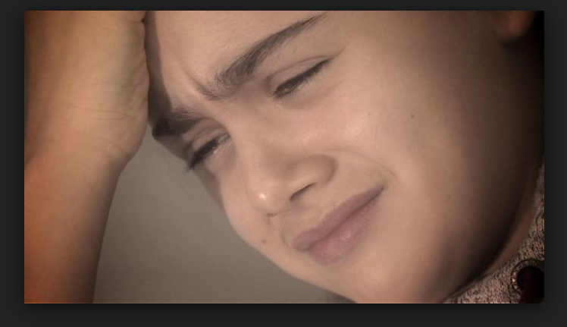

Content and Awareness
It’s not just them…

Slide 3
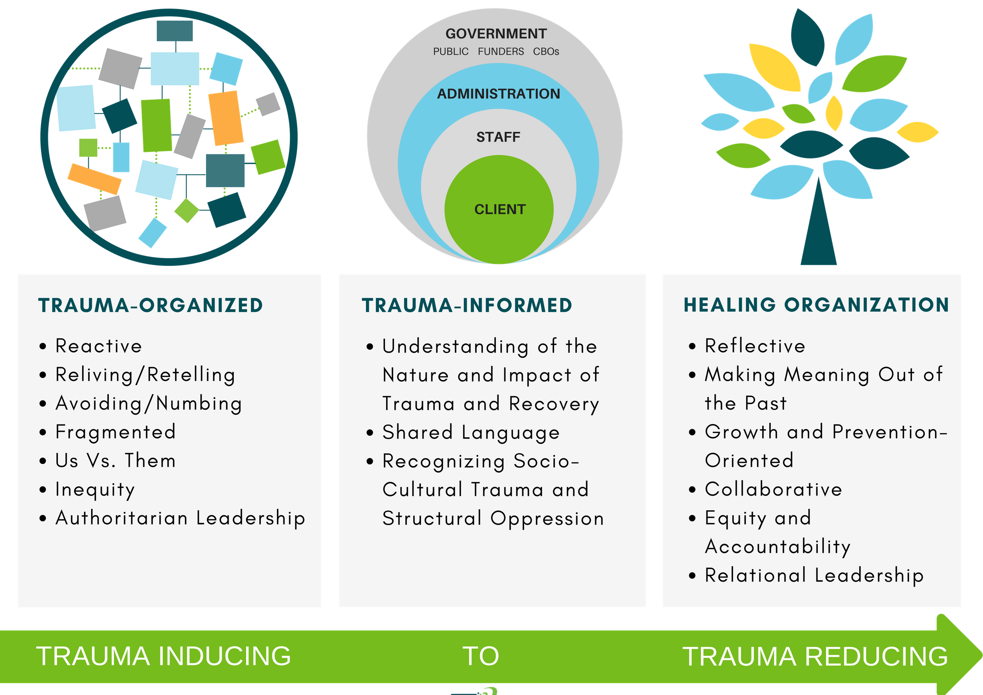

Overarching Principle and Progression
Trauma informed care is “universal precaution” to stop the spread of trauma and toxic stress (Sandra Bloom)
SAFETY AND SECURITY

Slide 4
Professionals: Impact of Stress (Dan Hughes, Ph.D & Jon Baylin, Ph.D.)
Over-reactive to nonverbal comm.
    Poorly evaluate the student’s intentions
Experience their student as a threat
The stress activates a defensive stance:
  Become at odds with your student (competitive, angry).
  And deactivates the attachment stance
  Resentment, fear, hate, retribution and blame
https://www.youtube.com/watch?v=RZWf2_2L2v8

Slide 5
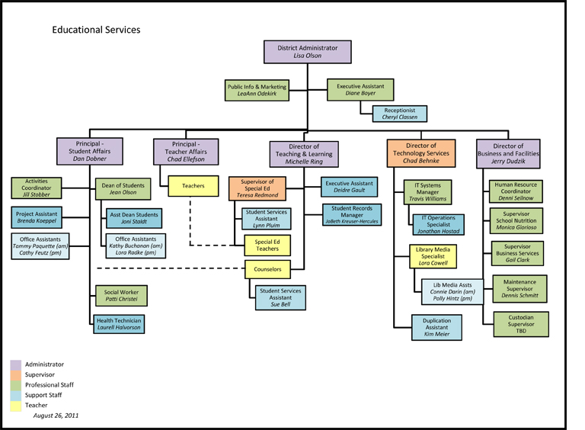
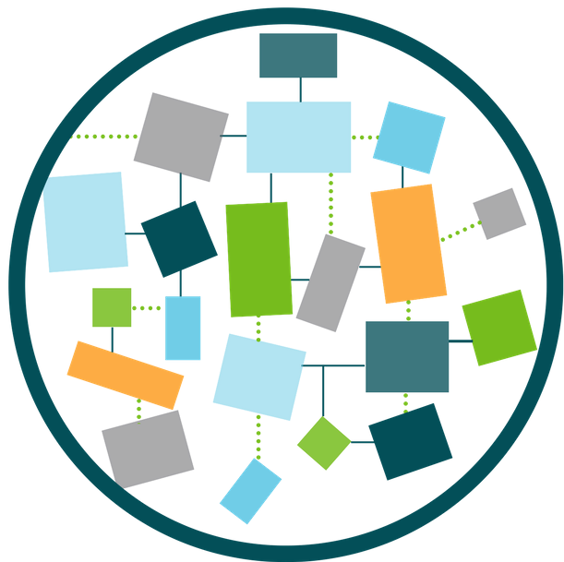
Systemic Level: Chronic Stress and Trauma Can Lead to Dis-organization

Slide 6

What pushes your buttons?
Out of proportion reactions
Confusion between
“there and then” and “here and now”

Slide 7
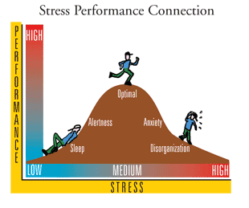
How Stress Affects Our Job Performance:
The Yerkes-Dodson Law

Slide 8
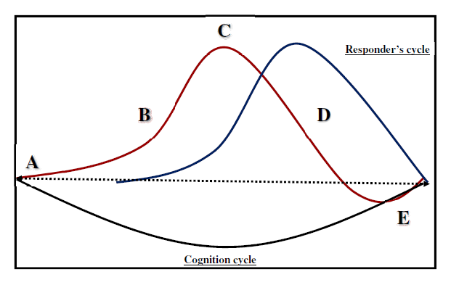
Avoid Re-escalation:
Where Are You in the Cycle?
colleague’s Cycle
(Adapted from SFGH Safety Management and Response Techniques (SMART) Training)

Slide 9
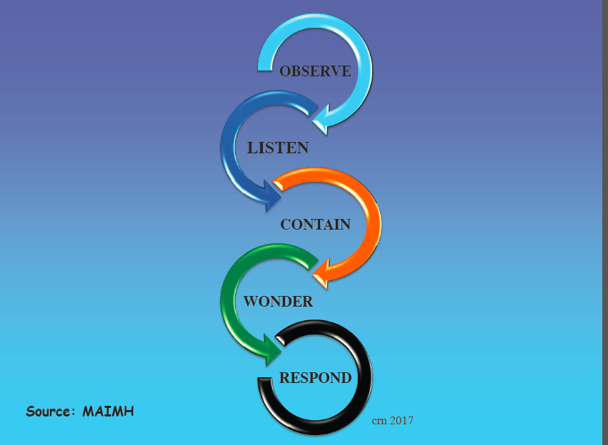
Path to supporting one another

Slide 10
What we can get from one another?
Vicarious Trauma
Vicarious Resilience

Slide 11
Strategies to address impact of stress:
System responses and practices
Reflective Practices and Reflective Supervision
Focus on what we “do, with, for” the adults
Strengthening adult assets
Classroom/Community practices

Slide 12
Shift Your Perspective
It is a mindset more than a curriculum
from
"What is wrong with you?"
to
"What has happened to you?"
(from Wisconsin Dept. of Health Services www.dhs.wisconsin.gov/tic)
Provides context, fosters compassion,
helps us to see strengths in face of adversity

Slide 13

A Goal of Trauma-Informed Work
Developmental Insults/risk factors
Capacities
Developmental assets/ resiliency factors
Demands
© NFI Vermont 2018

Slide 14
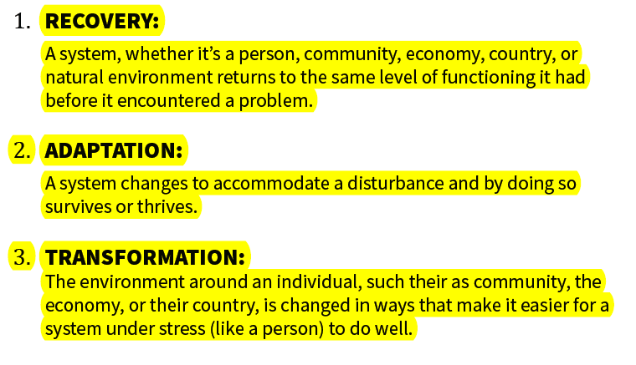
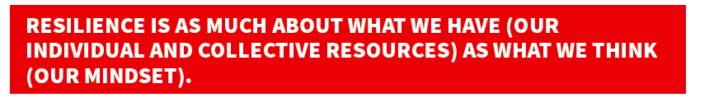
Resilience
Source: Michael Ungar, PhD

Slide 15
How do we think about trauma-informed practices within a Multi-tiered Systems of Support (VT MTSS)?
Meet students where they are at and help them get to where they need to go!
VT MTSS is:
A systemic and comprehensive approach
Effective collaboration
High quality instruction and intervention that is responsive and differentiated
Comprehensive and balanced assessment system
Expertise (well designed professional learning)

Slide 16
Tertiary or clinical population:
Intensive:
Secondary or Targeted intervention:
At-risk & Sx
Primary Prevention/ Universal Precautions
“Everyone is at risk”
Public Health Model: Stress
© NFI Vermont 2018

Slide 17
The Big Board of Strategies
Relationships: enduring, patient, boundaried, high expectations, trustworthy
Understanding Stress
Interpreter/Re-interpreter
Stress Regulator
Congruence
© NFI Vermont 2018

Slide 18

© NFI Vermont 2018

Slide 19
Progression of human action….
  Sensory Experience
Physiological
Perceptual/impulse
(simple appraisal-neg/pos/neutral)
Affect/Emotion
(Feeling Tone)
Cognition
Behavior
  Taste
  Touch
  Sight
  Smell
  Hear
  Pain
Capacities
Demands
Corresponding Impulse:
Avoid
Approach
Ignore
© NFI Vermont 2018

Slide 20

Upstream versus Downstream Interventions
Physiology
Perceptions
Affect/Emotion
cognition
Behavior
© NFI Vermont 2018

Slide 21

What is Trauma?
Trauma is a sudden, unpredictable, physiological experience that overwhelms a person’s ability to cope. It is not just an event itself, but rather a response to a stressful experience in which a person’s ability to cope is dramatically undermined.
Event(s)
Experience
Effects
© NFI Vermont 2018

Slide 22

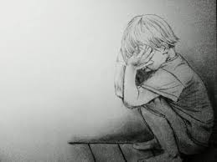
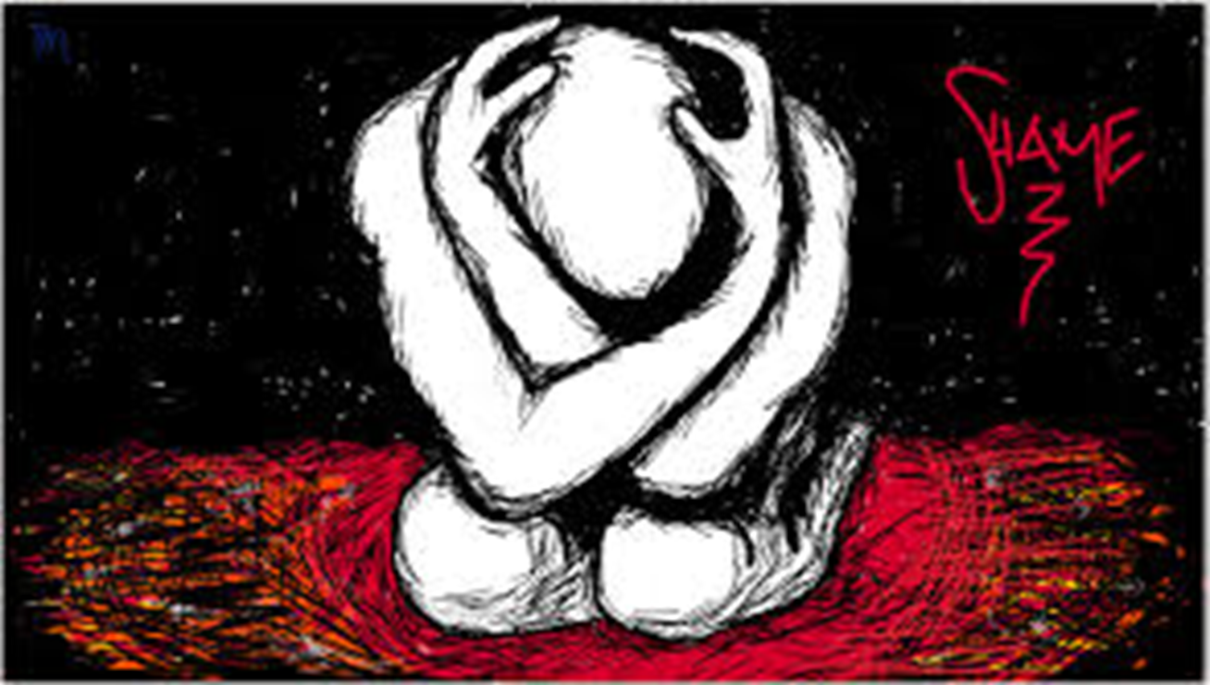
What is Trauma?
Trauma is a sudden, unpredictable, physiological experience that overwhelms a person’s ability to cope.
Direct Exposure
Personally experiencing interpersonal violence
Secondary Exposure
Directly witnessing interpersonal violence of another
Vicarious Exposure
Hearing about the interpersonal violence of another
Event(s)
Domestic Violence, Neglect, Physical Abuse, Sexual Abuse
© NFI Vermont 2018

Slide 23
What is Trauma?
Trauma is a sudden, unpredictable, physiological experience that overwhelms a person’s ability to cope.
Helplessness/Fear
Isolation/
Alienation
Mistrust/Shame
Experience
Destruction of Relationships
Experience of Trauma
© NFI Vermont 2018

Slide 24
Developmental Trauma:
…that leads to developmental wounds/injuries in 7 areas
…perpetrated by people in child’s caregiving system
multiple events before age 5…
© NFI Vermont 2018

Slide 25
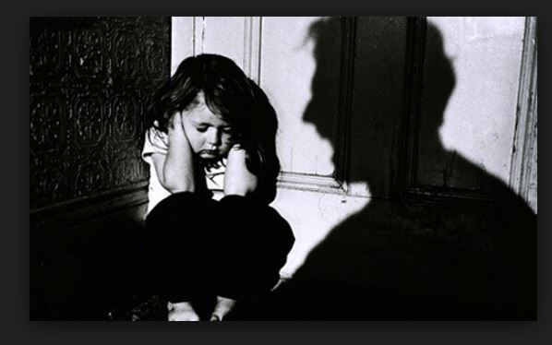

What is Developmental/Complex trauma?
A psychological and neurobiological injury that results from protracted exposure to stressful events
Derails typical development across all domains
Experiences often occur in the caregiving system.
Impact is immediate and long term
Effects will require specialized intervention
Requires multiple tiers of intervention
Notes:
25

Slide 26
“Trauma is not a story of what happened to you a long time ago, it is what is in your body.”
Bessel van der Kolk

Slide 27
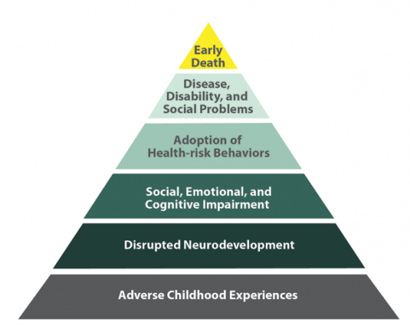
Adverse Childhood Experiences
Death
Conception

Slide 28

Sick, bad or injured?
“Once a problem becomes a social problem and not just the problem of an individual perpetrator, then we are all engaged (and) we must all participate in solving the problem.”
Sandra Bloom, MD
https://changingmindsnow.org/stories

Slide 29
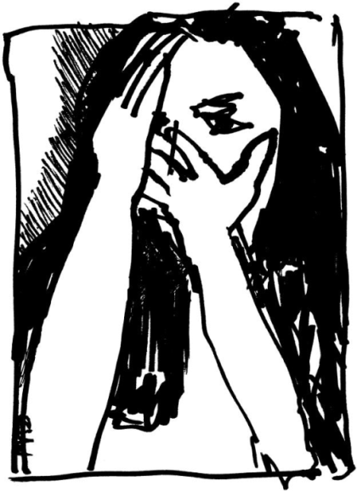
Toxic Stress creates shame that is...
… Often constant,
… Isolating and alienating,
…A barrier between your pain and resolution of your pain, and
…A barrier to believing that I can change
I did something bad
I am bad!
What is the difference between shame and guilt?

Slide 30

Self-Concept
If I am treated like I am worthless, then I don’t matter.
If I am rejected because of mistakes, then I am bad.
If I failed today, I will fail tomorrow.
If I don’t have what I need, I can’t worry about others.
If I am treated like I matter, then I matter.
If I am loved in spite of mistakes, then I am good.
If I am successful today, I can be successful tomorrow.
I am secure, so I can think about what others need.

Slide 31
T
Trauma is a sudden, unpredictable, physiological experience that overwhelms a person’s ability to cope. It is not just an event itself, but rather a response to a stressful experience in which a person’s ability to cope is dramatically undermined.
#1
Physiology:
Body & Brain
#2
Attachment & Relationships
#3
Emotion Regulation
#4
Cognition & Learning
#5
Behavioral Control
#6
Dissociation
#7
Self-esteem & Future Orientation
Domains of Impact/Developmental Injuries
UN-REGULATED STRESS
© NFI Vermont 2018

Slide 32
#1 Physiology: Body & Brain
Developmental Injuries
ACES Study
Hypersensitive/sensitized
Hyposensitive/desensitized
Regressions and Delays
Neurodevelopmental Delays and Exaggerated Stress Response
© NFI Vermont 2018

Slide 33

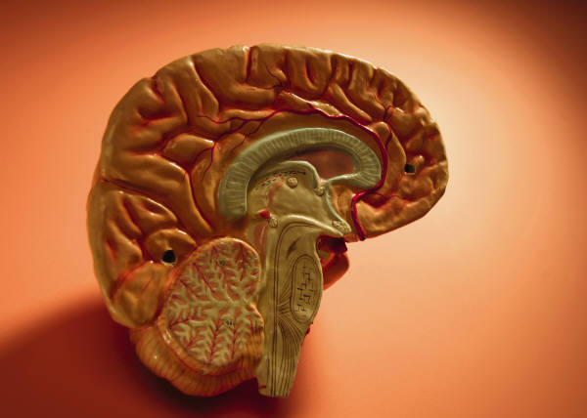
The brain develops from the bottom up
Neocortex
Cortex
Limbic
Limbic
Diencephalon
Diencephalon
Brainstem
Cerebral Cortex
Prefrontal Cortex
Brainstem
Limbic
Diencephalon
and the
inside out
Brain Stem

Slide 34
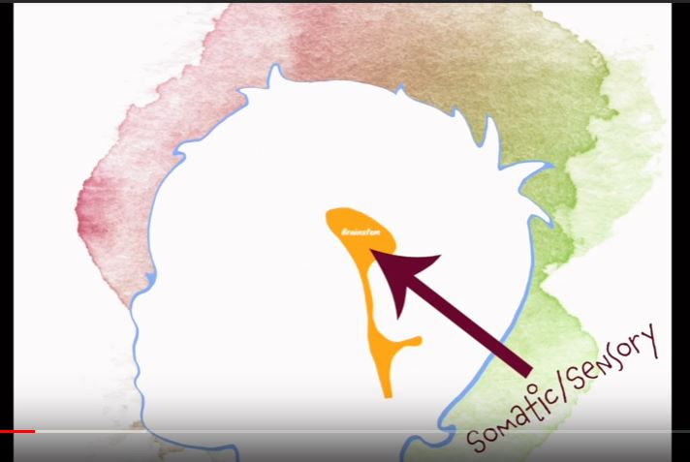
Brain Stem
Brain Stem

Slide 35
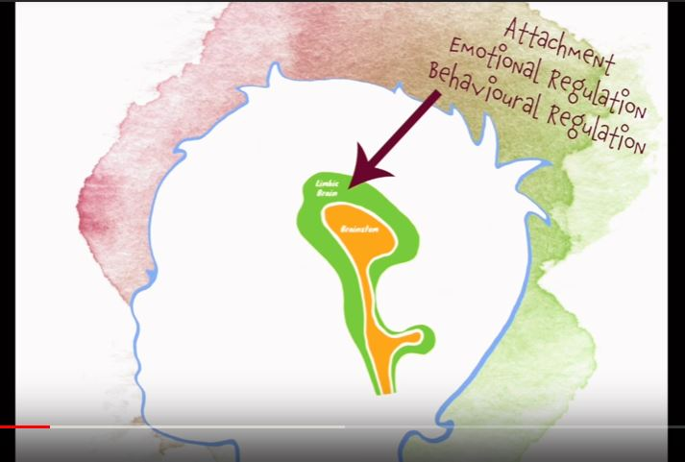
Limbic region
Limbic

Slide 36
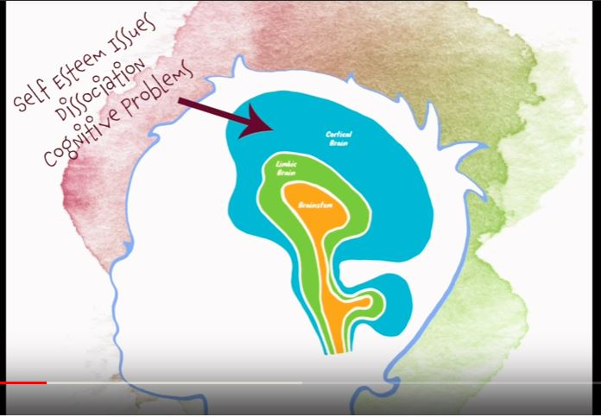
Cortex
Cortical Brain

Slide 37
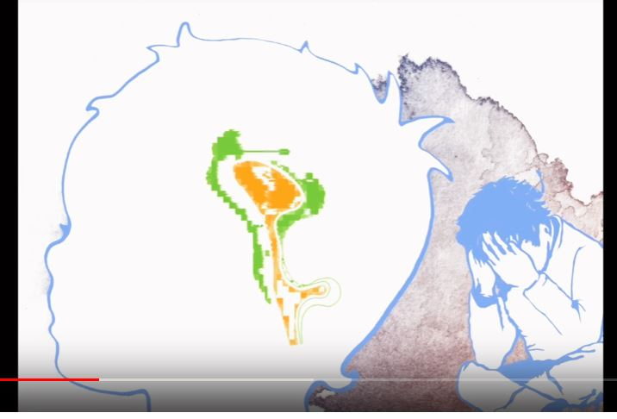
Brain injury

Slide 38
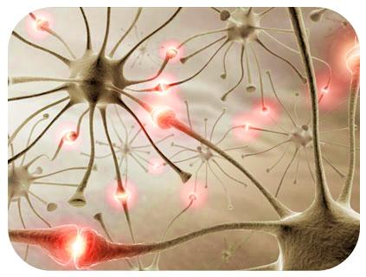
Neurons that fire together wire together
(Hebb’s Rule)

Slide 39
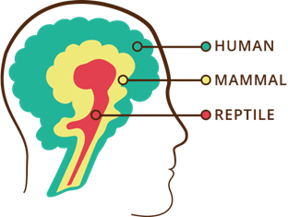

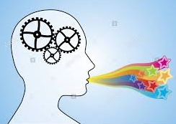
Brain functioning
Logic and Reason
Healthy Brain: Three Operating Systems Working Together
Emotion and Relationship
Survival
© NFI Vermont 2018

Slide 40

Erratic
Sluggish
Shuts down
© NFI Vermont 2018

Slide 41
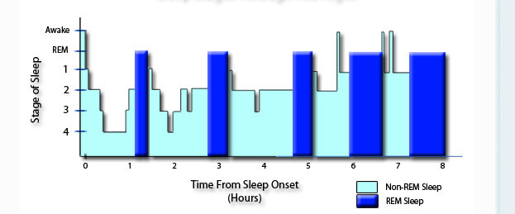
Stages of Sleep

Slide 42
Effects of Trauma on Brain Functioning
Thalamus
Visual, auditory, olfactory,
kinesthetic, gustatory
Pre-frontal cortex
(integration and planning)
Amygdala
(Intensity/significance)
Hippocampus
(cognitive map)

Slide 43
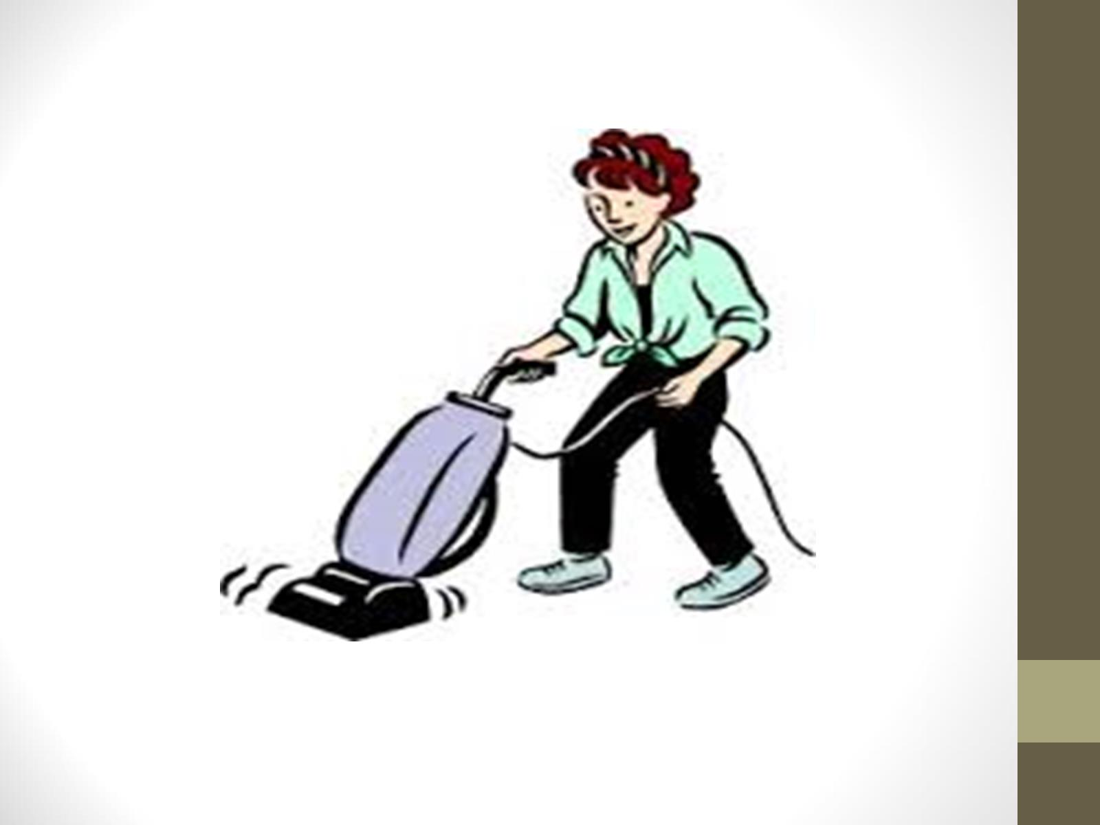

Slide 44
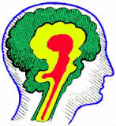

Increase of Stress
Increase of Stress
Stress Continuum:
Inverse
Functional IQ drops
Lower Brain Region Control
Lack of Integration
© NFI Vermont 2018
Adapted from Bruce D. Perry: All rights reserved © 2007-2017

Slide 45
Increase in stress
Increase in stress
Cortex: Logic & Reason
No Stress
Mild Stress
Moderate Stress
50-60%
© NFI Vermont 2018
Adapted from Bruce D. Perry: All rights reserved © 2007-2017

Slide 46
20-30%
20-30%
Limbic: Emotion and Attachment
Moderate Stress
High stress
50-60%
Increase in stress
Increase in stress
© NFI Vermont 2018
Adapted from Bruce D. Perry: All rights reserved © 2007-2017

Slide 47
Increase in stress
Increase in stress
30-40%
Brainstem: Survival
Toxic Stress
50-60%
10-20 %
© NFI Vermont 2018
Adapted from Bruce D. Perry: All rights reserved © 2007-2017

Slide 48
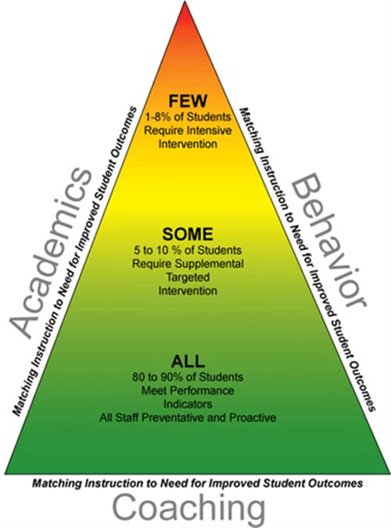
Targeting the Tiers, PBIS approaches
Brain stem/diencephalon
Intensive
limbic
targeted
universal
cortex

Slide 49
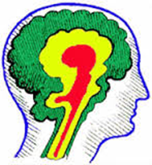

Neocortex: Logic & Reason
(optimized)
50-60%
CBT/DBT
Prior behavioral reference points
Contingency Planning
Behavioral Plans
FBA
Logic and Reason
Stating Norm/Rule
Reminders/Warnings
Adapted from Bruce D. Perry: All rights reserved © 2007-2017
© NFI Vermont 2018

Slide 50

Co-Regulating Moderate Stress
30-40%
20-30
Attachment & Relationships: (50-60%)
Connect before you correct
Listen more lecture less
Reframe: misbehavior to stress
Deal with the stress before you deal with the misbehavior
Get distance from the emotion of the behavior
Slow vs. Fast
Check it before you wreck it
Non-identification
Intentional Proximity/Presence
Adapted from Bruce D. Perry: All rights reserved © 2007-2017
© NFI Vermont 2018

Slide 51

Interventions
Limbic: Relationship & Emotions:
Reptilian: Survival (50%)
Neocortex: Logic & Reason
Physical Hold
Movement
Rhythm
Physical contact
Empathy
Co-regulation
Silence/Non-verbal
Adult affect regulation

Slide 52
#1 Physiology: Body & Brain
Developmental Interventions
Stabilize the nervous system
  Structure, Routine, Rituals
    Especially during transitions, discipline, saying “no”
  Movement
  Rhythmic activities
Judicious use of Proximity
Building Core Strength (Consult with OT)
Regulate—Relate—Reason
Co-Regulation: Mimic early attachment needs
Addressing somatic needs (basic needs)
Somatic Narrative
© NFI Vermont 2018

Slide 53
Strategies and Activities
Use of pillows
Change body position, change arousal: stand, sit, move
Breathing
Orienting and grounding
Fidget toys
Tunnels and forts
Pogo sticks and trampolines
Therapy balls and yoga chairs
Tug of war
Body sox, rocking
Writing rules/instruction for your body
Instructing the teacher/staff member where to sit
Boundary setting activities with rope and exercise ball
Use your body to say ‘yes’ and to say ‘no’
Hoberman’s Sphere: http://www.youtube.com/watch?v=5Q63hSmbhxA

Slide 54
Targeting the Tiers, PBIS approaches
Brain stem/diencephalon
Intensive
limbic
targeted
universal
cortex

Slide 55
T
Trauma is a sudden, unpredictable, physiological experience that overwhelms a person’s ability to cope. It is not just an event itself, but rather a response to a stressful experience in which a person’s ability to cope is dramatically undermined.
#1
Physiology:
Body & Brain
#2
Attachment & Relationships
#3
Emotion Regulation
#4
Cognition & Learning
#5
Behavioral Control
#6
Dissociation
#7
Self-esteem & Future Orientation
Domains of Impact/Developmental Injuries
UN-REGULATED STRESS
© NFI Vermont 2018

Slide 56
#2 Attachment & Relationships
Developmental Injuries
Attachment is the search for protection.
“We do to others what was done to us….unless we remember our pain (Lieberman)
Highly insecure and mistrustful of others (particularly authority figures)
Lack of congruence between internal experience and external world response (invalidation)
Broad symptoms pattern including: bossy, controlling and commanding, clingy and dependent, avoidant and detached; separation anxiety
Highly sensitized/reactive to transitions, limits, hearing “no”, working cooperatively
Difficulty attuning to others and taking perspective
Unusual self-soothing habits and patterns
Reenactments
Atypical Seeking Behaviors
© NFI Vermont 2018

Slide 57
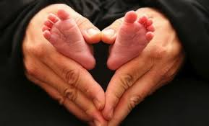

Key Principles of Attachment
Empowered and future oriented
Engagement
Psychoeducation
Routine
Build school staff capacity to manage affect
Build school staff-child attunement
Build school staff capacity to have effective responses to child behavior
Adapted from ARC, Kinniburgh and Blaustein

Slide 58
Healthy Attachment Sequence
Physical or psychological need
Security, trust, attachment, self-regulation, object constancy
Relaxation (parasympathetic ANS)
State of high arousal
Attunement/satisfaction of need
Beverly James

Slide 59
Unhealthy Attachment Sequence
Physical or psychological need
Shame, mistrust, disregulation, disturbed mental blueprint
Anxiety, rage, numbing
State of high arousal
Needs are disregarded/attunement disrupted
Beverly James

Slide 60
Components of bonding
Touch
Rocking
Hugging
Kissing
Gazing
Singing
Physical
Vestibular
Sensory
Proxemics
Visual
Auditory

Slide 61
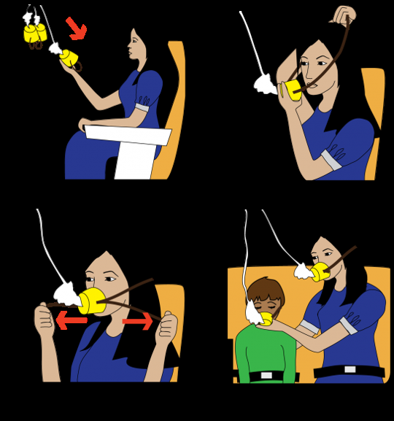
Affect Management
When caregivers modulate their own affect and emotional responses, they can create an emotionally safe environment in which children can learn
Validation
Vitality matching

Slide 62
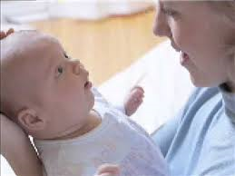
ATTUNEMENT
  Reading and responding to the cues of another
  Synchronous and interactive
  Helps prevent mismatch between need and provision
  Reading the non-verbal, social-emotional “language” of another
https://www.youtube.com/watch?v=oa6znlKBFAg

Slide 63
Consistency
Every Day
Every Grade
Every Body
Every Environment

Slide 64
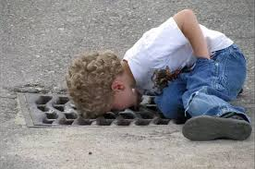
PACE: Curiosity
Promotes adult child attunement
Decreases defensiveness
Get curious, not furious
Promotes understanding and reduces negative judgement
Helps inhibit caregiver’s first reaction to a child

Slide 65
PACE: Empathy
Empathy is awesome: it fuels connection to both the giver and receiver
helps establish and maintain an “in synch” feeling between child and caregiver
authenticates the child’s experience, facilitates a more relaxed mental state
is an emotion-based process, visceral and extremely impactful to the body and mind
https://www.youtube.com/watch?v=1Evwgu369Jw

Slide 66
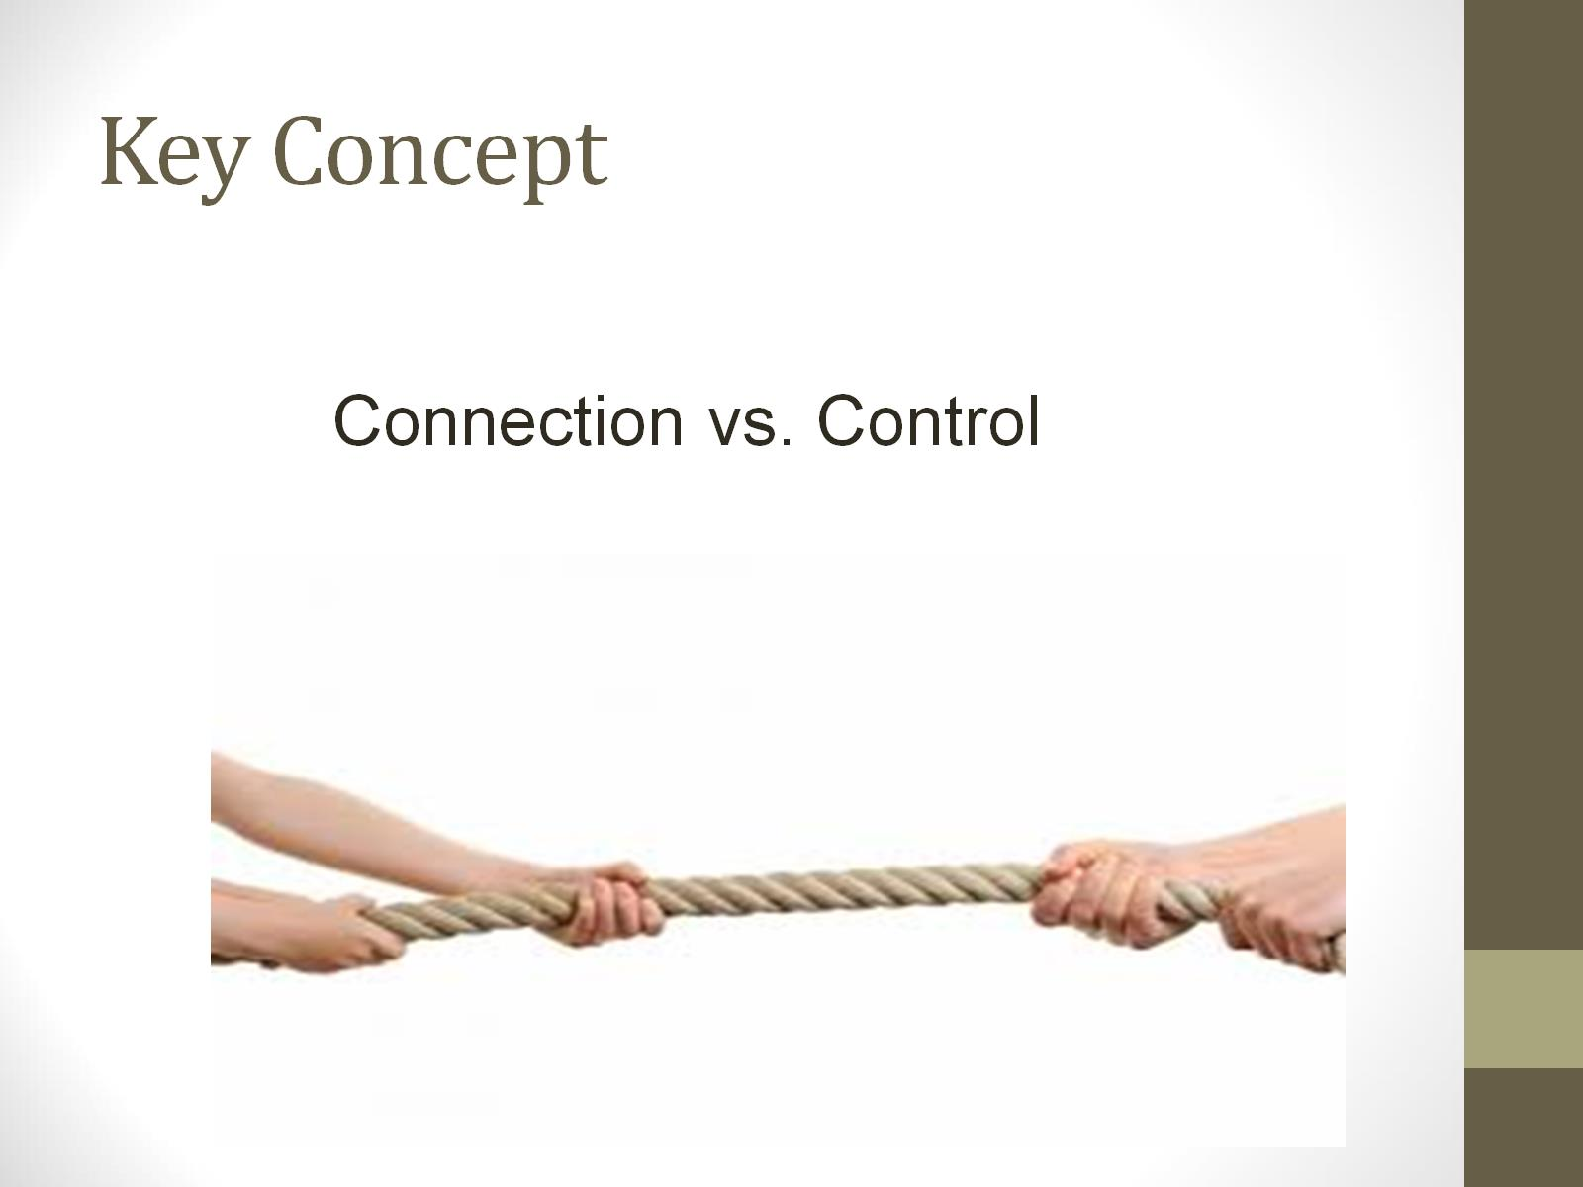
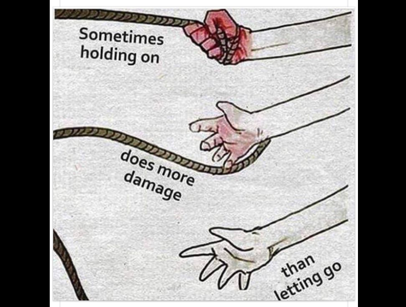
Key Concept

Slide 67
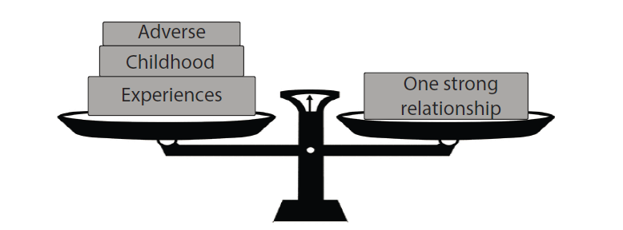
The Power of Relationship
Instill confidence that through enriched connections and persistence they have the power to impact each others lives in a meaningful way.

Slide 68
Strategies
Adult Affect Regulation & Adult Restraint
  Ability to ‘feel and deal” (Fosha)
  “Serve and return”
  Your family is in the room with you
“One good relationship away”
Minimize Reenactment
Connect-Rupture-Repair
Empathy and Validation
Coregulation

Slide 69
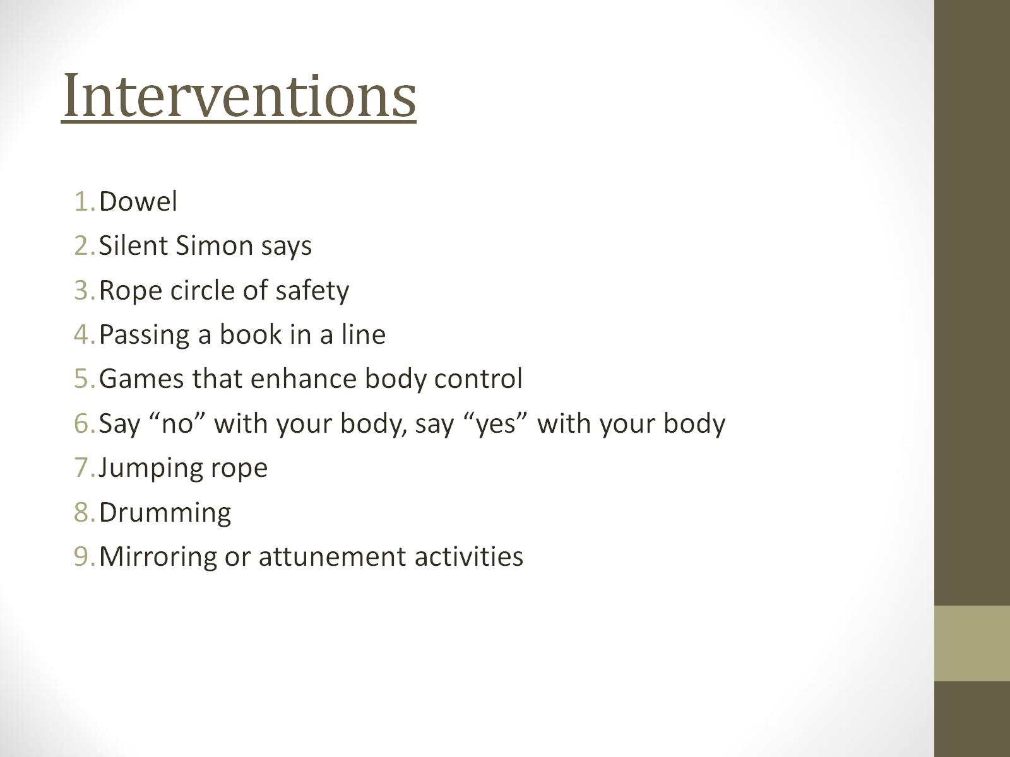
Interventions

Slide 70
#2 Attachment & Relationships
Developmental Interventions
Relational deposits/Relational endurance
Create congruence between internal experience and external world response
  Validation not reassurance (enter the darkness)
Its not the rupture, it’s the repair—expect the rupture, work the repair
Avoid ensnarement in reenactment
Refine your language:
  Connection seeking not attention seeking
  Repair seeking
  Validation seeking not manipulation
PACE
Build architecture of healthy interactions
Maintain awareness about the impact on relationships within workforce (contagion)
© NFI Vermont 2018

Slide 71
Targeting the Tiers, PBIS approaches
Brain stem/diencephalon
Intensive
limbic
targeted
universal
cortex

Slide 72
T
Trauma is a sudden, unpredictable, physiological experience that overwhelms a person’s ability to cope. It is not just an event itself, but rather a response to a stressful experience in which a person’s ability to cope is dramatically undermined.
#1
Physiology:
Body & Brain
#2
Attachment & Relationships
#3
Emotion Regulation
#4
Cognition & Learning
#5
Behavioral Control
#6
Dissociation
#7
Self-esteem & Future Orientation
Domains of Impact/Developmental Injuries
UN-REGULATED STRESS
© NFI Vermont 2018

Slide 73
#3 Emotion Regulation:
Developmental Injuries
Difficulty knowing and identifying physiological states
Incongruence between internal physiological states and external expression
Poor affect identification and affect expression
Over-dependence on behavior to reveal internal affect states
Difficulty expressing needs in socially acceptable ways
Emotions have proven to be very dangerous for child; they often reenact this with others
Sleep and eating disruptions
© NFI Vermont 2018

Slide 74

Normative Danger Responses
Autonomic Nervous Response System
Fight
Flight
Freeze
Flock

Slide 75
Reason
Relate
Regulate
Sequence of Engagement
All rights reserved © 2007-2014 Bruce D. Perry

Slide 76
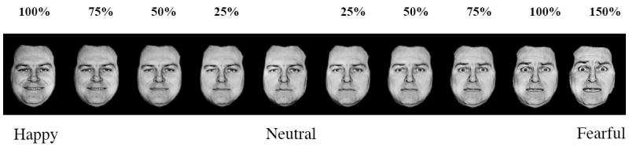
Recognizing Affect – Emotional Identification

Slide 77
Facial Expression Recognition

Slide 78
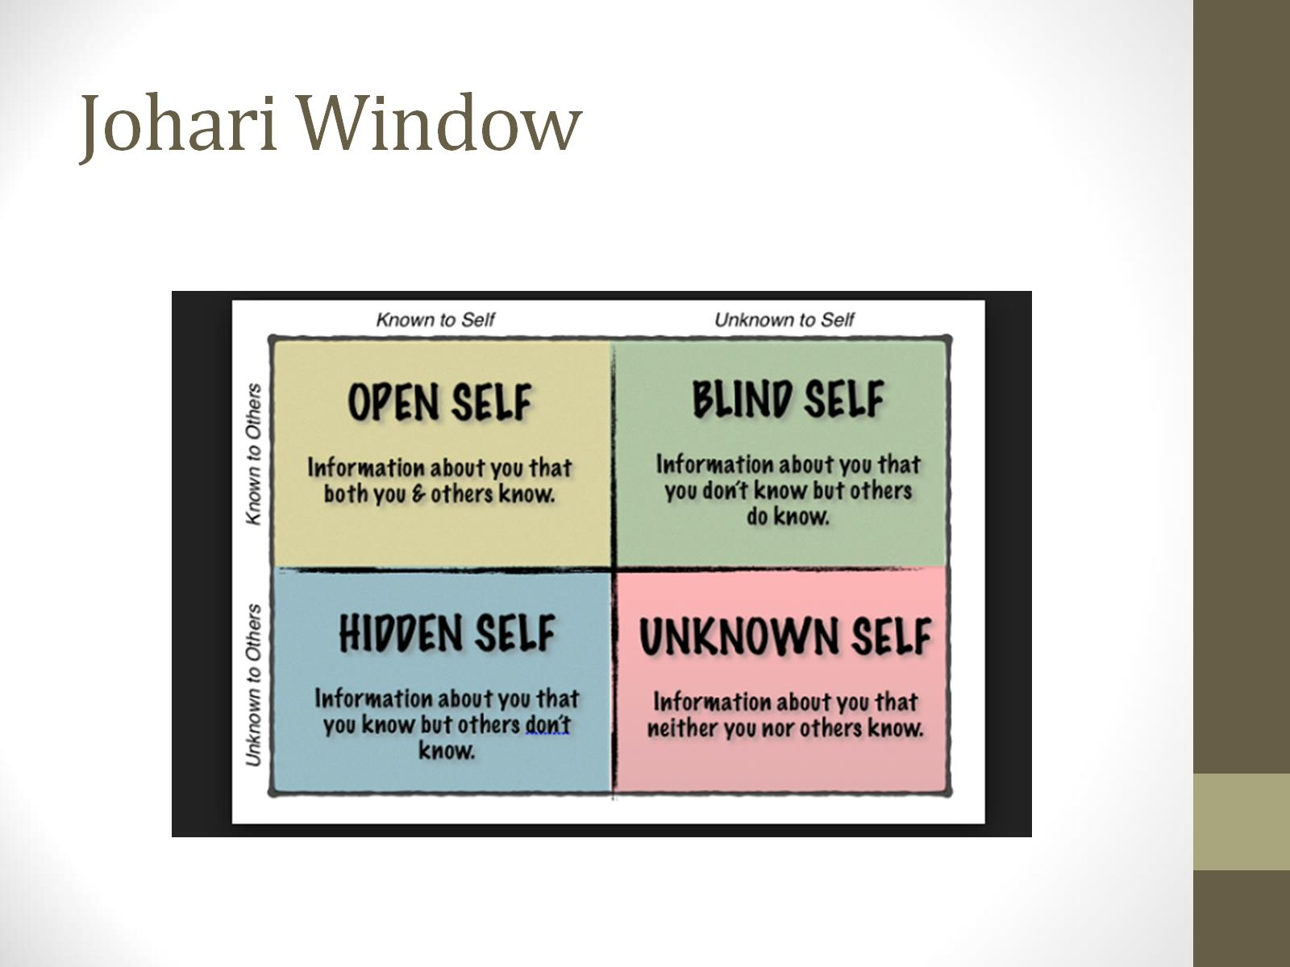
Johari Window

Slide 79

Key Concept
All functioning
is state dependent

Slide 80
Increase in Stress
Increase in Stress
Do With
Do For
Do Alone
Developmental Stage Not
Chronological Age
© NFI Vermont 2018
Adapted from Bruce D. Perry: All rights reserved © 2007-2017

Slide 82
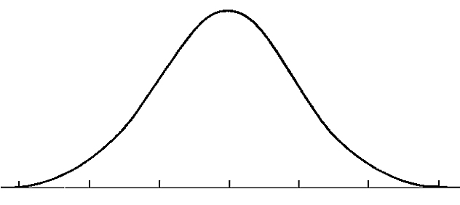
The Stress Continuum & Trauma Transformation
Moderate/High Stress:
Overload
Mild/Moderate Stress:
Optimum
Stress is community property and therefore…
Everyone has some responsibility for the success of others because…
Connections moderate stress
Low/No Stress:
Rest and restore
Objective to Subjective
Toxic Stress:
Breakdown
Implicit Bias
Stress: The amount of energy in your body
© NFI Vermont 2018

Slide 83




The Stress Continuum:
Typically Developing Person
Mild/Moderate Stress:
Optimum
Moderate/High Stress:
Overload
Low/No Stress:
Rest and restore
Toxic Stress:
Breakdown
Positive Tolerable Toxic
Resiliency Vulnerability
© NFI Vermont 2018

Slide 84




The Stress Continuum:
Person Exposed to Chronic Trauma (sensitized)
Mild/Moderate Stress:
Optimum
Moderate/High Stress:
Overload
Low/No Stress:
Rest and restore
Toxic Stress:
Breakdown
Positive Tolerable Toxic
Resiliency Vulnerability
© NFI Vermont 2018

Slide 85
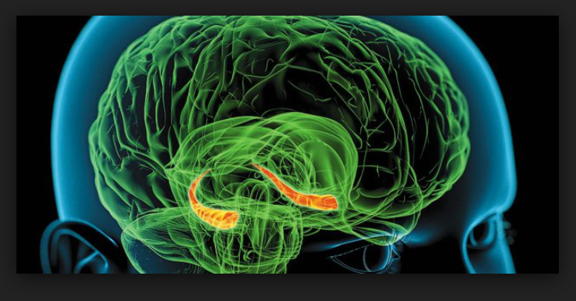
Experiences and Memories
It is often not the task or request that causes the child to struggle with behavior….
It is the feeling and negative thoughts that it evokes

Slide 86
Potential strategies
Movement
Mindfulness
Non-verbal communication
Reflectively listen
Validation
Shhhhh
Attunement
  Match affect without replication

Slide 87
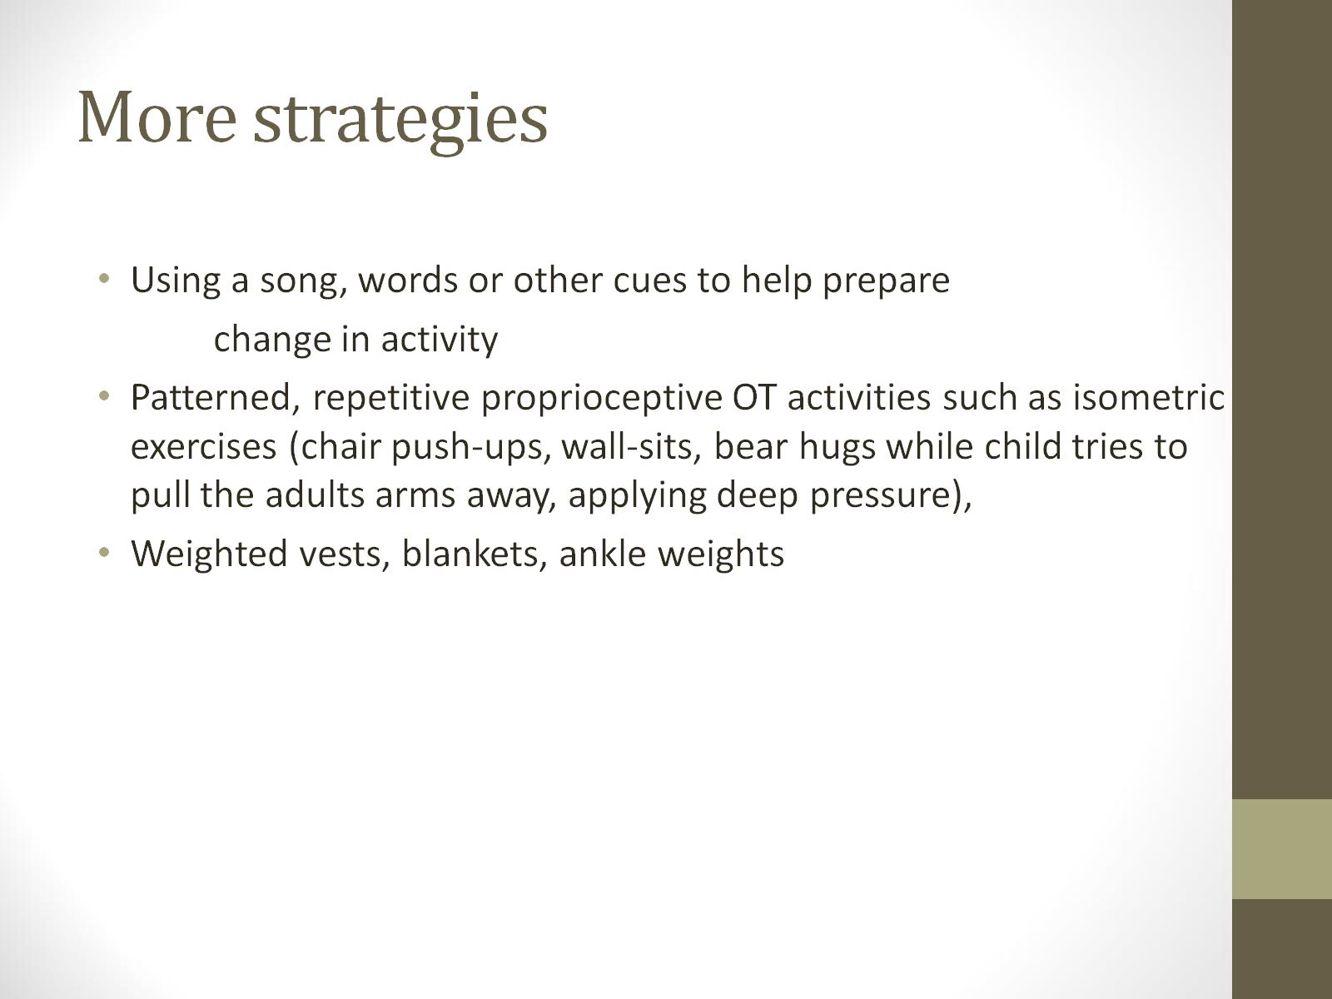
More strategies

Slide 88
#3 Emotion Regulation:
Developmental Interventions
Be an interpreter
Use movement, yoga, martial arts, music, create connections between internal physiological states and behavior
Teach affect identification and expression
Reflective listening
Do for, Do with, Do Alone
Co-regulation strategies: RRRR
Mindfulness
© NFI Vermont 2018

Slide 89
Targeting the Tiers, PBIS approaches
Brain stem/diencephalon
Intensive
limbic
targeted
universal
cortex

Slide 90
T
Trauma is a sudden, unpredictable, physiological experience that overwhelms a person’s ability to cope. It is not just an event itself, but rather a response to a stressful experience in which a person’s ability to cope is dramatically undermined.
#1
Physiology:
Body & Brain
#2
Attachment & Relationships
#3
Emotion Regulation
#4
Cognition & Learning
#5
Behavioral Control
#6
Dissociation
#7
Self-esteem & Future Orientation
Domains of Impact/Developmental Injuries
UN-REGULATED STRESS
© NFI Vermont 2018

Slide 91
#4 Cognition & Learning:
Developmental Injuries
Rigid/concrete thinking
Poor cause and affect thinking/consequential thinking
Language Delays, Language Use
Difficulty with Executive Functioning
Attention, Memory and Curiosity Deficits
Learning challenges
Intrusive memories
7 Core negative beliefs
© NFI Vermont 2018

Slide 92
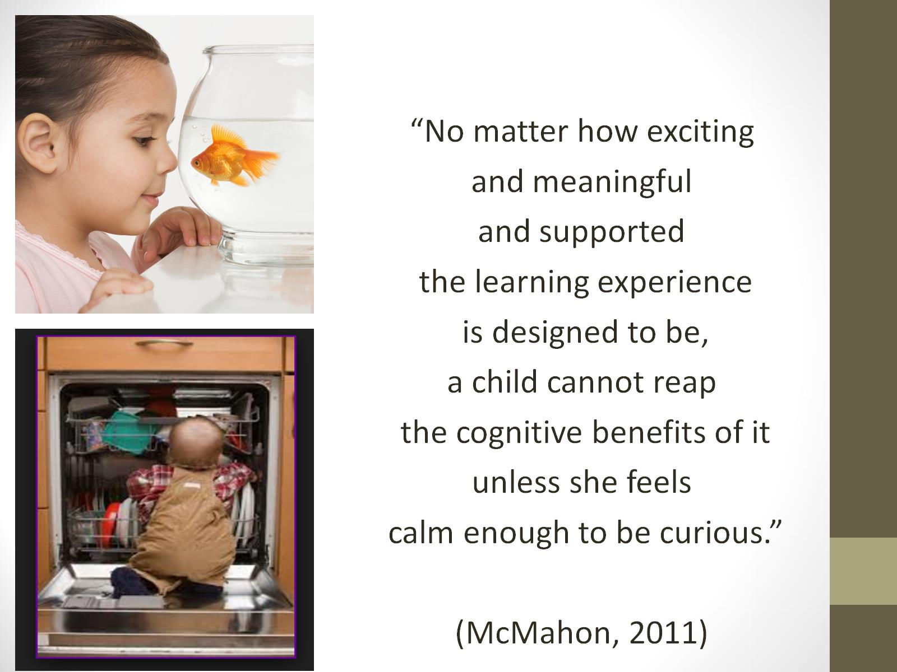

Slide 93
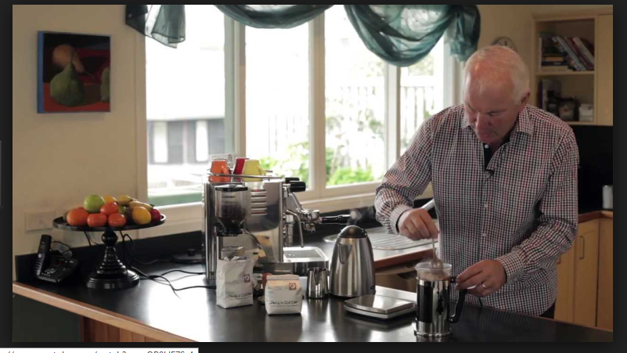
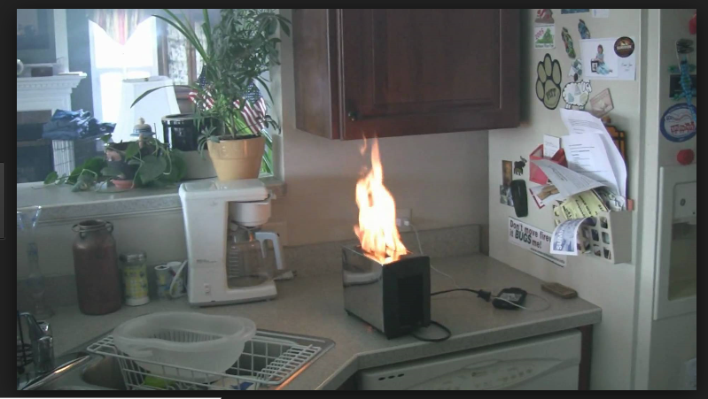
Interrupted Sequential Thinking

Slide 94
Sequential Thinking
A child’s successful completion of many academic tasks depends on the ability to bring a linear order to the chaos of daily experience. Traumatic experience can limit this ability to organize material sequentially, leading to difficulty in reading, writing and communicating verbally.
From Helping the Traumatized Child Learn

Slide 95

Executive functioning
Delaying and inhibiting responses
Cognitive flexibility
Working memory

Slide 96

Sit n Git
Brain fatigues after 7 minutes!

Slide 97
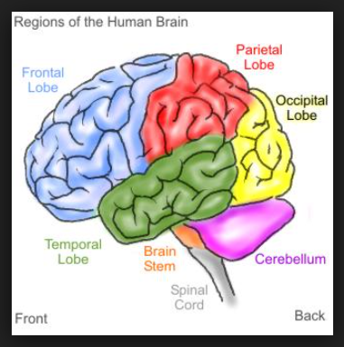
Move it!
Movement is important for learning and staying calm

Slide 98
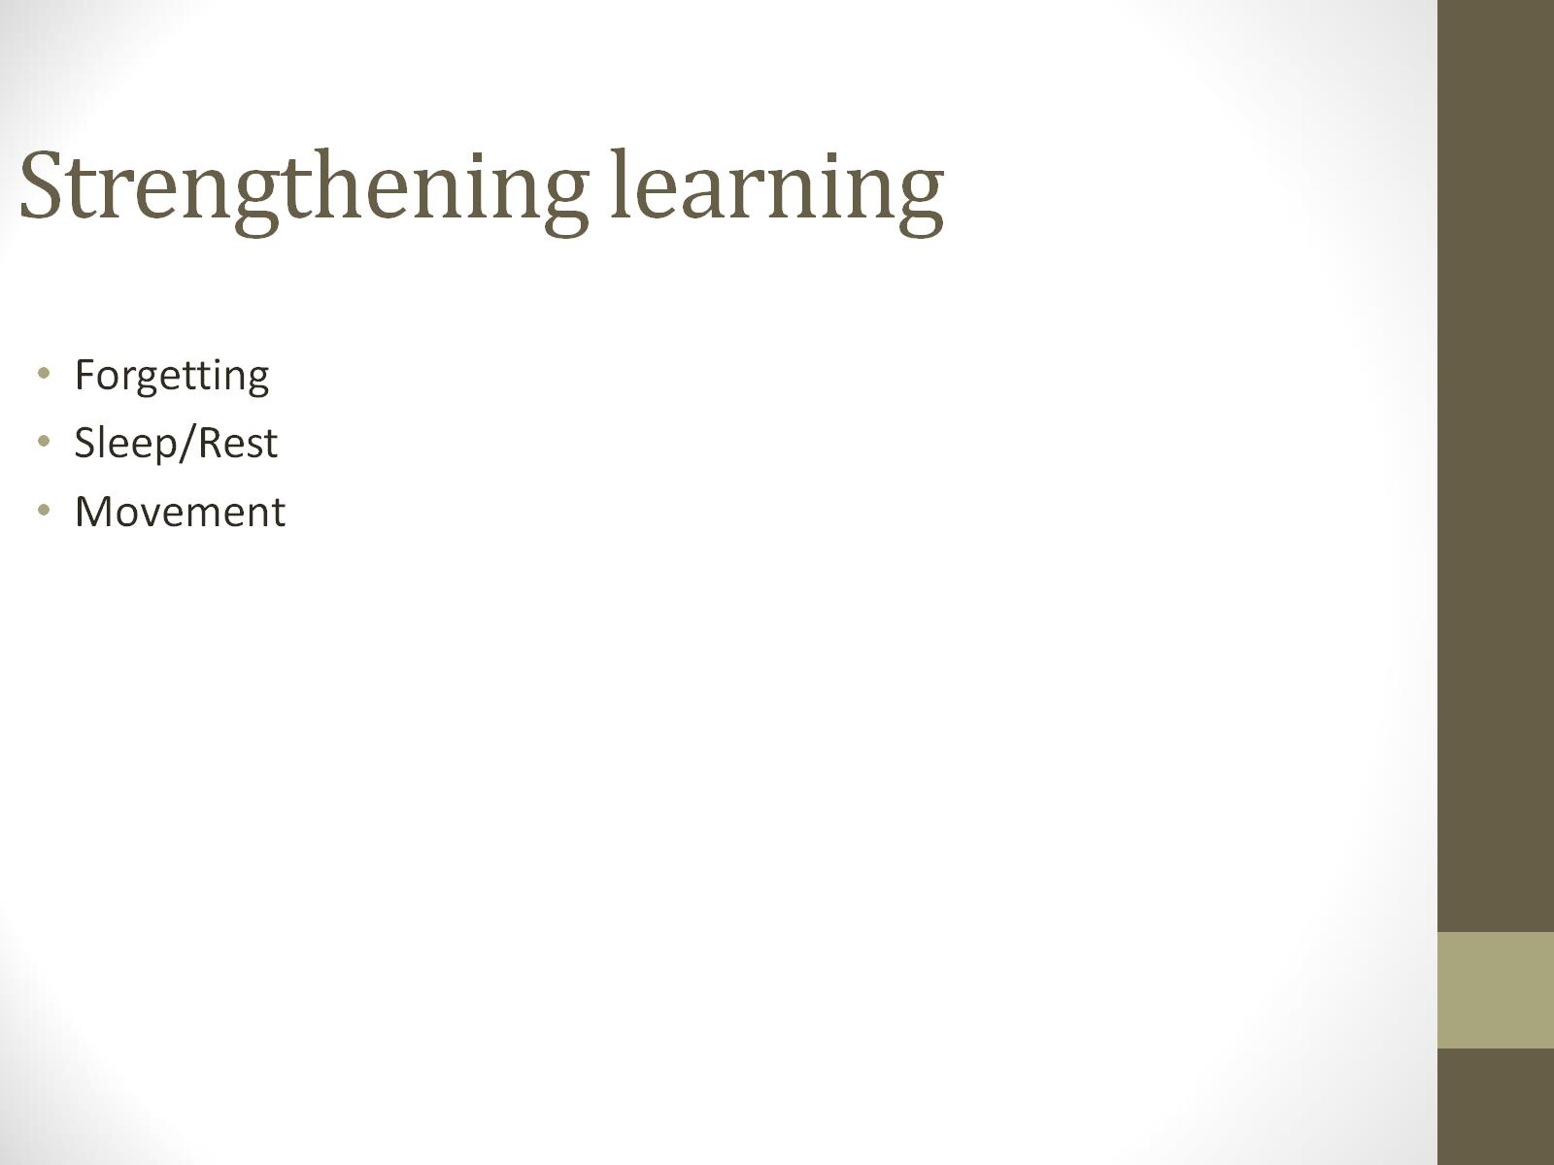
Strengthening learning

Slide 99
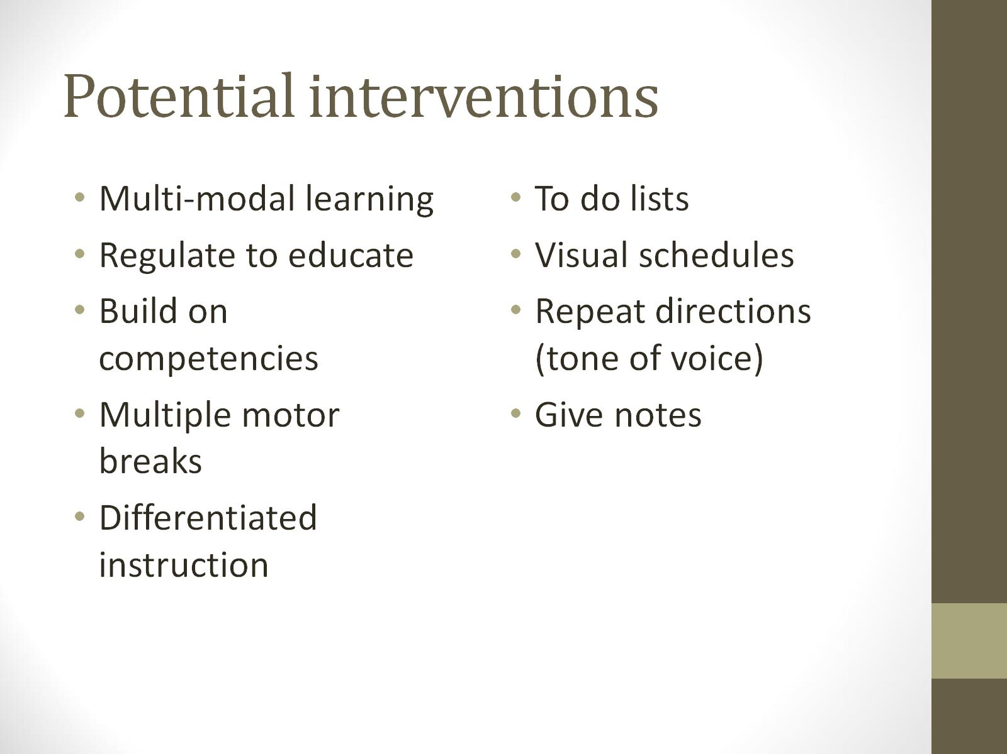
Potential interventions

Slide 100
#4 Cognition & Learning:
Developmental Interventions
Movement
Multi-sensory experiences
Targeted training in Executive Functioning
Sensory breaks
Structure and routine
Partialize
Stress reduction
© NFI Vermont 2018

Slide 101
Targeting the Tiers, PBIS approaches
Brain stem/diencephalon
Intensive
limbic
targeted
universal
cortex

Slide 102
#5 Behavioral Control:
Developmental Injuries
Impulse control, disinhibited, risk taking
Sleep and eating challenges
Managing fluctuating arousal
Trauma reenactment, repetition, avoidance
Opposition, resistance
Self-destructive, self-sabotaging
“Comfort” with chaos
Compliance, collapse, helplessness, defeat
© NFI Vermont 2018

Slide 103
Can’t vs. Won’t
Would you jump off a cliff?
https://www.youtube.com/watch?v=Iuv__-nyO1M

Slide 104
Misbehavior versus Stress Behavior
Misbehavior | Stress Behavior
Explainable by the youth… | Lack of reasonable explanation…
…In a reasonably linear fashion | 2. …which is not linear and clear, and…
3. Once they are calmed down to baseline | 3. The youth’s story often sounds implausible and abounds with self-protection in the form of…
In a way that generally makes sense | 4. Circularity, time traveling, primitive defenses
5. The youth can usually state his/her motivation | 5. The youth often cannot state clear motivation
6. The behavior typically responds to traditional discipline | 6, The youth is typically non-responsive to traditional discipline
7. Behavioral Plans, FBA, Incentives, Threats often work | 7. Actions and behaviors are motivated by survival
 | 8. The youth is reactive/non-responsive to behavioral plans, FBA, etc.
© NFI Vermont 2018

Slide 105
Misbehavior versus Stress Behavior
Misbehavior | Stress Behavior
Traditional discipline was never designed for youth who are at-risk | 1. Focuses on the importance of co-regulation, connections, and calming strategies
2. Punishment and the threat of punishment activates the stress response system—the very system that likely causes the acting out | 2. Focuses on intentional use of language, and what certain words mean to the youth exposed to trauma
External Rewards are not durable in behavioral change | 3. Tries to work with instead of opposition to the youth
4. Conventional discipline creates an “us versus them” feel and increases stress | 4. Prioritizes the preservation of the relationship (worth with)
5. Conventional discipline focuses on the negative attributes of the child, again increasing stress and alienation | 5. Examines deficits in skill and unmet needs, not lack of will or negative intention
© NFI Vermont 2018

Slide 106
Misbehavior versus Stress Behavior
 | Misbehavior (submit and admit) | Stress Behavior (survival based)
Intention | Avoid/Seek | Safety
Child’s Motivation | Willful, Choice, Intention Child has the skill, not using it | Survival Skill Defect: Child must learn the skill
Adult’s Approach | Authoritative: incentives, bribes, threats, punish, contingencies | Collaborative: Co-regulate, collaborate, reframe, core themes, see the meaning of the behavior
Primary Skill Deficit | Lack of self-control | Lack of self-Reg, self-awareness, skill deficit
Adult Motivation | Control | Connect, Curiosity, Co-regulation
Re-frame | What is wrong with you? Why cant you control this? | What happened to you? How can I help? What is the source?
Stuart Shanker, Ph.D.
© NFI Vermont 2018

Slide 107
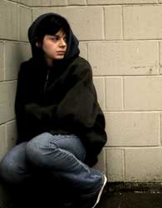
Reframing Risk Behaviors
  Tension reduction behaviors
  Drugs and alcohol
  Risk-taking behavior
  Self-injurious behavior
  Compulsive stealing
  Aggression
  Problematic sexual behaviors (where any connection feels better than abandonment and isolation)
(from training on Integrated Treatment for Complex Trauma by John Briere, 2009)

Slide 108
Behavior
Behavioral Plans
Co-regulation Plans
Tend to be reactive
Focus on behavior management
Focus on reduction of behaviors
Little or no focus on partner behavior
May not be developmentally appropriate
Focuses on superficial antecedents and consequences of the behavior
Less focused on early intervention and preventive skill building
Tend to be responsive and preventative
Focuses on and builds emotional regulation
Focus on emotional well-being of the person
Focus on “mutual” regulation
Addresses the underlying function/feeling of the behavior
Helps person learn how others can help
Based on the work of Nancy Clements, M.A., CCC–SLP; Socialthinking.com

Slide 109
But…what about consequences?
Relational and relevant
Restorative and reparative
Notes:
109

Slide 110
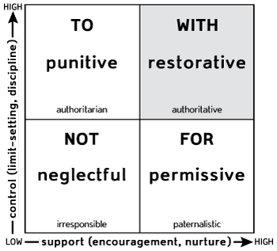
Social Discipline Window
Activates defense
Deactivates attachment
Empower
Relationship
attachment
reenactment
Disempower
Poor self-concept

Slide 111
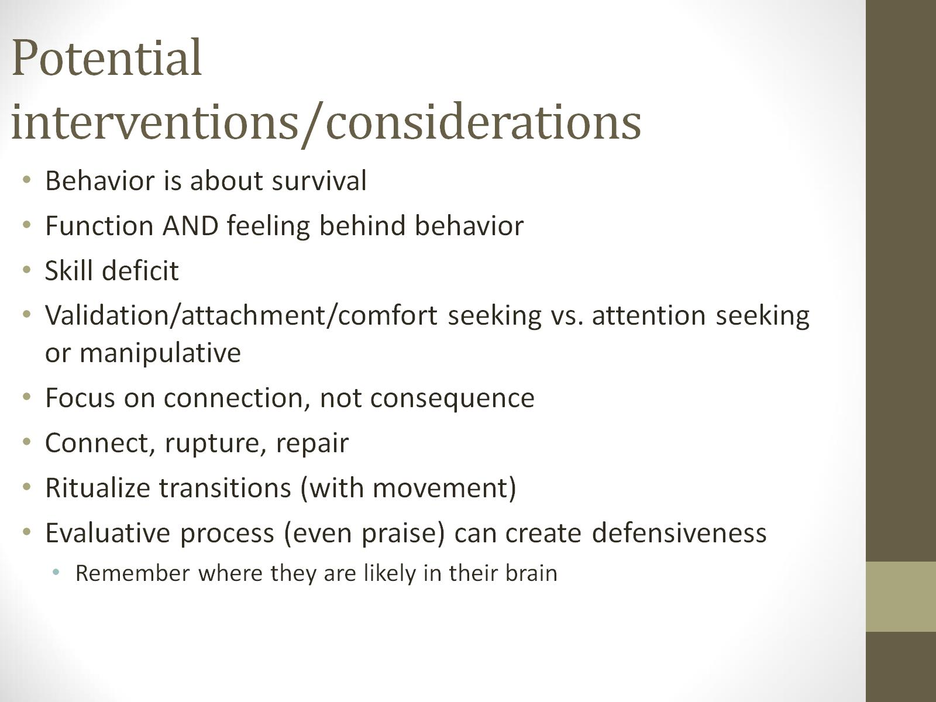
Potential interventions/considerations

Slide 112
#5 Behavioral Control:
Developmental Interventions
Understanding that symptoms are a means (attempt at) to self-regulate
Stress behavior versus misbehavior (psychoeducation goal)
Accountability Formula= Validation + Empathy + Co-regulation + (validate child as victim before approaching as a perpetrator of harm
Re-framing
Restorative Practices
Reduce stress as a priority
© NFI Vermont 2018

Slide 113
Targeting the Tiers, PBIS approaches
Brain stem/diencephalon
Intensive
limbic
targeted
universal
cortex

Slide 114
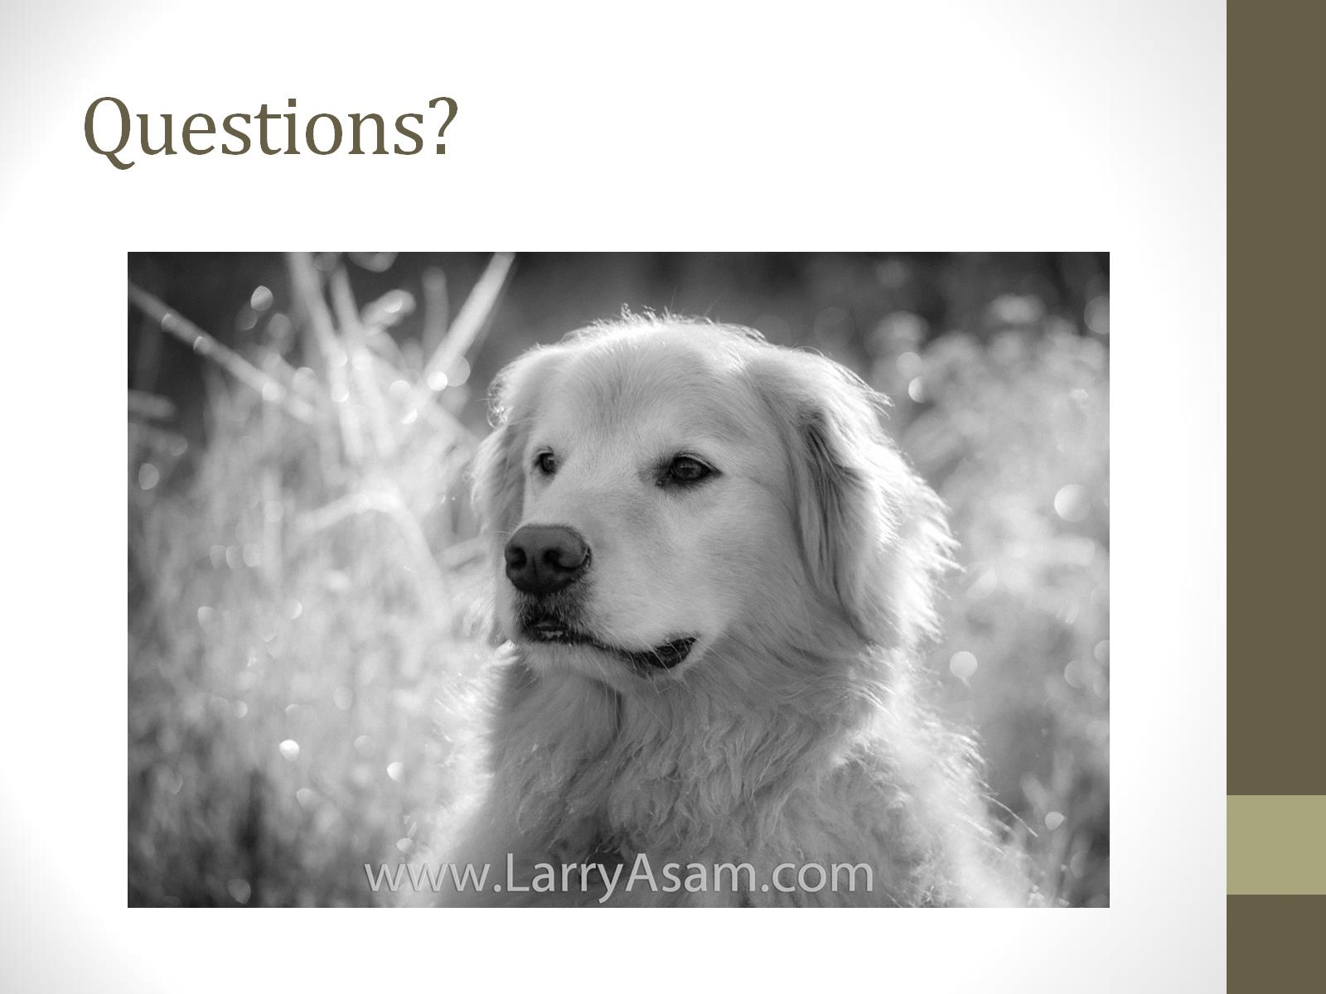
Questions?

