Slide 1
2020 VTPBIS Virtual Forum
Crisis Prevention and Response In the COVID-19 Era: What we know and what we’ve learned
Ken Kramberg, Amanda Babcock, and Judy Houde-Hardy

Slide 2
Agenda
Educating Our Vulnerable and Behaviorally Challenged Learners
How Vermont Schools Prepared For The Return to School.
What Does It look Like
What have we Learned
Breakout or small group discussion. Tracy Harris for the AOE will join us to answer questions about VT Rule 4500 in the Covid 19 environment.

Slide 3
JFK Elementary School makeup:
408 students K-5
18 different languages spoken within the school
Arabic, Bosnian, Burmese, Chinese, French, Hindi, Japanese, Karen, Kirundi, Kizigua, Loatain, Mai Mai, Napali, Somali, Spanish, Swahili, Vietnamese
6 Liaisons
About 133 ELL students K-5
PBIS school since 2016
This year at our virtual preservice we reviewed and did activities to refresh all 3 tiers. We also introduced our JFK Covid-19 handbook.

Slide 4
How we prepared for Covid-19:
Over the summer the JFK Leadership (PBIS) team became the JFK Reopening Committee. This team met weekly as a full team to discuss and plan the details for reopening our school at all 3 phases (remote, hybrid, and full).
Team members then broke out into smaller groups to work specifically on areas of their expertise and focus.
This work helped to created the JFK COVID-19 Handbook
As the Behavior Coach my task was to anticipate and outline responses to behaviors that we may see during this time.

Slide 5
What supports and policies were created and put into place:
Covid-19 General Procedures/Responses for Dealing with Challenging Behaviors
SSR What It Is and Is Not
SSR Responses to Behaviors
Behavior Response Scenarios

Slide 6
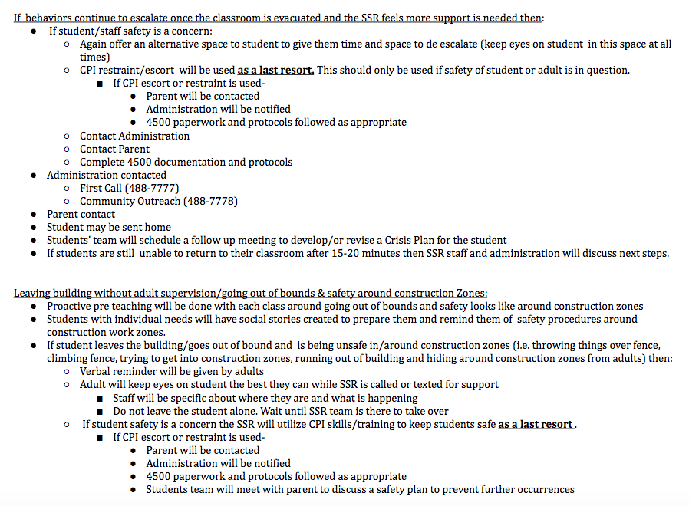
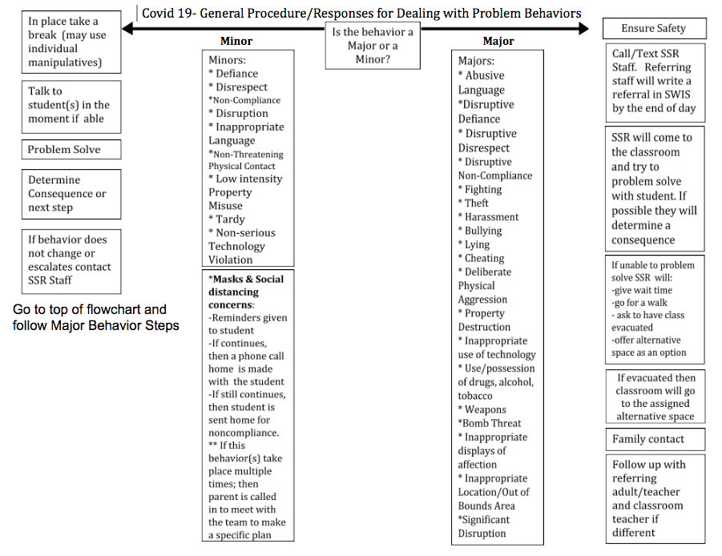
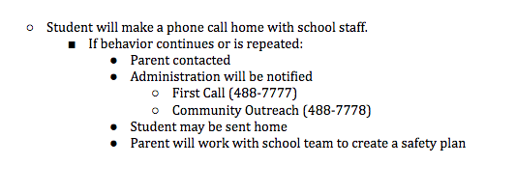
Covid 19 General Procedures/Responses for Dealing with Problem Behaviors

Slide 7
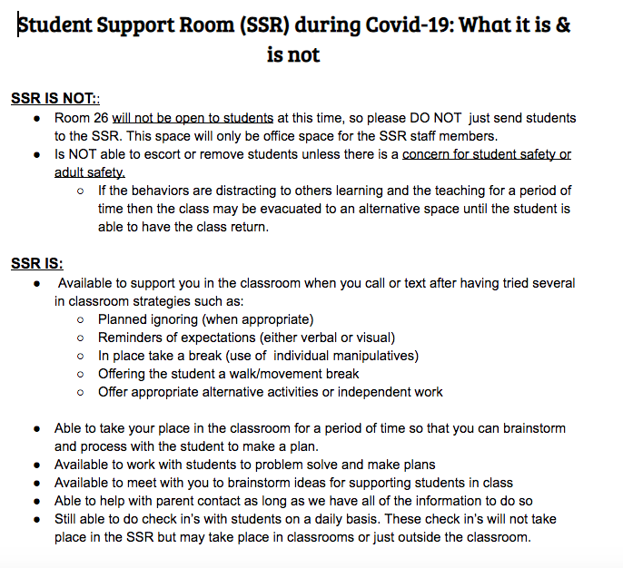

Slide 8
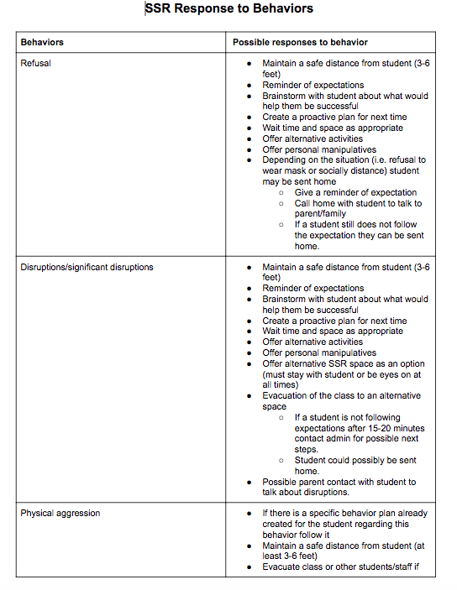
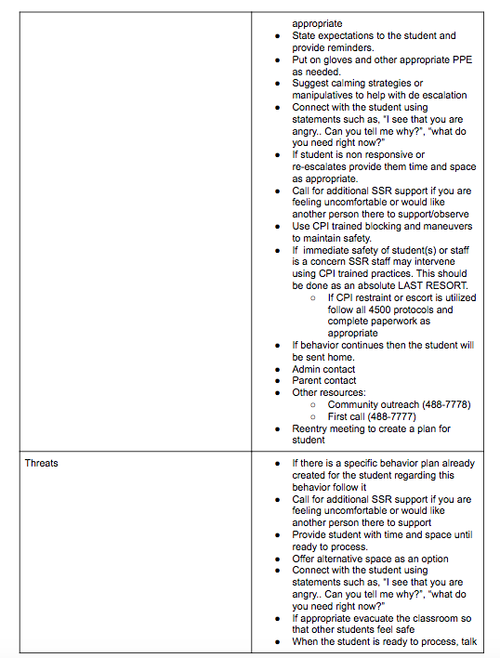
SSR Responses to Behaviors

Slide 9
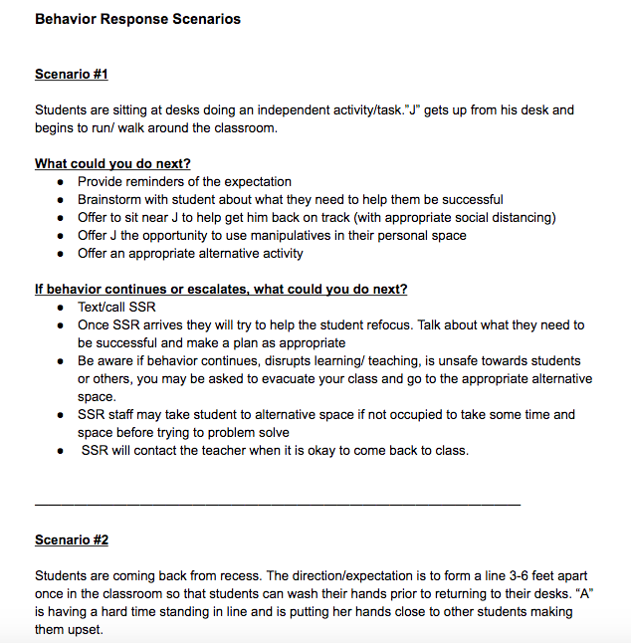
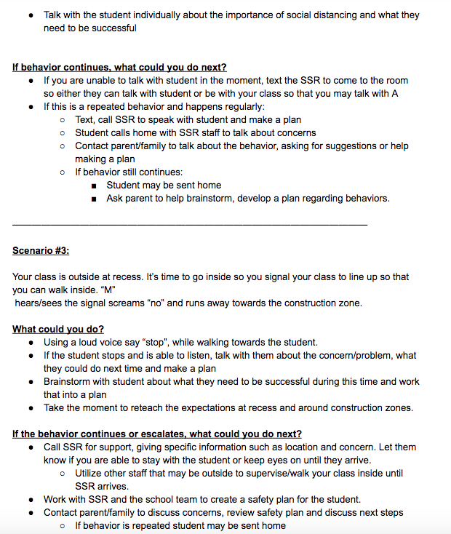

Slide 10
What I have learned:
As much as you want to anticipate all behaviors that may take place you cannot. There is always something that comes up that doesn’t fit the outline.
In that case you need to consult with your admin and crisis team to figure out the next steps.
Having taken the time to outline these things in a clear way will help well beyond Covid-19 times, guiding us to be even more consistent and clear with our responses to behavior.
These types of outlines help all staff when responding to behaviors but also hold us accountable to provide consistent responses to our students.
Our Liaison’s are a godsend!!!!! Many of the challenges students have had (ie: mask use, staying in space, distancing) we were able to call upon them to help us translate and help our ELL students understand why particular expectations are important.
The added layer of the enormous building renovation has added more restrictions on students and teachers making this transition back even more challenging.

Slide 11
How are things going so far?
At this point in time we have had 29 referrals.
The highest number coming from Kindergarten (high ELL #’s, no school experience)
The other referrals are a result of students adjusting to being back in school with many changes and new expectations.
A handful of students, who I had anticipated would struggle coming back, are doing really well. The smaller class size and more individualized adult attention has made a huge difference for them. I am hoping the connections that have already been made during this time will help once we transition back to more in person days.
Many adults have had to adjust their practice and response to behaviors as there is no place to send students to such as buddy rooms or the SSR.
I feel like our staff has done an amazing job and really come together to do what has been necessary to make this work for our school.

Slide 12
Judy Houde Hardy

Slide 13
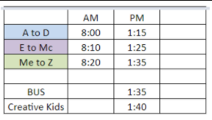
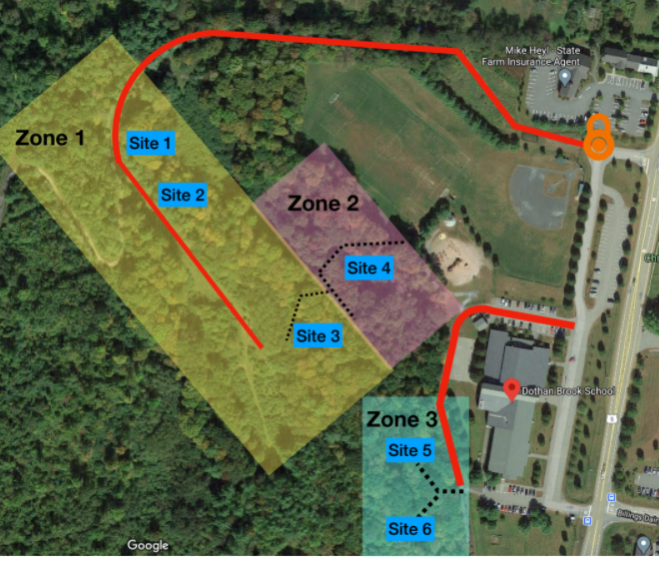
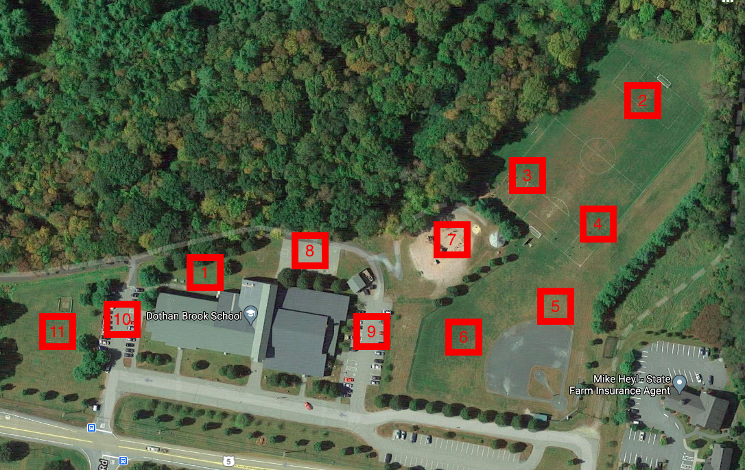
Dothan Brook School
Otters
We are a pre-k through 5th grade school. We are currently teaching in-person all 5 days of the week. We’ve created staggered start times and dismissal times to reduce crowded hallways. There are dedicated recess spots for each pod. We have 8 outdoor classrooms. We dismiss one hour earlier than our regular dismissal time.
Notes:
The lay of the land - the logistics of how we’re functioning each day.

Slide 14
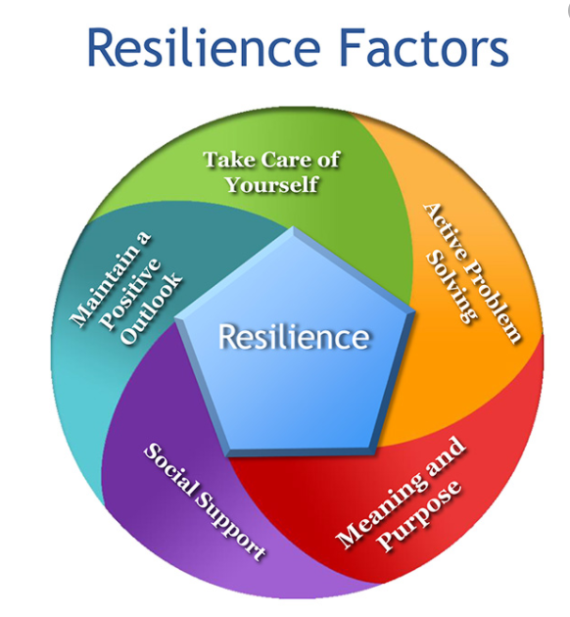
Before we prepared for the children, we took time to prepare ourselves.
We took our own best advice for our students and we slowed ourselves down before ramping back up for the school year.
All meetings started with a chance to check-in and share hopes, fears, and concerns.
Notes:
Adults shared feelings of fear, trepidation, concern, and excitement. Coming together was challenging in itself after months of staying home. Honoring all of these feelings was important for our community. Resilience work is part of DBS ongoing school-wide focus.

Slide 15
How we prepared for Covid-19:
Summer team meetings:
Universal - Videos and slideshows for all the new expectations
Targeted - Processes and locations for new Check-In + Breaks
Intensive - Behavior Support Plans with renewed focus on de-escalation strategies
Logistics - TONS and TONS of safety planning, visual supports, and organizational feats
Crisis Team - Additional de-escalation training and LOTS of Rule 4500 review and discussion
Notes:
Summer work included team work to explore the breadth of changes facing the school, including priority indicators in content areas.

Slide 16
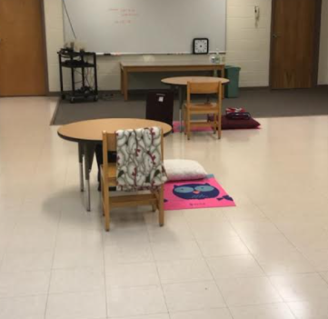
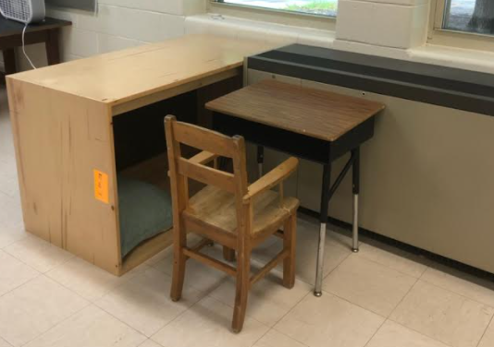
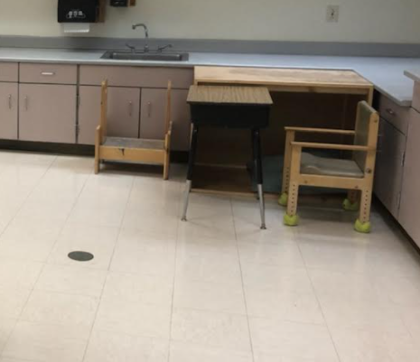
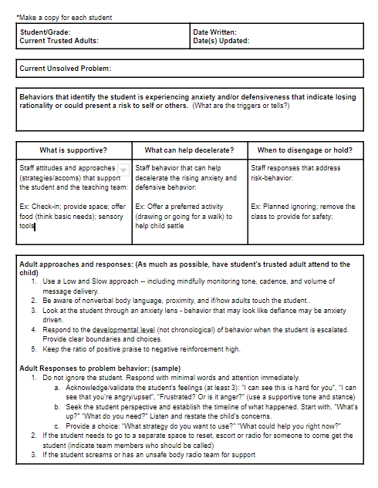
Supports and ideas we put into place:
SPACE:
PORTABLE POSITIVE REWARDS (and data):
REVISED BSPs:
Notes:
Like Amanda’s team, we drafted new policies and documents to support our teams, including additional data forms documenting behavior that is in direct response to COVID safety expectations. Targeted and Intensive logistical planning involves expanded spaces to provide greater bandwidth for students with behavioral and sensory challenges.

Slide 17
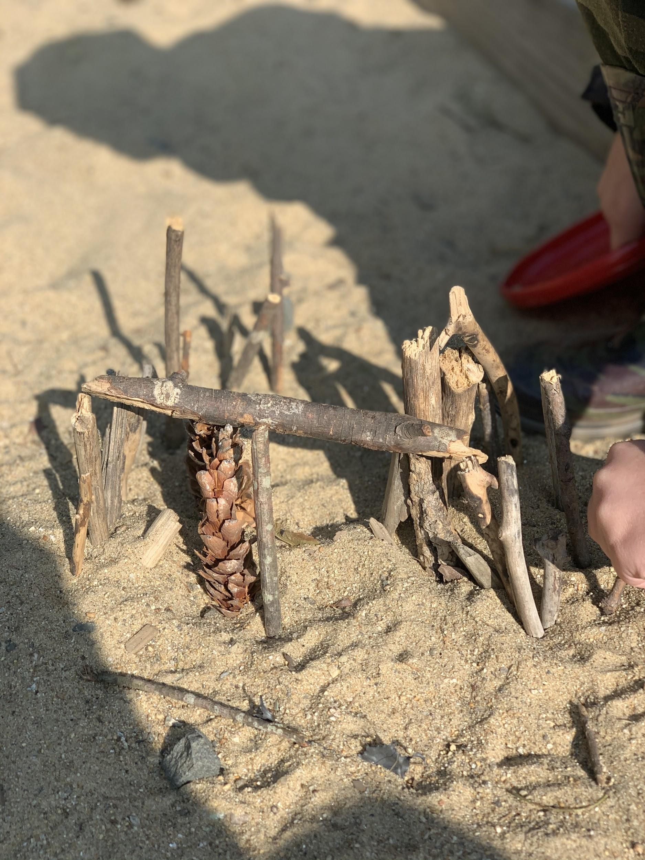
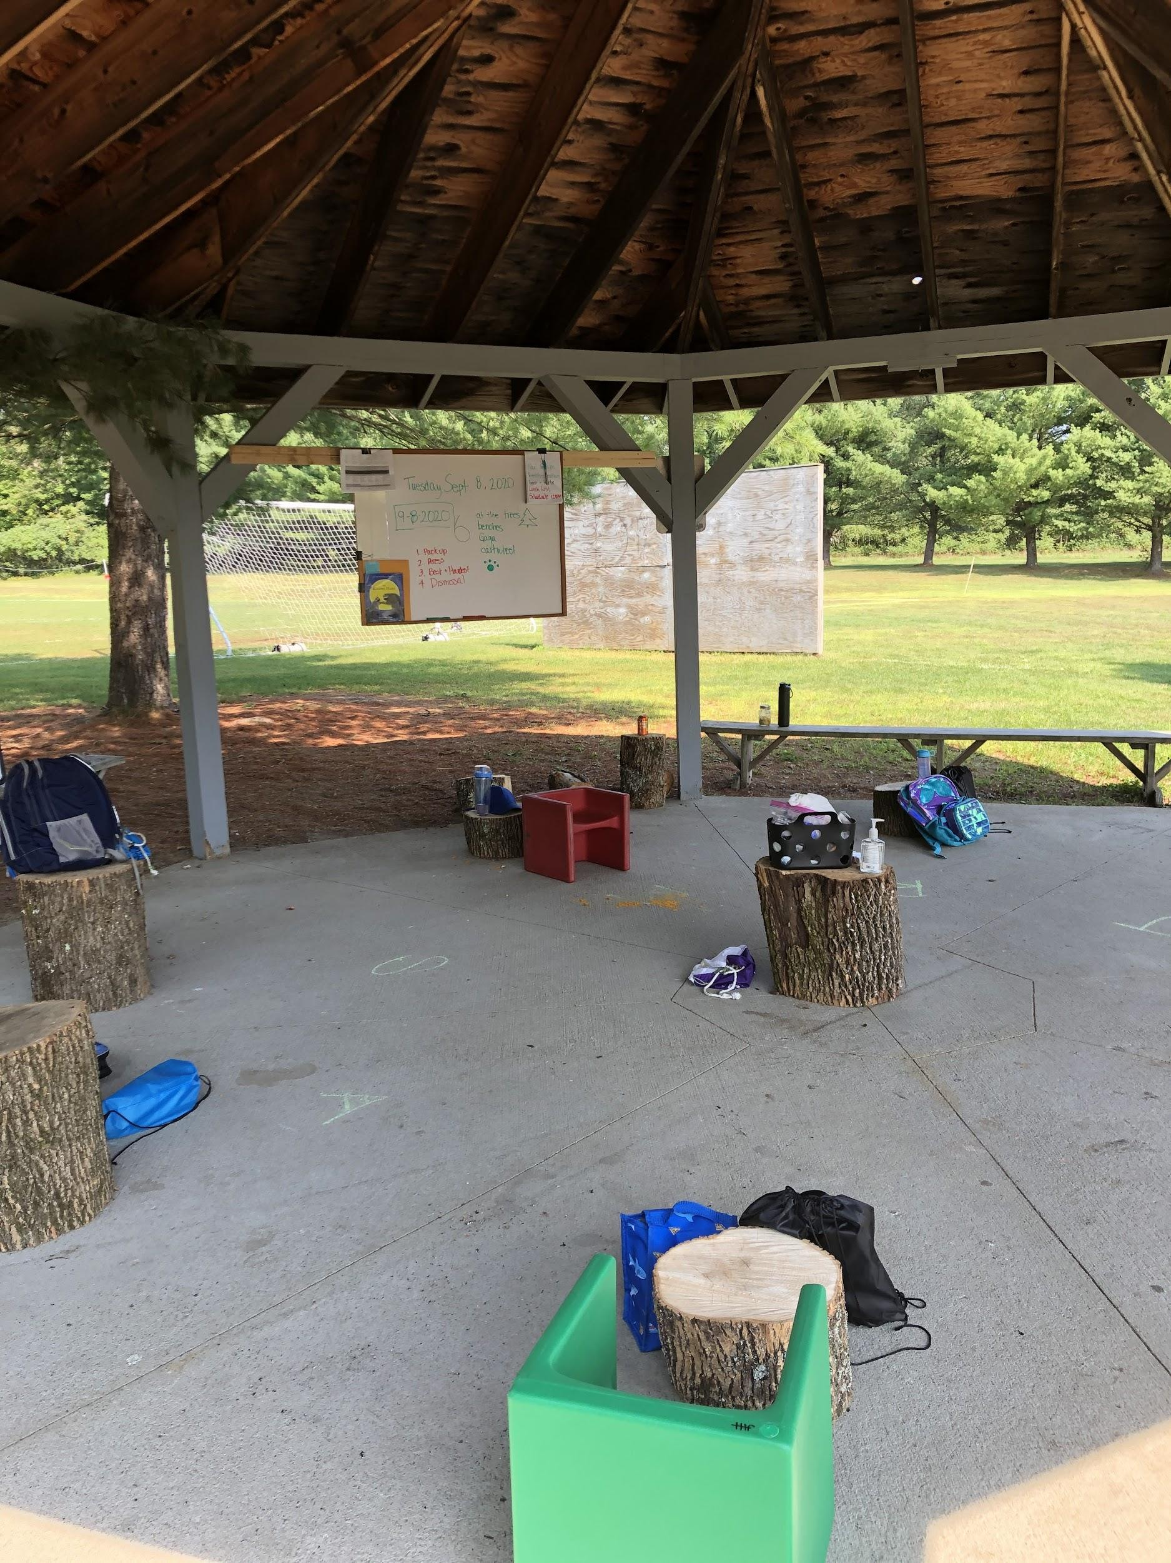
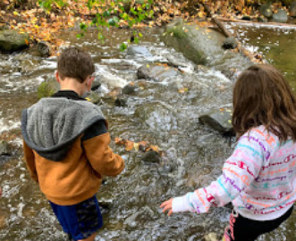
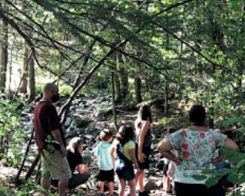
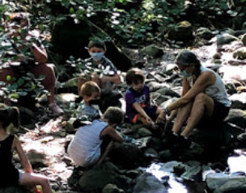
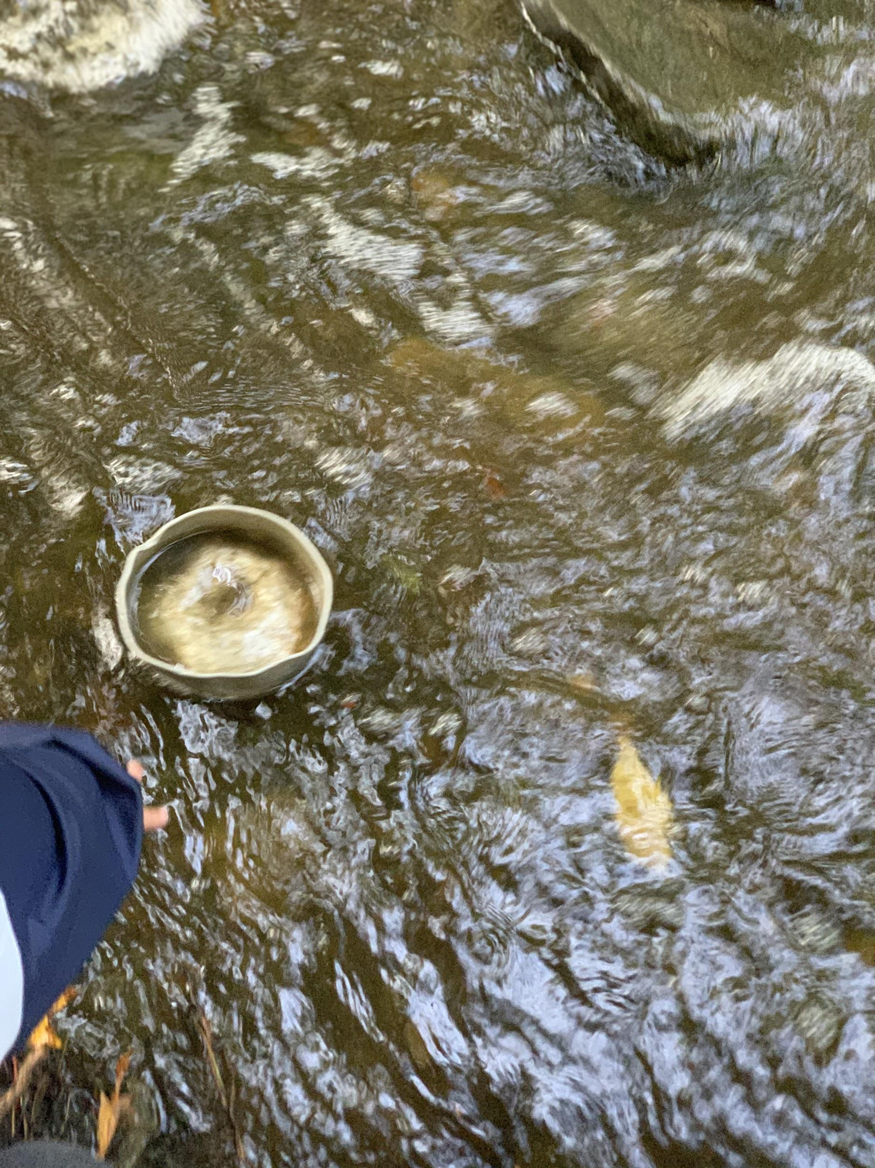
What we’ve learned:
Being outside really helps. The big space
helps to promote a sense of calm adventure.
Notes:
Dothan Brook School expanded from one outdoor classroom space to 8 outdoor teaching spaces in the lead up to school. Chainsaws and stumps and tarps and brush hogs… Being outside has created lots of extra space to manage student responses. Example 1: Walking away in frustration while still being in line of vision has decreased explosive episodes.

Slide 18
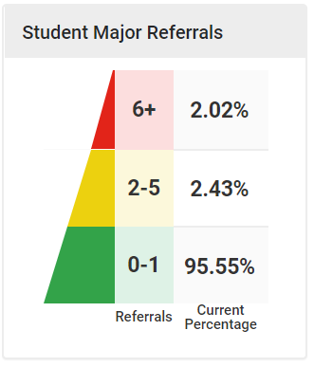
Reviewing data and being flexible has been key:
Changes in:
BSP
Notes:
Example 2: Accessing remote platform for academic instruction to reduce stress and promote access to academic content; Social skills instruction happening within high-interest activities, including when in the woods. Reduced referrals and improved participation.

Slide 19
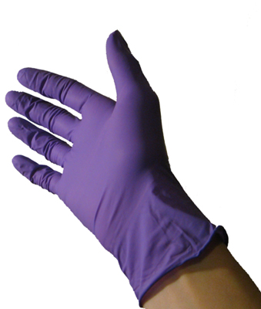
During a crisis, teamwork and collaboration has been critical:
Notes:
Example 3: 60 minute incident; full PPE required although no seclusion nor restraint; Tagging out by staff members; Crisis Team meeting at end of day to review and debrief.

Slide 20
Rule 4500 changes and understanding:
What additional cleaning protocols are necessary?
How does this change things?
What does this mean for outdoor safety?
Tagging out and staying safe!
What about additional PPE?
Notes:
Example 4: Running into parking lot and stopping them; triggering anger and reaction. What constitutes restraint and when to document. Crisis Team discussion and de-brief.

Slide 21
Crisis became opportunity for us…
Opportunity to:
Create systems that keep all school members safe
Think and act creatively for hybrid programming
Increase training across staff to meet the needs of students who have impulse control issues and social, emotional, and behavioral concerns
Expand our Outdoor Classroom program
Prioritize learning goals and outcomes
Continue to take best possible care of each other during these challenging times.

