Slide 1
Expanding Your Inventory of Tier II Supports
Kristin Beswick kristin.beswick@ncsuvt.org
Technical Assistance
Josh Souliere
Notes:
For purpose of this Workshop, i will refer to Targeted and Tier II supports and interventions as being synonymous.
Tier II or Targeted Supports or interventions are those things that are layered onto universal supports to enhance a student’s skill development.

Slide 2
Personal Inquiry
What is something you would like to know when you leave this session today?
How can I/we…?
What can I/we…?
Jot down something that will guide your
learning today.
Notes:
This is a large group and it can be difficult to meet everyone’s individual needs. Therefore, I would like each of you to consider why you chose this workshop. So I will give one minute to reflect and identify something…
As we move through today’s workshop, I will stop and have you reflect on what you would like to know.

Slide 3
What Targeted Interventions are Currently Implemented in Your School?
Present Mentimeter
Notes:
Enter one intervention at a time
Place a dash or no spaces to write more than one word
If you are in a school that has not yet started implementing Tier II supports, you can respond with ‘none’
https://www.menti.com/usxebsjuw5

Slide 4
Objectives
Consider readiness for targeted interventions
Define and Identify appropriate targeted interventions
Consider Current Inventory of Tier II Supports
Match student needs with targeted interventions
Data and progress monitoring
Support implementation fidelity
Targeted interventions for remote learning

Slide 5
Norms and Community Agreements
Be fully present
Be mindful of other learners
Be engaged and take risks
Take care of yourself
What do I need from the group?
What does the group need from me?
Notes:
The chat box will be used for responding once or twice this workshop but more importantly, Josh Souliere will be monitoring the chat box and making decisions about what may need to be addressed before moving on and what could hold off because it may be addressed later

Slide 6
Notes:
This is true for each layer of support.
This does not mean that we decrease the expectations, rather, we maintain high expectations and give them the supports and build their skills so they can reach them.

Slide 7
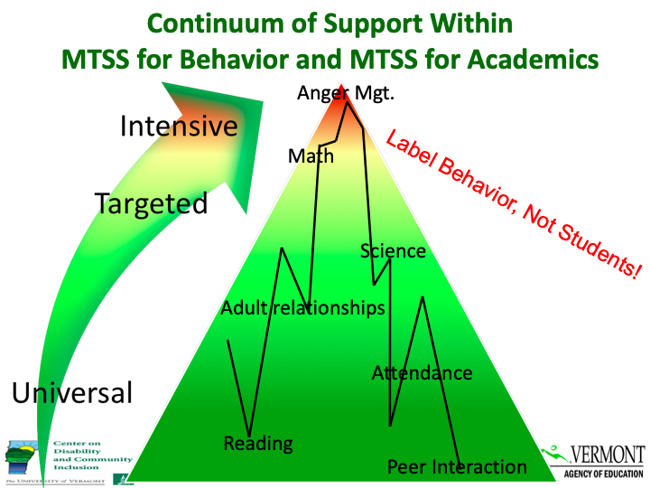
Notes:
As we dive into Tier II Supports, this is just a reminder that we want to use Person-first language
Students receive supports, they are not defined by them
If a student is not being successful it is the responsibility of the adults in that environment to first look to change their practices, the environment or both before recommending that students receive additional layers of supports

Slide 8
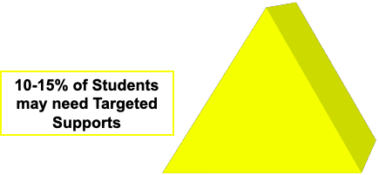
What is a Targeted or Tier II Intervention?
Address function of behavior
Continuously available
Quickly and easily accessed
Consistent with school-wide expectations
Require minimal extra effort by teachers
Identify and work toward goals
Monitor progress
Include student voice
Use school resources creatively
Implemented with fidelity
Notes:
All of these must be in place for the intervention to be considered truly targeted
Once students achieve their goals, celebrate when they have reached their goals.
Chat Box - Show of hands, how many are currently implementing interventions at the targeted level?

Slide 9
Is Your School Ready?
Implementation at the Targeted Level
is likely to be more effective and efficient
if Universal Systems are implemented
with high fidelity
(at least 70% on Tier I of the TFI).
www.pbis.org
Notes:
If your school has not implemented Universal Systems with fidelity, it will be difficult to determine which students are struggling due to lack of universal systems in place vs. actual skill deficits.
What might be other indicators, other than Tier I TFI scores, that universal systems may need to be revisited? (high referrals, low attendance rates, class cuts)

Slide 10
Assessing Your Capacity
How many students do you currently have identified as receiving/requiring targeted supports?
Is the number of students within 10-15%, or less, of your student population?
What resources do you have available to you (i.e. people, space, time)?
Can you accommodate the number of students you have identified?
Will you have interventions to support the types of student needs identified (i.e. attention seeking, avoiding academic work, avoiding social situations)?
ODR Focus Chart

Slide 12
Personal Inquiry Check
Notes:
Take 1 minute to look at your question you are hoping to answer by the end of this session. Feel free to make changes to your question based on information covered so far.

Slide 13
Systems: Inventory of Targeted Supports
What interventions are currently in place?
What behavior functions do they address?
What is the short-term goal?
What will it look/sound like when the goal is met?
How will we know the intervention is working?
How will we know when to stop the intervention?
Inventory of Supports - Template
Sample Inventory of Interventions
Notes:
Systems involved in tier II supports - process gathering data and analyzing data related to student needs, aligning resources, process for accessing those resources, reallocation as needed
These conversations are separate from those about individual students and their progress as they access tier II interventions.

Slide 14
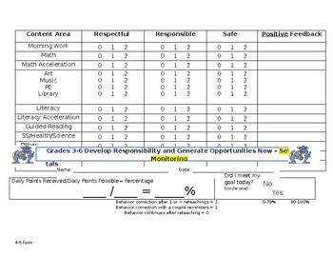
Examples of Tier II Interventions
Check-in
CICO with identified goals
Teacher Check and Connect
Self-Regulation - Gear Up, Mindfulness Breaks
Earned, Scheduled, and Processing Breaks
Lunch Groups
Recess Planning
Social Skills or Confidence Boosters Groups
Mentoring

Slide 15
Inventory of Targeted Supports
Targeted Support | Function (goal dependent) | SEL Lagging Skills Addressed | Referral Criteria | Data Collection & Progress Monitoring | Fading Criteria | Exit Criteria
Check-in | Adult attn | Self-regulation | Difficult transition into school; Fade from CICO | AM SSFs Frequency ratings by teacher | Regulated AM integration into classroom; Confidence in independence | Fading plan success OR Check-in unsuccessful in meeting behavioral needs of student
CICO | Adult attn; Avoid task/activity; Gain item/activity | As identified through ALSUP | Need for consistent/ frequent feedback to address lagging skills | CICO SSFs Frequency ratings by teacher | Consistently meeting goals, ≥ 83% point goal, and no additional goals needed | Fading plan success, no additional goals needed OR CICO unsuccessful in meeting behavioral needs of student
Teacher Check & Connect | Adult attn; Avoid task/activity | As identified through ALSUP | Need for consistent/ frequent feedback to address lagging skills | CICO BODs Frequency ratings by teacher | Consistently meeting goals, ≥ 83% point goal, and no additional goals needed | Fading plan success, no additional goals needed OR TCC unsuccessful in meeting behavioral needs of student

Slide 16
Inventory of Targeted Supports
Targeted Support | Function (goal dependent) | SEL Lagging Skills Addressed | Referral Criteria | Data Collection & Progress Monitoring | Fading Criteria | Exit Criteria
Check-in | Adult attn | Self-regulation | Difficult transition into school; Fade from CICO | AM SSFs Frequency ratings by teacher | Regulated AM integration into classroom; Confidence in independence | Fading plan success OR Check-in unsuccessful in meeting behavioral needs of student
CICO | Adult attn; Avoid task/activity; Gain item/activity | As identified through ALSUP | Need for consistent/ frequent feedback to address lagging skills | CICO SSFs Frequency ratings by teacher | Consistently meeting goals, ≥ 83% point goal, and no additional goals needed | Fading plan success, no additional goals needed OR CICO unsuccessful in meeting behavioral needs of student
Teacher Check & Connect | Adult attn; Avoid task/activity | As identified through ALSUP | Need for consistent/ frequent feedback to address lagging skills | CICO BODs Frequency ratings by teacher | Consistently meeting goals, ≥ 83% point goal, and no additional goals needed | Fading plan success, no additional goals needed OR TCC unsuccessful in meeting behavioral needs of student

Slide 17
Inventory of Targeted Supports
Targeted Support | Function (goal dependent) | SEL Lagging Skills Addressed | Referral Criteria | Data Collection & Progress Monitoring | Fading Criteria | Exit Criteria
Check-in | Adult attn | Self-regulation | Difficult transition into school; Fade from CICO | AM SSFs Frequency ratings by teacher | Regulated AM integration into classroom; Confidence in independence | Fading plan success OR Check-in unsuccessful in meeting behavioral needs of student
CICO | Adult attn; Avoid task/activity; Gain item/activity | As identified through ALSUP | Need for consistent/ frequent feedback to address lagging skills | CICO SSFs Frequency ratings by teacher | Consistently meeting goals, ≥ 83% point goal, and no additional goals needed | Fading plan success, no additional goals needed OR CICO unsuccessful in meeting behavioral needs of student
Teacher Check & Connect | Adult attn; Avoid task/activity | As identified through ALSUP | Need for consistent/ frequent feedback to address lagging skills | CICO BODs Frequency ratings by teacher | Consistently meeting goals, ≥ 83% point goal, and no additional goals needed | Fading plan success, no additional goals needed OR TCC unsuccessful in meeting behavioral needs of student

Slide 18
Inventory of Targeted Supports
Targeted Support | Function (goal dependent) | SEL Lagging Skills Addressed | Referral Criteria | Data Collection & Progress Monitoring | Fading Criteria | Exit Criteria
Check-in | Adult attn | Self-regulation | Difficult transition into school; Fade from CICO | AM SSFs Frequency ratings by teacher | Regulated AM integration into classroom; Confidence in independence | Fading plan success OR Check-in unsuccessful in meeting behavioral needs of student
CICO | Adult attn; Avoid task/activity; Gain item/activity | As identified through ALSUP | Need for consistent/ frequent feedback to address lagging skills | CICO SSFs Frequency ratings by teacher | Consistently meeting goals, ≥ 83% point goal, and no additional goals needed | Fading plan success, no additional goals needed OR CICO unsuccessful in meeting behavioral needs of student
Teacher Check & Connect | Adult attn; Avoid task/activity | As identified through ALSUP | Need for consistent/ frequent feedback to address lagging skills | CICO BODs Frequency ratings by teacher | Consistently meeting goals, ≥ 83% point goal, and no additional goals needed | Fading plan success, no additional goals needed OR TCC unsuccessful in meeting behavioral needs of student
Notes:
What data will be collected and used to progress monitor?

Slide 19
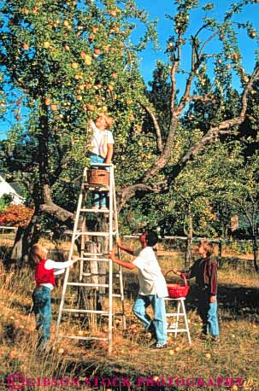
Student Planning: Who Could Benefit
Categories of risk:
Multiple discipline referrals
Excessive absences or tardies
Frequent visits to the Nurse’s Office
Homework not completed
Behaviors not addressed by discipline
system (i.e. internalizing behaviors,
social withdrawal)
Others?
Notes:
In the chat box: Are there others that we do not have listed here?

Slide 20
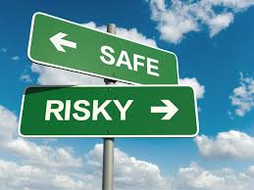
Student Identification
Consider how your school determines that a
student may need additional layers of support:
Risk factors/data
Number of interventions tried
Academic success
Social success
Teacher request/grade band meetings
Universal Screening (s)
Lagging Skills Questionnaire
Notes:
It used to be that students who were demonstrating behavioral challenges would receive additional interventions. We have a variety of other ways to identify students who may require additional supports.
What additional sources of data does your school use to assist your team(s) in identifying student need?
We do not change the expectations when students do not meet them, rather, we build their skills so they can meet them.

Slide 21
Tracking Indicators of Risk

Slide 22
Example - Jimmy Dean
Function = Peer Attention
Jimmy is 9 years old and in the third grade.
What we know:
6 referrals since Sept. 8th, all for inappropriate interactions with peers
On average, Jimmy is asked to take a break 3x per day for inappropriate interactions with peers or taking items from peers.
Academically on grade level
Past history of social struggles documented since 1st grade
Frequent complaints of having no friends
Interventions tried:
Precorrection of skills related to ‘respect for others’ (i.e. taking turns, listening to others) prior to recess, transitions and pair/group work
Changing student pairs/groups
Reteaching expectations
Specific, positive praise
Notes:
It was reported that Jimmy will often say ‘no one likes me’, ‘they won’t play with me’ and ‘I have no friends’. His previous and current classroom teachers indicate that he makes several attempts to engage with peers but does not know how to gain their attention, engage in pre-established play or accept views that are different than his own. In this school, grade level teams make a referral for tier II supports after trying various interventions. Since Jimmy has a documented history of social difficulties, his referral has been accepted and a plan is to be developed.

Slide 23
Choosing Appropriate Interventions
Targeted Support | Function (goal-dependent)
 | Adult attn | Peer attn | Avoid attn | Avoid task/activity | Gain item/ activity | Sensory
Check-in | x
CICO | x |  |  | x (goal dependent) | x
Earned Breaks | x | x | x |  | x
Recess Planning | x | x |  |  | x
Notes:
How do we choose an intervention? Well…
Do we close our eyes and throw a dart? No, we consider the data that shows indicators of risk, we use pre-determined cut-off for tier II interventions, and we match the student’s needs/lagging skills/function with the interventions.
Once you have chosen the intervention, you already know what the goals would be and how to track them. This was developed by the Target Level Systems team.

Slide 25
Criteria for Targeted Interventions
Address function of behavior
Continuously available
Quickly and easily accessed
Consistent with school-wide expectations
Require minimal extra effort by teachers
Identify goals
Monitor progress
Includes student voice
Use school resources creatively
Implemented with fidelity
Notes:
First and foremost, interventions will not support students if they do not address the function. For example, if a child has difficulties with reading comprehension and the intervention allowed for time to read with a preferred adult but no checks for comprehension, though this intervention may be lovely and preferred, we are not likely to see improvements in reading comprehension.
The same applies to behavior - if a student is seeking peer attention and we build in breaks with an adult, we are NOT likely to see changes in the student’s attention-seeking behaviors. We have missed the mark.

Slide 26
Criteria for Inventory of Supports
Inventory Includes:
Referral criteria
Functions/lagging skills addressed
Data sources for progress-monitoring
Fading and Exit criteria
Frequency/intensity of intervention
Resources needed

Slide 27
Do all the interventions you have in place actually meet the criteria for a
targeted intervention?
Notes:
Now that we have discussed what a targeted intervention is, consider what you currently have in place.
Chat box - yes or no
Those of you that said yes, congratulations on your hard work!
Those of you that said no, congratulations on recognizing that things may need to be tweeked a bit!

Slide 28
Intervention Success
Some things to consider if interventions are not working:
Fidelity of implementation
Lack of buy-in/support from staff
Contextual Fit (i.e. developmental level)
Identified function
Notes:
Another question to consider if you have all of the components in place is are these interventions successful?
If not, here are some things to consider.
Fidelity - the degree to which the intervention is delivered as intended. Research tells us that this significantly improves student outcomes. An example might be, if a student’s identified function is adult attention and they have a CICO, are they happening at the right time and consistently?
Lack of buy-in - I had a teacher who refused to circle the points for a child after their class so the para was doing the circling but had not been trained on definitions and criteria which resulted in inconsistencies and lack of buy-in from the child.
Administrators are a key piece in intervention success - carving out time for resources to be available, making certain there is a back-up plan, and speaking regularly to the impact interventions have on student success.
Contextual fit is important - do the interventions match the school environment. Are the interventions in line with your school-wide expectations and your goals for that child.

Slide 29
What could your team focus on for improvement?
Address function of behavior
Continuously available
Quickly and easily accessed
Consistent with school-wide expectations
Require minimal extra effort by teachers
Identify goals
Monitor progress
Includes student voice
Use school resources creatively
Implemented with fidelity
Inventory Includes:
Referral criteria
Functions/lagging skills addressed
Data sources for progress-monitoring
Fading and Exit criteria
Frequency/intensity of intervention
Resources needed
Notes:
Implementing a tiered system of supports is hard work and requires lots of discussion, self-reflection, and tweeking. Don’t give up!
You can use this as a checklist for supporting your efforts moving forward.

Slide 30
Fidelity
the degree to which an intervention is delivered as intended
Improves the odds for improving student outcomes
Notes:
If we know this, why can achieving fidelity be so difficult?

Slide 31
Exiting Students from Interventions
Celebrate accomplishments
Provide reminders that everyone needs help sometimes
Do not ‘graduate’ in case they need assistance in the future

Slide 32
System Check
Processes for:
Teaching staff about Targeted supports
Identification of students
Matching support to student needs
Progress monitoring
Exiting from a support

Slide 33
Personal Inquiry Check
Notes:
Take a few seconds to look at your question you are hoping to answer by the end of this session. Did you get your answers to your question? Visual - thumbs up or down

Slide 34
Additional Resources
VTPBIS Coaching Support
VTPBIS TA Support
Applying the Check-in/Check-out Intervention to Meet Different Needs in Different Environments
Research Based Interventions for Behavior
RTI Academic and Behavioral Evidence Based Interventions

