Slide 1
2020 Annual VTPBIS Virtual Forum
October 7th, 2020
10:15 - 11:45
While we are waiting to get started:
1. Please put your name/role/district in the chat box.
2. In the chat box, identify and share a question you would like answered by the end of this session.

Slide 2
Welcome!
You will be muted during this session. Please use the chat box or raise your hand.
You can show or hide your video.
This session is being recorded.
All materials can be found here: https://www.pbisvermont.org/training-resources/vtpbis-annual-forum/
Notes:
We give thanks to the Abenaki whose land we live and work on. We acknowledge the long history of hardship faced by all First Nations Peoples in the ongoing struggles of colonization and resistance.
We recognize that many Vermont educators are people of European descent coming from a place of privilege and opportunity. We acknowledge that inequities and injustices must be reconciled and healed, and there is much work to be done!

Slide 3
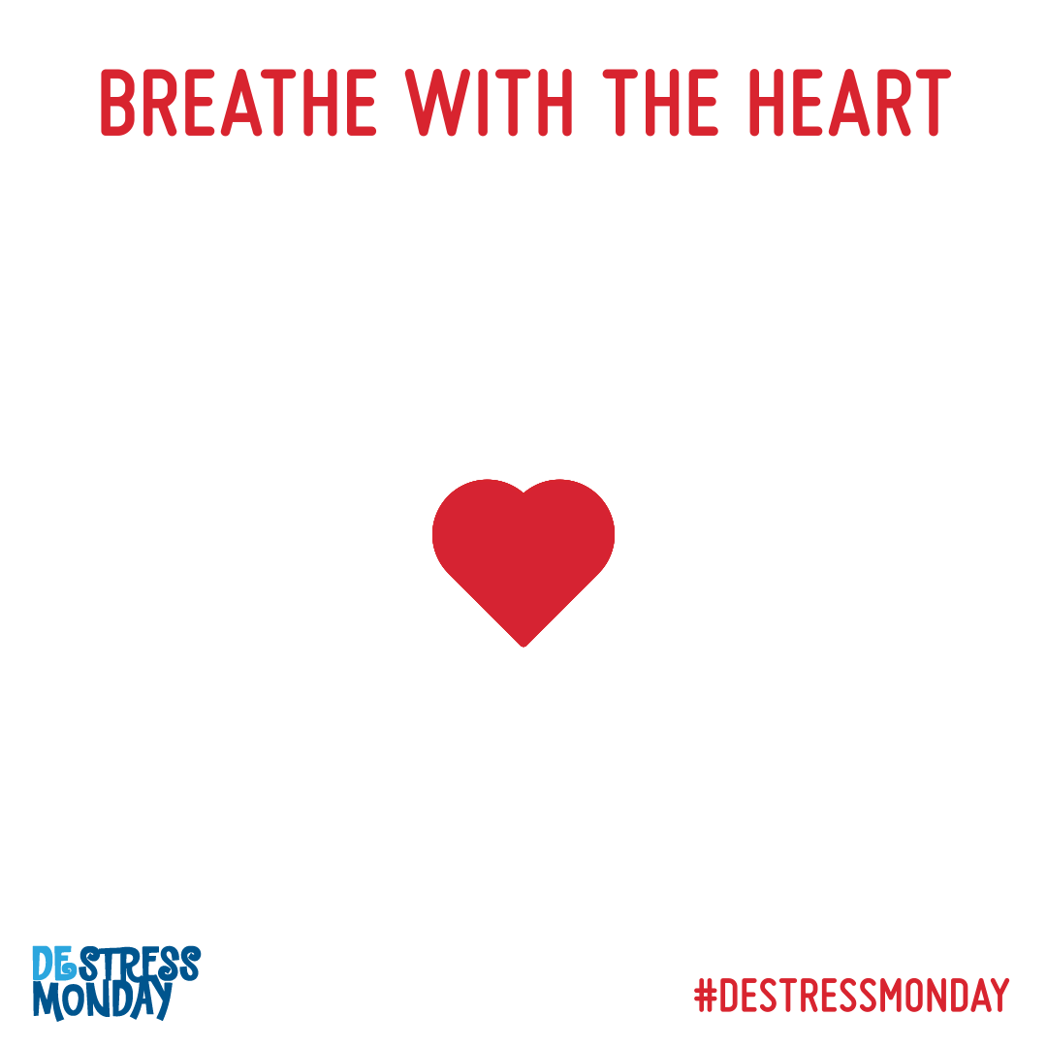

Slide 4
Who are we?
Notes:
ISF Learning and Networking Session - From Planning to Action and Back Again: The Vermont Project AWARE grant provides a unique opportunity for three LEAs to prioritize mental health for ALL – students, staff, and families across home, school, and community. In the first year of implementation, grant-funded LEAs began to explore and install the systems, data, and practices needed to build out interventions and supports based on school and community need. In this session, Project AWARE technical assistance partners will facilitate a process for District Community Leadership Teams (DCLTs) and school leadership teams to celebrate successes, identify challenges, and develop integrated action plans for next steps. There will be an opportunity for LEAs to share and learn from each other as well. Intended Audience: Project AWARE DCLTs and school leadership teams only. Presenters: Ami Flamini, Kim Yanek, and Kym Asam

Slide 5

IT IS POSSIBLE TO PREPARE FOR THE FUTURE WITHOUT KNOWING WHAT IT WILL BE. THE PRIMARY WAY TO PREPARE FOR THE UNKNOWN IS TO ATTEND TO THE QUALITY OF OUR RELATIONSHIPS, TO HOW WELL WE KNOW AND TRUST ONE ANOTHER.

Slide 6
What is the Vermont Project AWARE grant?
The Vermont Project AWARE grant provides a unique opportunity for three LEAs to prioritize mental health for ALL – students, staff, and families across home, school, and community.
In the first year of implementation, grant-funded LEAs began to explore, install, and align the systems, data, and practices needed to build out interventions and supports based on school and community need.
Notes:
What drew you to this project?

Slide 7



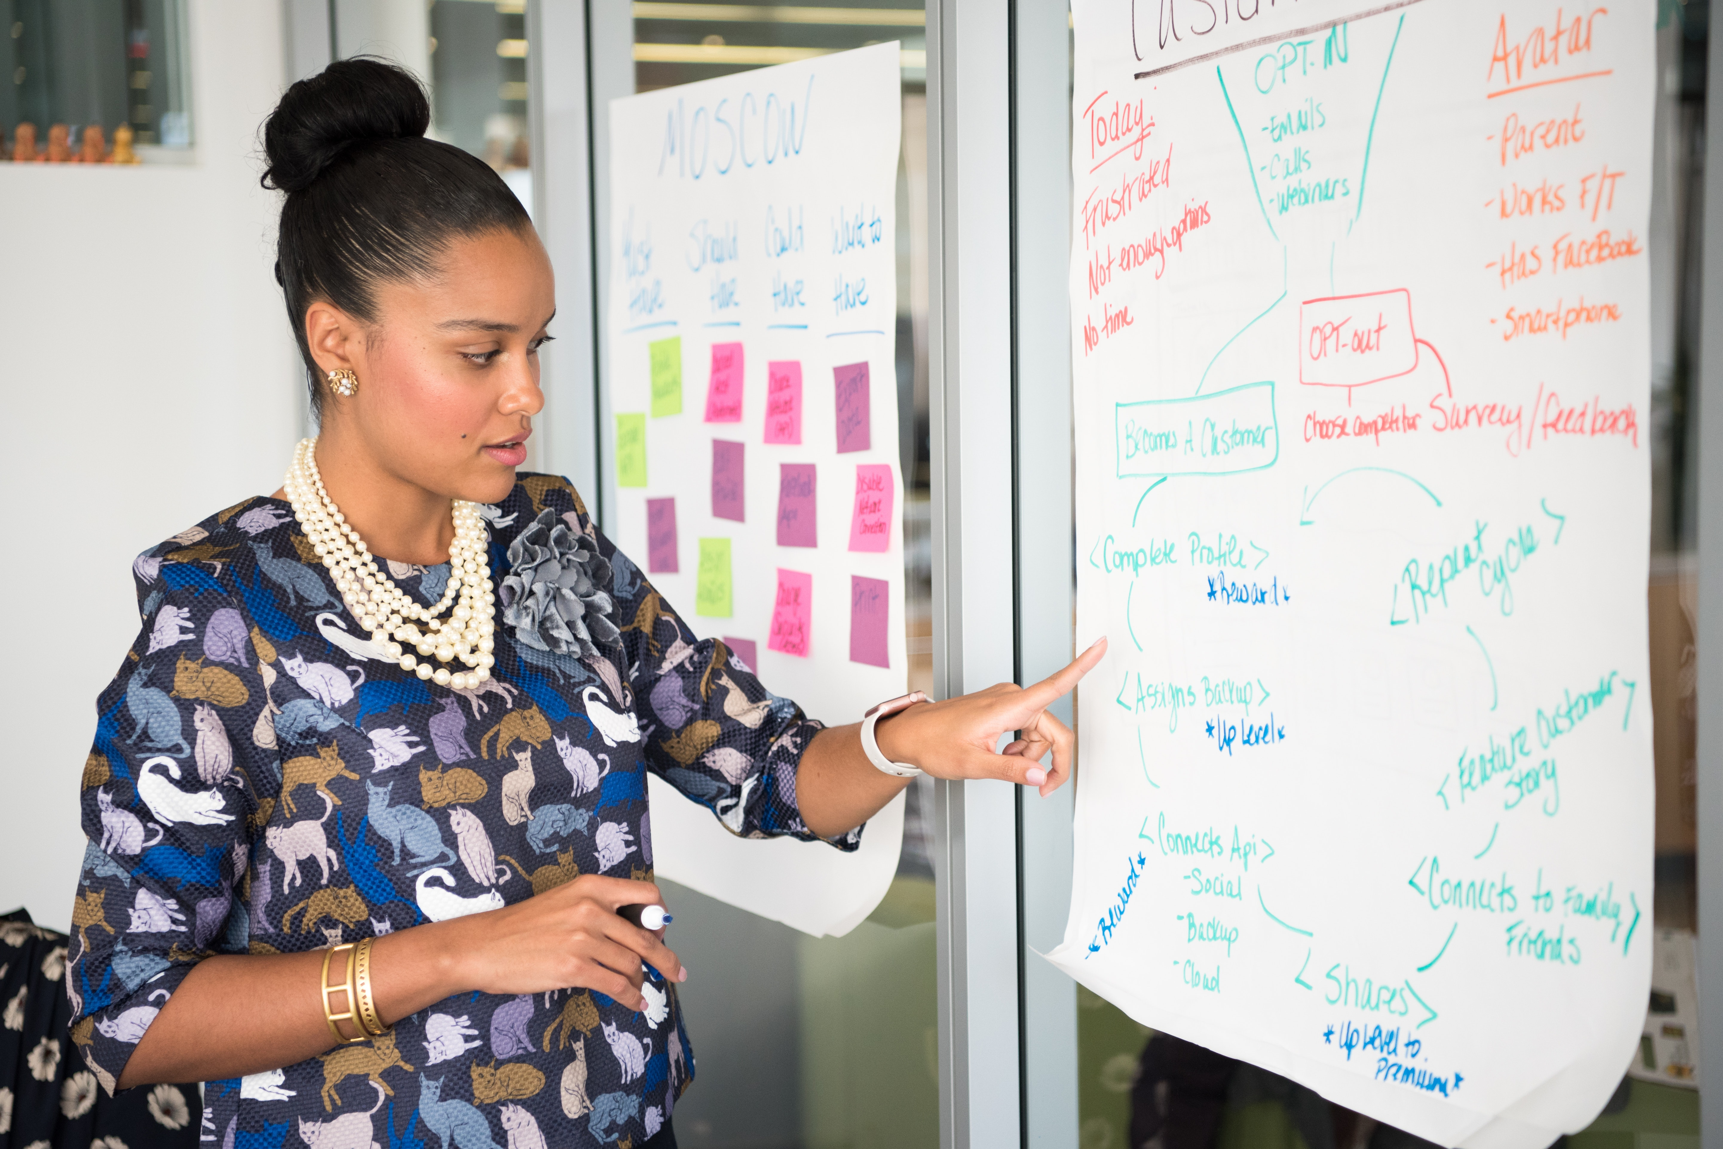

You will need the following in your breakout groups:
Leader/facilitator of your breakout time!
Someone to take a picture of the prompts!
Someone to take notes on your action plan!
Someone to report out to whole group!
EVERYONE PARTICIPATES!

Slide 8
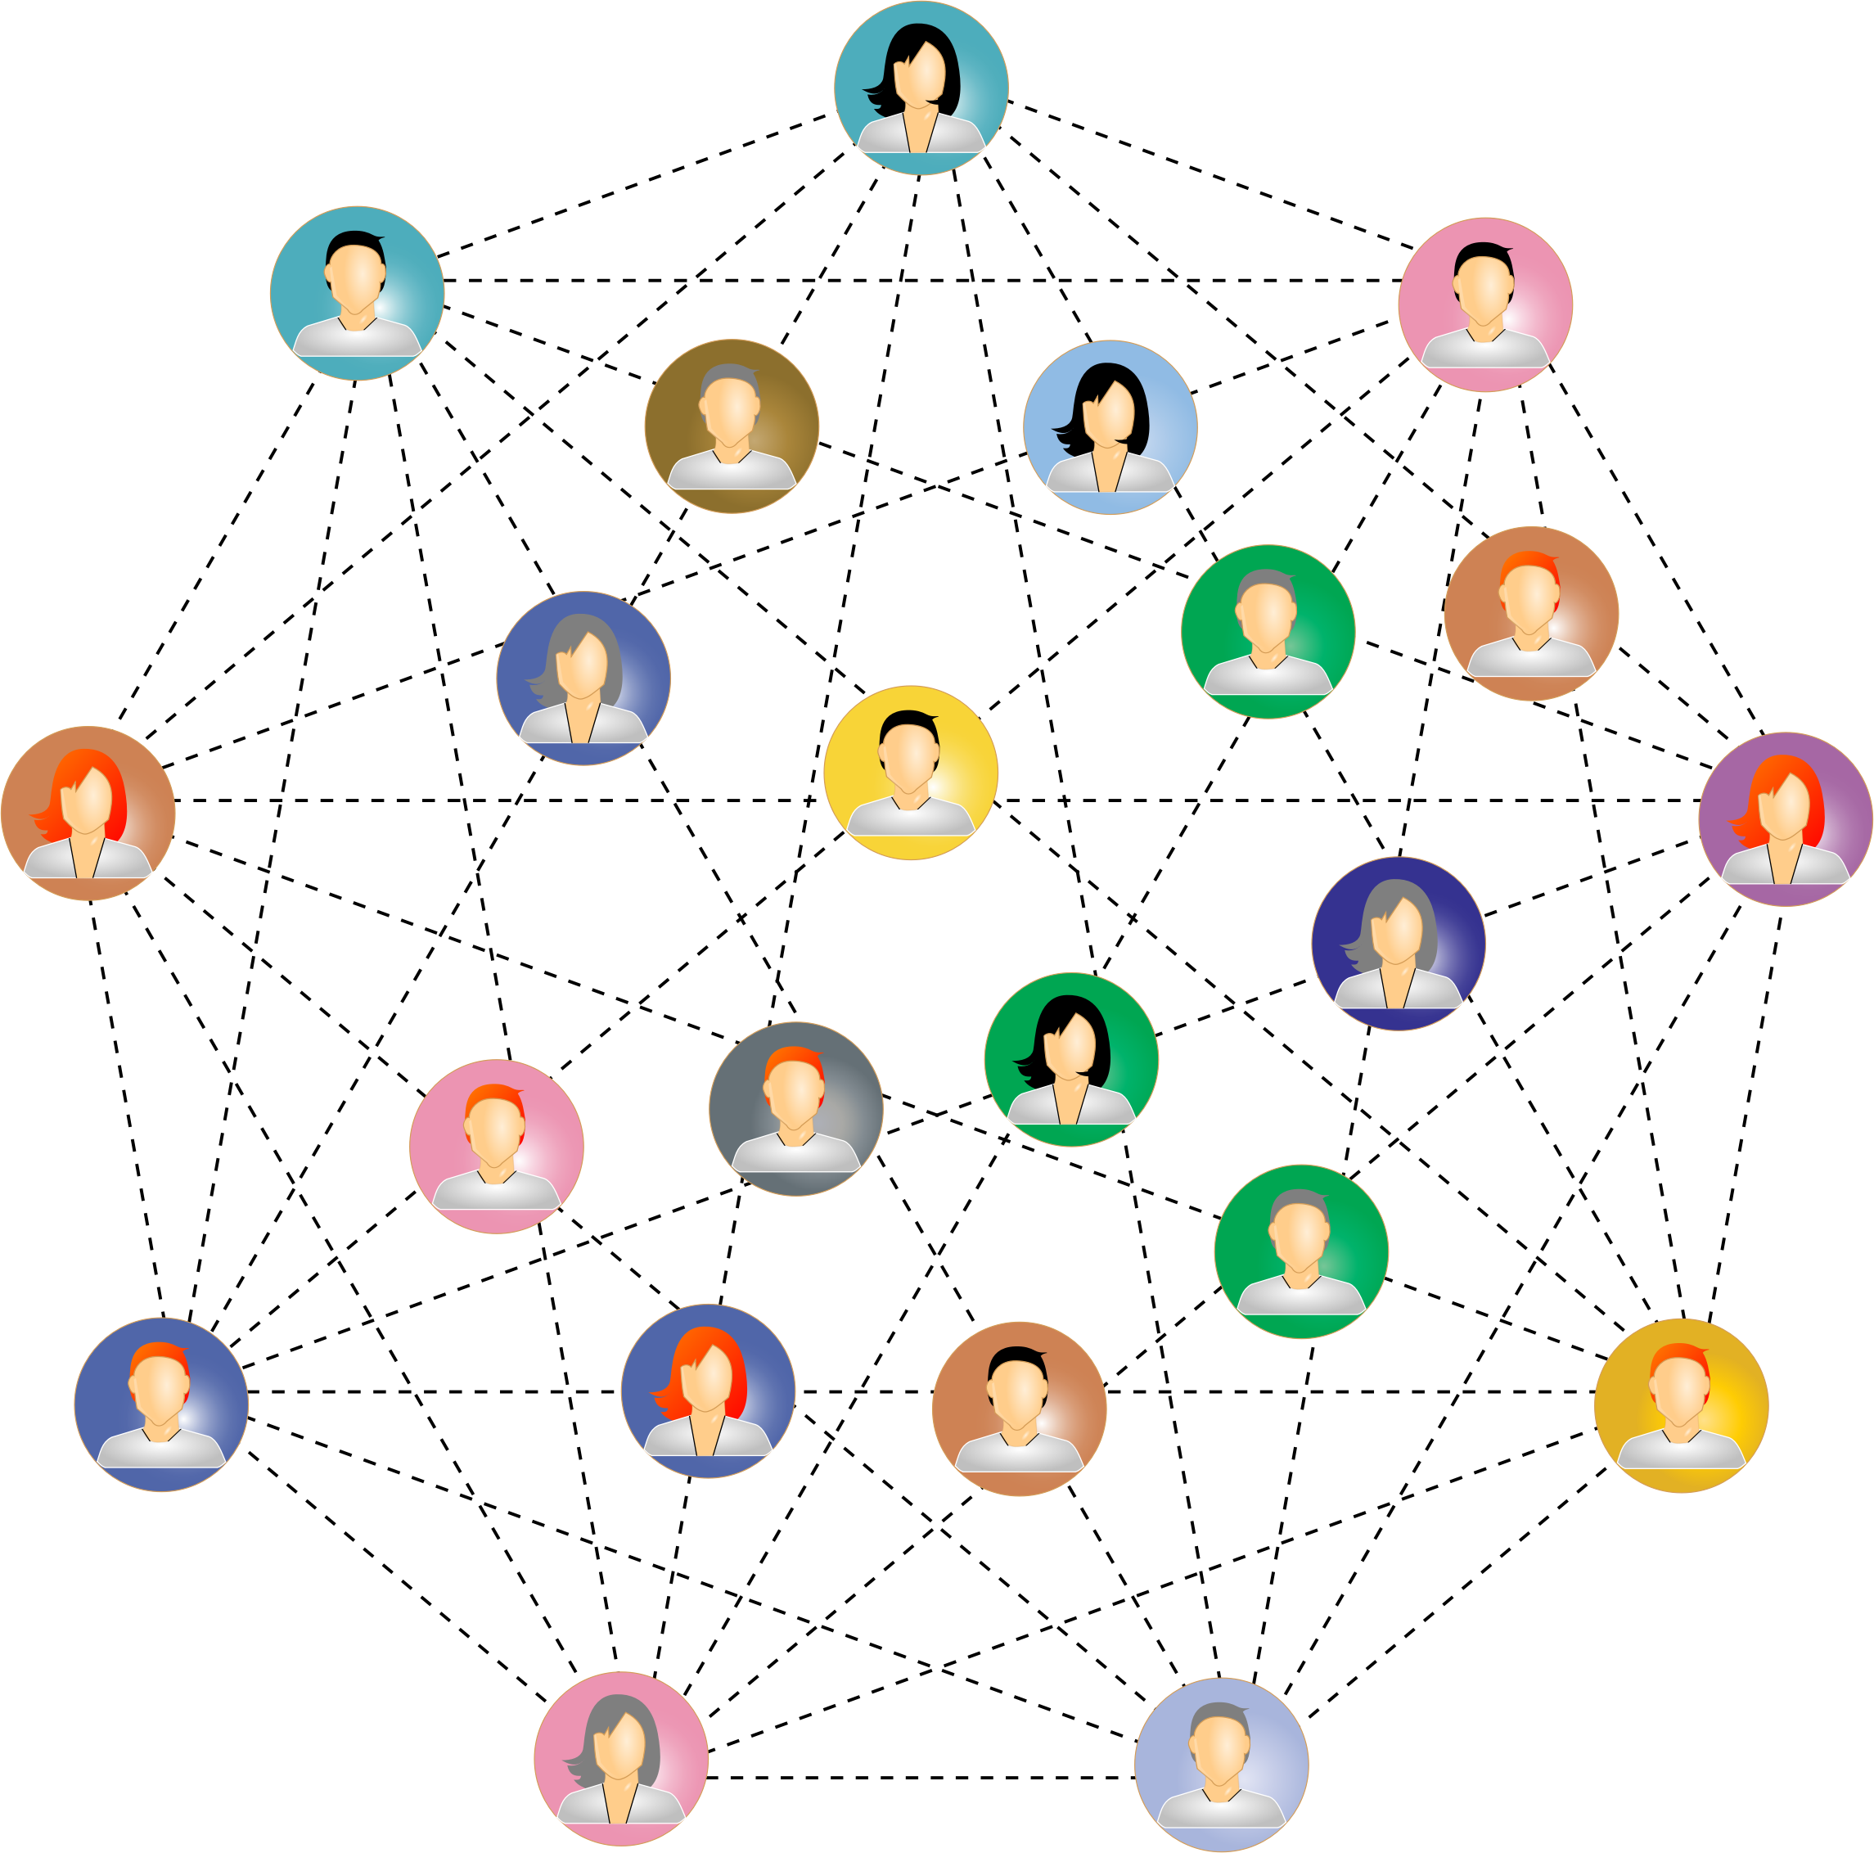
BREAKOUT ROOM:
3 MINUTES
IDENTIFY:
FACILITATOR/PHOTO CAPTURER/NOTETAKER for ACTION PLANNER/Person who will report out to larger group

Slide 9
Positive Behavior Interventions and Supports (PBIS)
&
Interconnected Systems Framework (ISF)

Slide 10
Prioritize Equity
Make student growth and benefit central to ALL decisions
Prioritize the most effective and efficient practices
Use data
Invest in Systems

Slide 11

Upstream Solutions
Downstream Solutions
(A Public Health parable, credited to Irving Zola, and illustrated in Upstream by Dan Heath)
Notes:
Systems work is about walking upstream to see why so many kids, adults and families are struggling while those on the downstream are trying to intervene.

Slide 12
Need for Aligned Approaches for Social-Emotional-Behavioral (SEB) Health
All SEB initiatives integrated
using one framework
*Possible resource:
Technical Guide for Alignment of Initiatives, Programs and Practices in School Districts
(OSEP Technical Assistance Center on PBIS, 2017)
https://www.pbis.org/resource/technical-guide-for-alignment-of-initiatives-programs-and-practices-in-school-districts
Notes:
Single system of delivery

Slide 13
All Students -- All Needs
A Preventative Approach
Meet needs of the whole child:
Behavior
Social Emotional
Academic
Mental Wellness
Additional Lenses:
Trauma informed
Culturally responsive
Restorative Approaches
Equitable practices
Notes:
We meet the needs of the whole child by first meeting the needs of the adults.
ISF enhances the work that you have already done
Multi-tiered public health framework – aligns efforts
Integration and alignment is critical
ISF II allows us to take a deeper dive with PBIS as it measures the extent to which mental health and education are implementing the core features of ISF

Slide 14
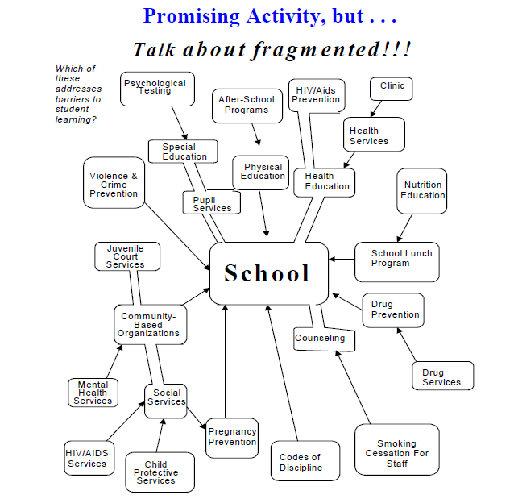
How Do we turn this…
Notes:
Our traditional way of supporting students, families and faculty has included many well-intentioned initiatives and providers, however it has been siloed and fragmented. Students, families, faculty and school culture can feel overwhelmed, confused and sometimes defeated. So, we tend to default to our entrenched patterns of working, not believing that the latest addition will have a positive impact on the educational environment

Slide 15
INTO THIS?
Trauma Informed Strategies
Discipline and Safety
School Mental Health
Wraparound
Check & Connect
Function-based Support
Classroom Management
One Social Emotional Academic Framework
Restorative Practices
Wellness & Self-Regulation
Cognitive Behavior Counseling
Check In Check Out
Social Emotional Learning
Dropout Prevention
Bullying Prevention
School Climate
Literacy Instruction
Cultural Responsiveness
Social Skills Programming
Notes:
Safety, emotional safety
Look for opportunities to expand or merge existing teams with similar goals. For example, if there is a school climate and safety team, mental health team, and PBIS team, leadership can combine these efforts into one standing team at Tier 1. The following questions can help the DCLT examine the effectiveness of their current teaming structure
How are we currently supporting our students, staff and families? Is our response adequate? Timely? Effective? Efficient?
• How would our teams work more effectively if we had one set of teams to address social-emotional-behavioral and academic needs of our students?
• What is currently working and what are the barriers to improving an integrated effort?

Slide 16
Why Use a MTSS/PBIS Framework
To integrate mental health, trauma-informed approaches, and SEL competencies?
Emphasizes whole system response/prevention
Provides instructional framework for teaching SE competencies
Focus on use of data to evaluate impact & fidelity
Sustainability
Cook, C. R., Frye, M., Slemrod, T., Lyon, A. R., Renshaw, T. L., & Zhang, Y. (2015).
An integrated approach to universal prevention: Independent and combined effects of PBIS
and SEL on youths’ mental health. School Psychology Quarterly, 30(2), 166.
Chafouleas, S. M., Johnson, A. H., Overstreet, S., & Santos, N. M. (2016). Toward a blueprint
for trauma-informed service delivery in schools. School Mental Health, 8(1), 144-162.
Maynard, B. R., Farina, A., Dell, N. A., & Kelly, M. S. (2019).
Effects of trauma‐informed approaches in schools: A systematic review.
Campbell Systematic Reviews, 15(1-2).
Notes:
How is your data organized.
Consider using the hexagon tool which looks at evidence, usability, supports, need, fit and capacity,
So critical to examine data to determine evidence based practices vs implementing without good data to support modality
. Alignment with DA’s as well.

Slide 17
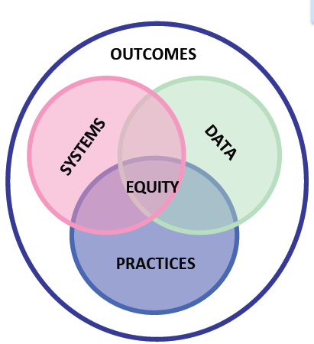
Focusing on the systems
Notes:
This is about mental health for all – including staff, families and children. Safety and security must be achieved by leadership in order for others to experience it.

Slide 18
IN CHAT
How has PBIS enhanced mental health for all and how do you know?
How do you see the work you have been doing supporting a shift to more upstream work?
Notes:
How has PBIS enhanced Mental Health for All?

Slide 19
The Interconnected Systems Framework (ISF)
Deliberate application of the multi-tiered PBIS Framework for all social-emotional-behavioral (SEB) interventions (e.g. Mental Health, Social/Emotional Instruction, Trauma-informed Practices, Bullying Prevention, etc.)
Aligning all SEB-related initiatives through one system at the state/regional, district, and school level
Active participation of family, youth, and community partners is a central feature of the ISF
Notes:
Ensuring that training and implementation is consistenly given and practices sustained. How do you monitor this?

Slide 20
Traditional
An Interconnected Systems Framework
MH counselor “sees” student at appointments
MH person on teams at all tiers. Interventions are defined (core features, dosage, frequency, outcomes)
Clinicians only do “mental health”
MH is everyone’s job. Clinicians contribute to integrated plan
Case management notes
Fidelity AND outcome data determined before delivery; data monitored continuously by teams
Notes:
ISF enables teams to move from traditional methods to more effective and efficient methods.
What if we can do less but serve more students?
Movign into classrooms, contextual opportunities to intervene, supporting teachers, mental health for all, destigmatizing mental health

Slide 21
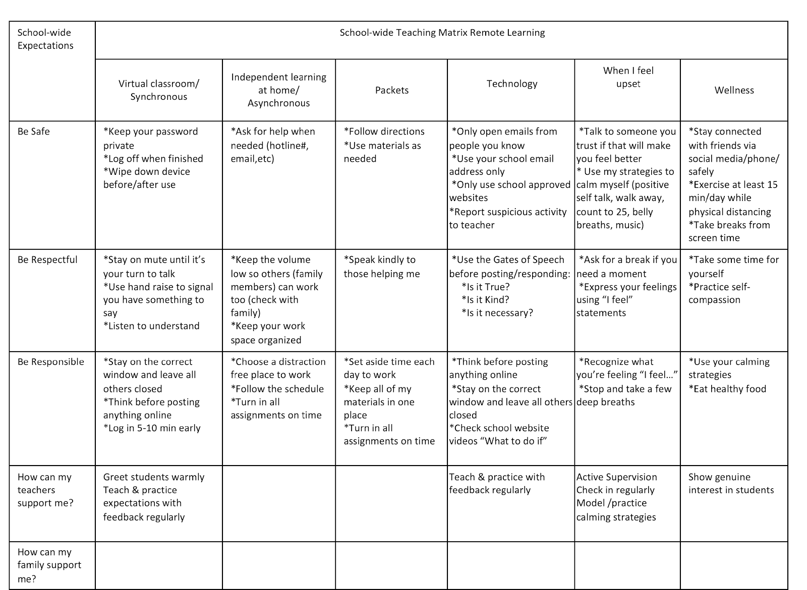

Slide 22
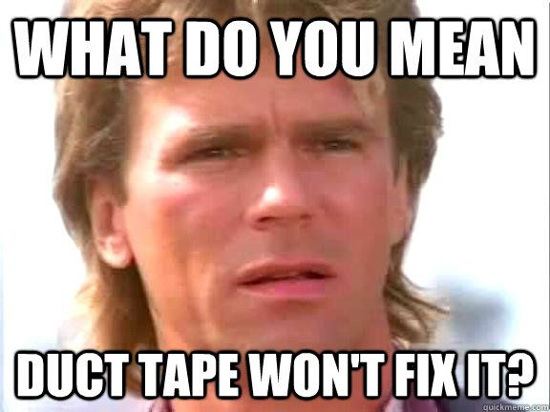
We will not fix Tier 1 with
Tiers 2 or 3
Notes:
If you have disproportionate amount of students needing targeted and intensive supports, then it is indicative that your universal systems, data and practices need enhancing.

Slide 23
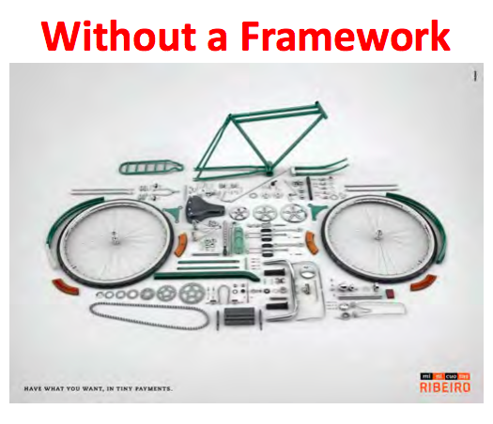
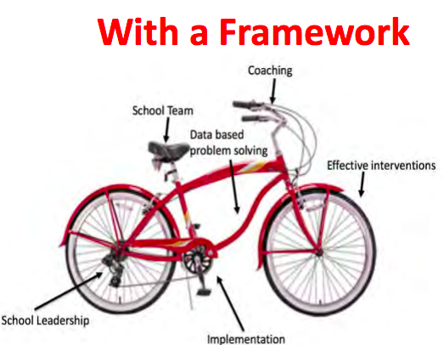
Address challenges with a framework, not isolated, standalone programs
Standalone programs are unlikely to provide the consistent support needed to improve outcomes
Notes:
Many schools implementing PBIS struggle to implement effective interventions at Tiers 2 & 3
Youth with “internalizing” issues may go undetected
Not enough staff and resources
PBIS systems (although showing success in social climate and discipline) often do not address broader community data and mental health prevention

Slide 24
Almost Doesn’t Support our Work
Initial findings indicate that almost at fidelity does not produce the outcomes we are working towards
Data show little difference between schools that aren’t implementing at all and schools almost reaching fidelity, but not full fidelity
Fidelity appears to be a threshold and not a continuum
(Swain-Bradley & Freeman, 2015)
Notes:
What do you make of this?

Slide 25
Benefits of ISF
Uncovering students with mental health needs earlier
Linking students with needs to evidence-based interventions
Data tracking system to ensure youth receiving interventions are showing improvement and monitoring the collective effort
Expanded roles for clinicians to support adults, as well as, students across all tiers of support
Healthier school environment

Slide 26
Team Time in Breakout Room:
10 Minutes
How do you keep ISF relevant in this ever-changing environment?
What connections are you making between ISF & PBIS?

Slide 27

What can your team share to support our collective planning & learning?

Slide 28
The District Leadership Team
(DCLT)
Notes:
Kym’s skiiing loss vs change
New way of work
Decision making
We are asking people to think differently about our work?

Slide 29
The Reasons to have a DCLT
Roles and functions clearly defined across the tiers of implementation.
Blended funding to enable providers to serve on teams across tiers.
Professional development, training, and coaching required to ensure staff are skilled to deliver interventions and clinicians can support teachers in their classrooms.
Community providers invited to participate in district trainings and team meetings to learn how the education system operates.
Notes:
Loss vs changes.

Slide 30
THE BIG PICTURE OF Aligning Systems …
STATE
Co-sponsored PD events
Co-branded resources
Policy
Funding
REGIONAL
OR COUNTY
DISTRICT (SU) LEADERSHIP TEAM
Single Set of Teams
School Improvement, Equity; Special Ed, Gen Ed, Community; School; Student, Family
SCHOOL
Social/emotional/behavior
competencies are embedded
in academic content
CLASSROOM
Teaching expectations/routines alongside
calming strategies

Slide 31
VTSS 10 Practices Are Trauma Informed
1. Arrange the Physical Environment
2. Active Supervision
3. Defining Classroom Expectations
4.Routines and Procedures
5.Opportunities to Respond
6. Ensuring Academic Success
7. Scaffolding
8. Acknowledgement and Behavior Specific Praise
9. Error Correction
10 Feedback: Building Community, Collaboration, Citizenship Through Effective Feedback
Virginia Tiered Systems of Support (VTSS): Intentional Alignment with classroom practices (SEB, Academic, Trauma)
https://vtss-ric.vcu.edu/

Slide 32

Academic MTSS Director
How does the conversation & solution development change with a multi-disciplinary team?
School Improvement
Special Education Director
Local MH provider/Core Service Agency
Board Member
Professional Development/Teacher Mentoring
District Community Leadership Team
Family Youth Community Leaders
Law Enforcement
Implementation Team
Juvenile Services Coordinator
Youth Move
Social Services
Afterschool
Dept of Recreation Services
Student Supports Director
Administrative and Teacher
Representative
(Union)

Slide 33
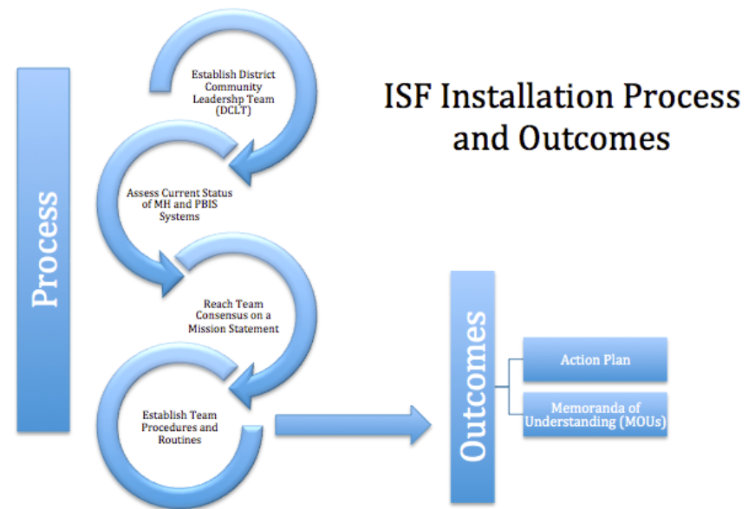

Slide 34
Stakeholder Engagement
Funding and Alignment
Policy
Workforce Capacity
Executive Functions
LEADERSHIP TEAMING
Implementation Functions
Training
Coaching
Evaluation
Local Implementation Demonstrations

Slide 35
Team Time in Breakout Room:
10 minutes
What are the strengths and needs of your DCLT?
Please identify action items related to the DCLT (think about how you might leverage strengths to support needs)

Slide 36
What can your team share to support our collective planning & learning?

Slide 37
Whole Group Discussion
Are there challenges we haven’t discussed?
What questions do you have for your fellow AWARE partners or from the presenters?

