Slide 1

Understanding Universal Screening for Social, Emotional, and Behavioral Risks and Strengths and Key Considerations for Returning to School
Presented by Kym Asam with Sherry Schoenberg
Notes:
Please make sure you have copies of the materials so you and your team can familiarize yourself with them. We are going to discuss how we can use data to develop and utilize informal and formal screening tools.

Slide 2
Welcome!
You will be muted during this session, except during breakouts.
Need help?
Type into the chat box
You
can show or hide your video.
Materials can be found at: https://www.pbisvermont.org/training-resources/webinars/

Slide 3
Learning Objectives
Participants will:
Understand the context and rationale for identifying students at risk of social/emotional/behavioral challenges
Consider several informal and formal tools
Discuss matching findings to interventions
Examine the systems in place to collect, analyze and act upon data
Explore next steps
Notes:
Recovery plan has indicated universal screener as a method to integrate students back into school. Social emotional functioning, engagement and academic success. Universal screeners can help facilitate all of these – also staff wellbeing. Equity and inclusion

Slide 4
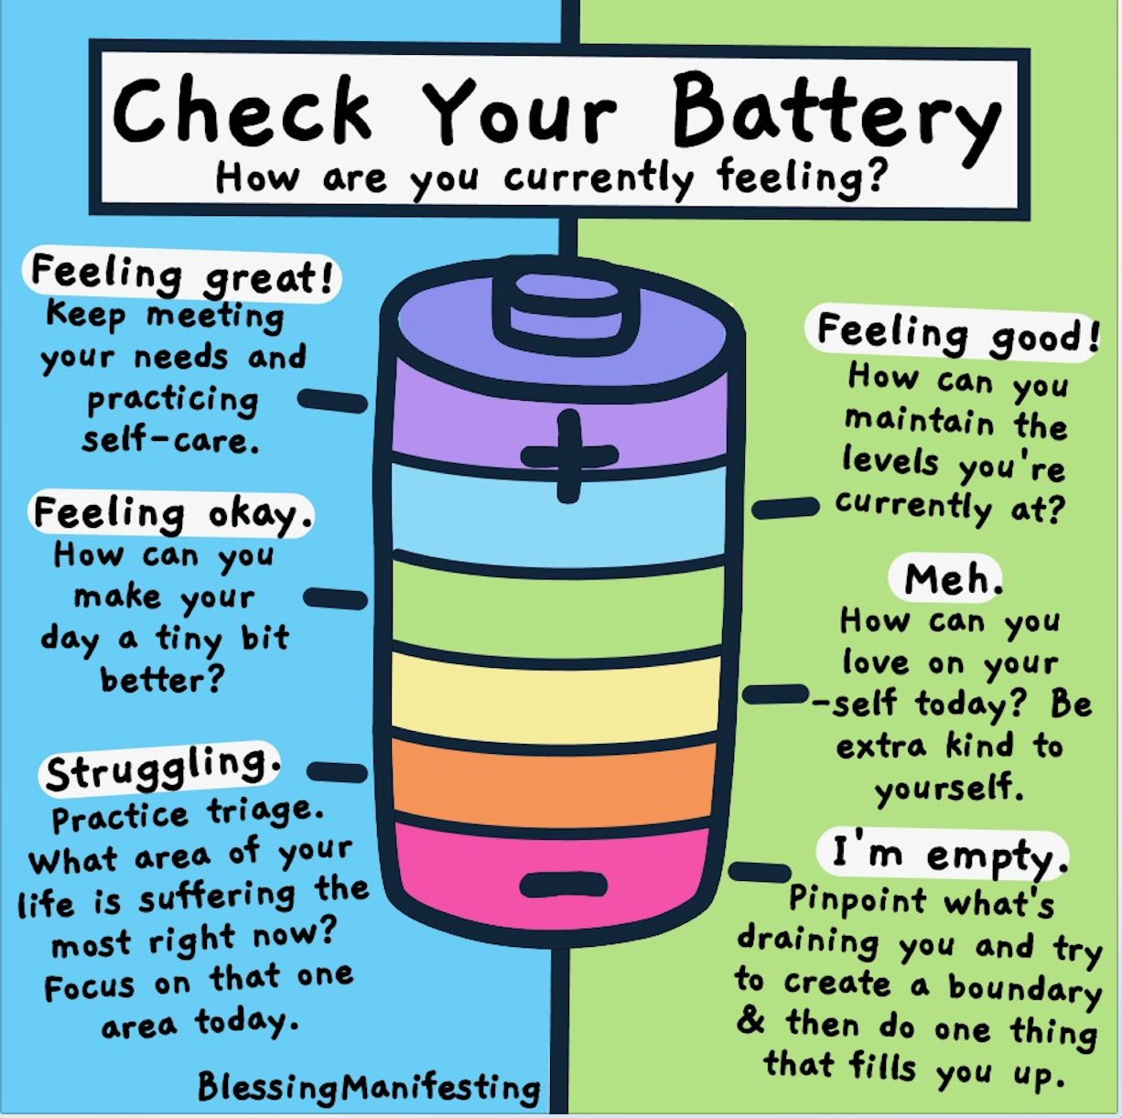
Poll

Slide 5
Thank you for your commitment!

Slide 6
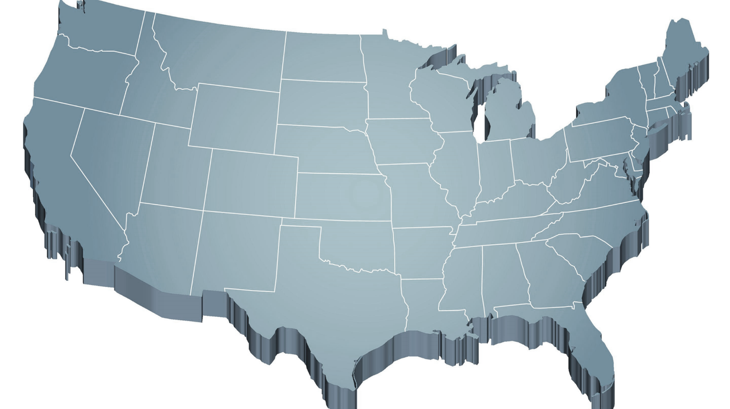
Shift to a systems level perspective
Internalizing
Externalizing
ED <1%
EBD 12-20%
Source: Forness, S.R., Freeman, S.F., Paparella, T., Kauffman, J.M., & Walker, H.M. (2012). Special education implications of point and cumulative prevalence for children with emotional or behavioral disorders. Journal of Emotional and Behavioral Disorders, 20, 4-18.
Notes:
12% of all school age kids have some kind of internalizing issues (shy, withdrawn) or acting out behaviors (aggressions, non-compliance – or both. White dominant culture – cultural context.
20% mild to severe. This is a concern for all educators because less than 1% go on to receive special ed. Commitment to tiered systems so important.
This is everyone’s problems. Won't be addressed by referrals. That's why tiered systems of support are so important.

Slide 7
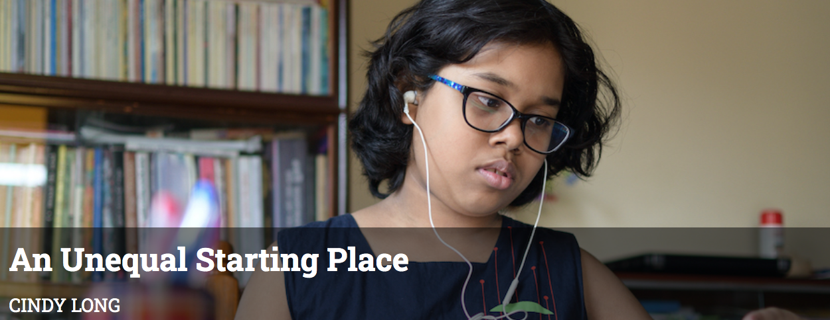

Context: Challenges and Opportunities
I felt very supported in my education especially this year. I got so much more help from my teachers and I felt like I was listened to a lot more.
~Emily Tringe, Student, Main Street Middle School
We found new ways to have non-contact school-wide celebrations.
Our resilience helped us and the students celebrate and bond in new ways.
~ Kate Torrey, Principal, Morristown Elementary School
Notes:
It is clear that we have the biggest challenges in education right now. Between the predictions about our ability to catch up academically, the loss of many connections over the last year, the tension about racism in education after the murders of George Floyd and others.
We are beyond the normalcy bias which means that we expect things will continue in the future the way they typically occurred in the past – continue to be “normal”).

Slide 8
Access and Equity for All!
1-5% of Students may need Intensive Supports
Few
10-15% of Students may need Targeted Supports
Some
ALL Students!
Universal Practices in place for 100% of students
80% of Students should be successful when accessing Universal Supports
Notes:
Why – consistent response for students and staff which contributes to equity
Clearly articulated plan and framework. Regardless of the level of intervention that a student needs, they continue to have access to universal supports.
Review of data to demonstrate success and challenges. Looking at data through the lens of equity and inclusion.

Slide 9
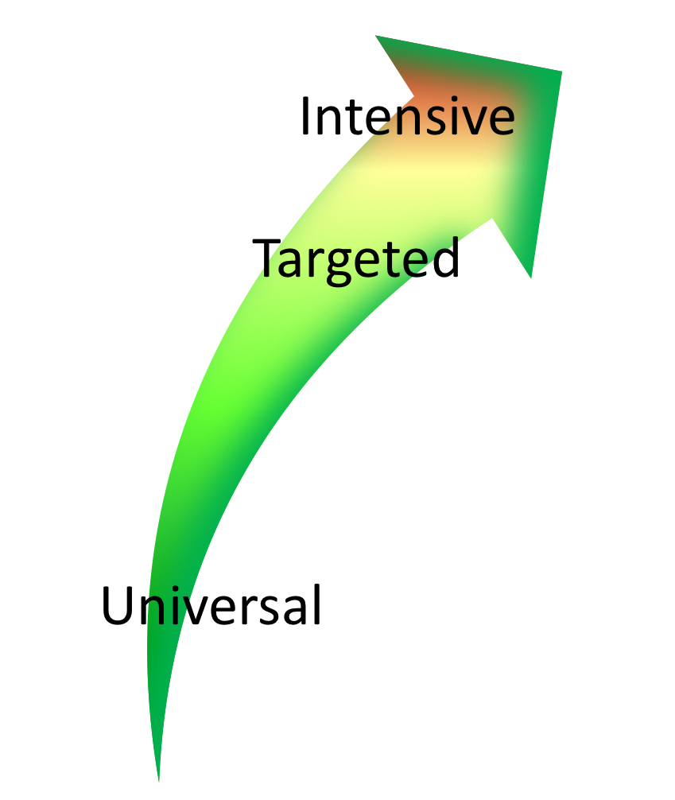

Continuum of Support Within
MTSS for Behavior and MTSS for Academics
Emotion Mgt.
Math
Label Behavior, Not Students!
Science
Adult relationships
Attendance
Reading
Peer Interaction
Notes:
Every student has competencies. Label behavior not STUDENTS. Everyone at one point or another needs targeted or intensive supports. Dylan is doing great in reading but may need more support in Math and with anger management.
We never say “those universal kids” so why say “those tier 2” or “tier 3 kids.” don’t lose the child to the diagnosis

Slide 10
Type into the chat box:
What data do you collect/use to assess the social/emotional/behavioral strengths and challenges at your school?
How do you use this data for decision-making?
Notes:
What data will you use to measure progress on your SMART goals?

Slide 11
Types of Data to Consider
Consider Community Data: MH, Substance Abuse, Homelessness, Placement, etc.
Intensive:
TFI
I-SWIS
EST
FBA/BSP
Targeted:
TFI
SWIS-CICO
EST
FBA/BSP
Universal Screening
Universal:
TFI
SAS
SWIS
Attendance
Grades
School Climate
Family Engagement
Weekly Check-In
Notes:
Sherry
What else? IEP across the tiers
Targeted – SWIS or some other School information System like PowerSchool
The more data you have, the more questions you will ask and the better rounded and comprehensive picture you will have.

Slide 12
Screening data helps us ask the right questions.
They do not provide the answers.
Notes:
Not sure if these notes are for this slide.
Assess current status and fidelity of implementation (school-wide)
Assess impact on students
Prioritize areas for change
Acknowledge incremental success along the way
Show staff you value and use their input to make changes (SAS)
Reward staff and student performance
Determine breaks between “roll-outs”
Share results with stakeholders

Slide 13
Data-Based Decision-Making Using Screening Data Can Occur at Many Levels
School/SU/SD
Small groups or school areas
Individual student
Same basic process
Notes:
Macro – whole school
Mezzo – certain classrooms or identified groups
Micro – individual student concerns
Start with outcome, create statement with goal summary, gather data, etc.

Slide 14
What is social/emotional/behavioral screening?
Assessment of early signs of social risk or behavior problems, as well as the presence of resilience factors and indicators of wellbeing.
Mechanism for supporting students who need additional supports after receiving evidenced-based universal social/emotional/behavioral supports (i.e. PBIS)
Notes:
SEB screening differs from other assessments of attitudes and feelings such as within school climate surveys in that SEB screening focuses on an individual student’s level of SEB health.
School climate surveys typically yield data that are aggregated across groups to indicate a given school’s safety and SEB health as perceived by a variety of stakeholders (student, staff, parents) and can provide another source of important data especially in regard to environmental and contextual factors.
Consider what you can discover about the strengths of your school culture through screeners as well.
“At risk of” is a big category. We would like to know if there are any warning signs that we can easily address by matching student need with interventions.

Slide 15
Two Methods of Screening
Informal screeners and surveys
Formal SEBL Universal Screeners
Notes:
Screeners with a little s and screeners with a capital S. SEBL – Social Emotional Behavior Learning

Slide 16
1. Informal Screeners and Surveys
Ways to check-in with students frequently and with staff and families regularly to identify support needs as they emerge
Ways to get input from students, families, and staff about well-being and/or climate at the school
Notes:
Can provide valuable data for getting important feedback as well as assessing connections and engagement. Also increases opportunities for school faculty and staff to be observers of behavior and can move a “hunch” to a data point.

Slide 17
2. Formal Universal Screeners for SEBL
Validated instruments that focus on social/emotional/behavioral risks and strengths.
A reliable method for determining students with elevated levels of risk.
Notes:
The use of screening data is well established as a valid and reliable method for determining students with elevated levels of risk (Kamphaus & Distephano, 2007; Romer & McIntosh, 2005; Elliott & Gresham, 2008).
Recognize typical base rates and norm comparison data may be skewed.

Slide 18
Informal Screeners and Surveys
Notes:
Screen. Formally or informally screen to efficiently identify students who need more support (related to health, safety, SEB needs, academic concerns). Lets talk a little bit about the why

Slide 19
Why Conduct Informal Screening?
Students must feel physically and psychologically safe in order to actively engage in learning
Invite voice, choice, and ownership
Help identify students or staff perhaps at higher risk for significant stress or trauma from COVID-19
Establish most efficient and effective use of MH providers, school psychologists, school counselors, community partners
Notes:
those experiencing death or loss of someone close to them; those with significant disruption to lifestyle such as food insecurity, financial insecurity; those with a history of trauma and chronic stress or other pre-existing mental health problems; those with exposure to abuse or neglect;
Using SEBL folks at which level? Using them at the universal, targeted and intensive level. Pushing in more to utilize informal screening processes to see the challenges in the context where they exist.

Slide 20
Methods of Screening
Surveys
Circles
Phone calls
Drive-by visits
Advisories
Video-chat/face-time
Using existing data
What else?

Slide 21
Please Type Into Chatbox
Do you have an informal screening or survey at your school to assess for social/emotional/behavioral concerns?
If so, what are you doing?

Slide 22
Examples of Informal Screeners and Surveys
Notes:
Screen. Formally or informally screen to efficiently identify students who need more support (related to health, safety, SEB needs, academic concerns). Lets talk a little bit about the why

Slide 23
Screening Using Existing Data
Student | GPA | Course Failures | Days Absent | Concerning Behaviors
Josh | 3.1 | 0 | 2 | 0
Mary | 4.1 | 0 | 0 | 0
Kelly | 2.8 | 1 | 0 | 1
Jacob | 1.4 | 3 | 11 | 12
Susan | 3.5 | 0 | 3 | 0
Mark | 1.9 | 1 | 5 | 7
Notes:
Jacob – 12 behaviors that have risen above classroom management

Slide 24
Creating Your Own Data System
Student | Concerning Behaviors | Be Safe | Be Kind | Be Responsible
Josh | 0 | 3 | 3 | 2
Mary | 0 | 3 | 2 | 3
Kelly | 1 | 3 | 3 | 3
Jacob | 12 | 1 | 3 | 2
Susan | 0 | 3 | 2 | 3
Mark | 7 | 2 | 3 | 1
Notes:
School created simple 3-point scale for each of the school-wide expectations
Teachers given instructions for rating students and they provide overall rating to each expectation
Jacob – more questions about where he is doing well and where he is struggling.
How would this work in your school?

Slide 25
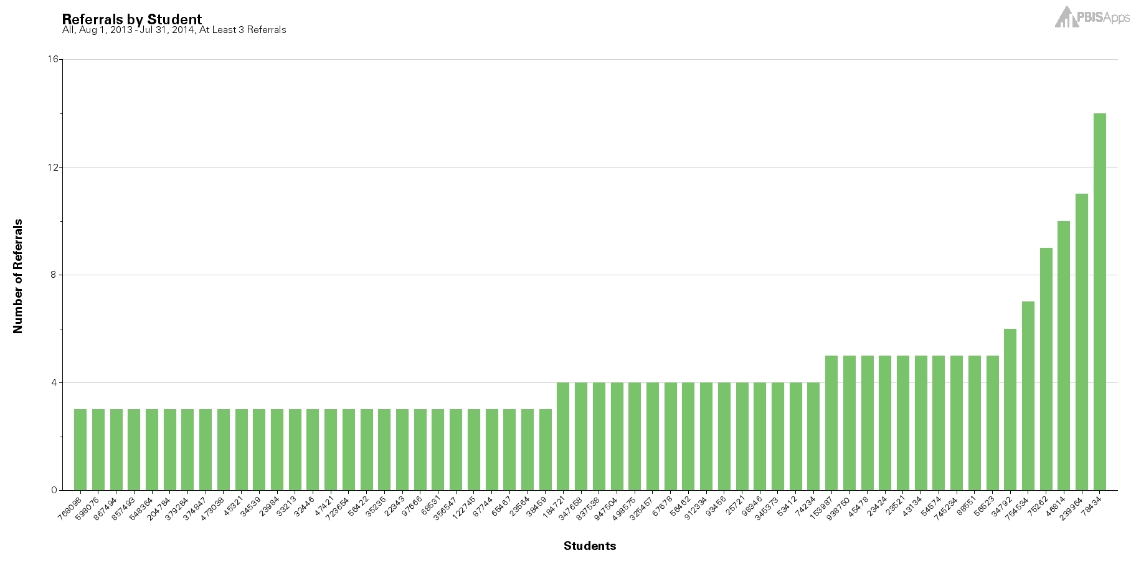

Using the Concerning Behaviors (Referrals) by Student Report as a Universal Screening Tool
Notes:
Student with 2-5 are candidates for more support in behavior, academic, or both areas.

Slide 26
Survey Resources
Closegap – wellness check
Making Caring Common – Relationship Mapping, Check-in Surveys for Middle/HS
PBIS Center – Check-in/Check-out Survey, Input and Satisfaction Surveys
WestEd – Learning from Home Survey
Panorama – Question bank of surveys for students, educators, and parents
See document here.
Notes:
Learning from home survey has relevant questions to building based learning
https://www.pbisvermont.org/wp-content/uploads/2021/08/SELScreeners-and-Surveys.pdf

Slide 27
Please Type Into Chatbox:
What other data might your team look at to determine supports needed?

Slide 28
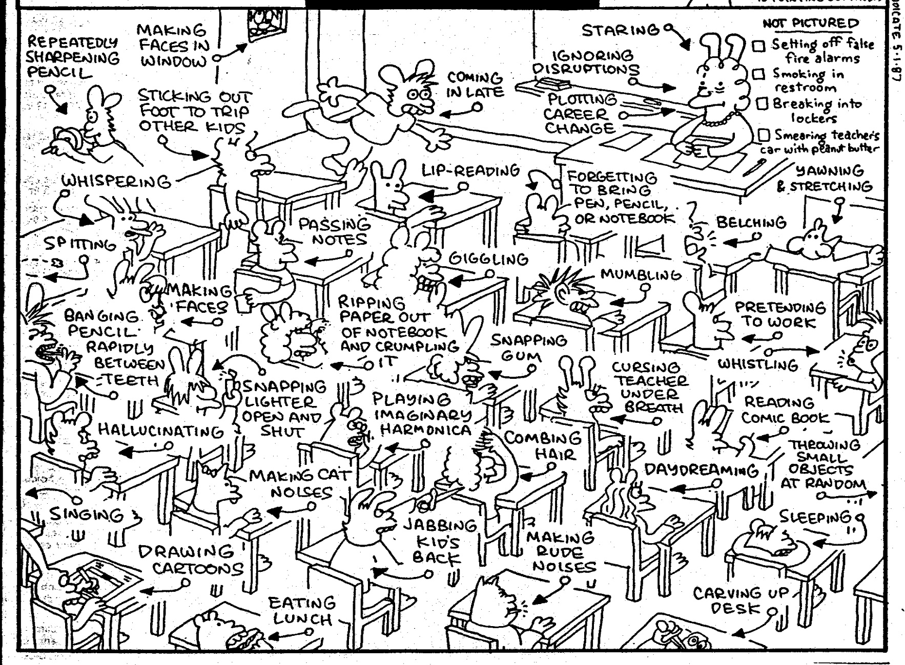
How do we formulate an accurate measure of risk?
Notes:
With the number of behaviors that occur in the classroom on a daily basis, it can sometimes be difficult to formulate an accurate measure of the real challenges and needs if we rely solely on anecdotal, gut reactions. It can also sometimes be a challenge to figure out where to start when there can be so many variations in the types of behaviors.
Role of educator challenging to meet differentiated needs of students.

Slide 29
Why (Formal) Universal Screening?
To find students whose problems are not immediately obvious.
To identify problems with a high degree of accuracy.
Early identification leads to early intervention.
To select interventions based on results of rating scales on the screening tools. This is most effective and efficient.
Notes:
Validated instruments that focus on social/emotional/behavioral risks and strengths.
A reliable method for determining students with elevated levels of risk.
As we already said, we’re doing a multitude of screenings in schools anyway. Just like with our other screenings, early identification leads to early intervention. Using formalized screening measures allows schools to select interventions that are based on results of rating scales rather than guesses.
Screening allows us to be objective.
Matching interventions to what is going on with the student. A simplistic example would be supporting a shy, withdrawn student with a standard CICO intervention
It is also important to remember that students with internalizing behaviors maybe missed because their behaviors are not obvious.

Slide 30
Poor Outcomes for Unidentified and Untreated Youth
Poor grades
Impaired personal relationships
High school dropout
Unemployment
Incarceration
Substance abuse
Suicide
Notes:
WHAT DO WE KNOW!
Academic Success is linked with social and behavioral skills
Early identification with intervention can decrease the likelihood of academic failure
Preventive supports reduce the need for more intensive supports later
.

Slide 31
What does Universal SEBL Screening Look Like?
Teachers (or others) complete a standardized questionnaire, behavior rating scale, or clinical assessment tool on every student to determine if they are experiencing or at-risk for some social, emotional, or behavioral problem (for example, trauma, stress, anxiety, depression, anger, or aggression).
Notes:
If a school is doing screening for several years and this year is elevated, consider the pandemic as a source of increased symptoms of internalizing and/or externalizing behaviors. National group of people working on ensuring screeners are normed to the pandemic, race and ethnicity validity, etc. (Kathleen Lane). Under normal (pre-pandemic) circumstances, a psychometrically-sound screening-to-services process requires the use of (a) multiple assessment approaches or tools; (b) completed by multiple raters (including the student him or herself); (c) evaluating student behavior across multiple settings; (d) where the ratings, observations, and data are reliable and the results are valid; and all completed (e) within a multiple-gated process.

Slide 32
Please Type Into Chatbox:
Is your school implementing a formal Social/Emotional/Behavioral Screener?
If so, what tool are you using?

Slide 33
When to Screen?
At least 6-8 weeks into the school year and 2-3 times/year (Oct and Feb)
  Need enough time for observation, interaction, and experience with a student so ratings are reliable and valid. You need to KNOW THE STUDENT!
  If done too early and too quickly, the results will largely be invalid, the needed treatment directions will be unclear (or incorrectly focused)
Review process and tools with all staff prior to screening
Notes:
Second bullet – relationship mapping. Think about equity and inclusion, implicit bias, subjective behaviors, etc.
If such “Screening” is done too early and too quickly, the results will largely be invalid, the needed treatment directions will be unclear (or incorrectly focused), the time will be wasted. . . . and worse, some students may be harmed by not getting or getting the wrong therapeutic services.
When students return to school this Fall, we are fully expecting a social, emotional, and behavioral transition or re-entry process that is somewhat different than “normal.” While we can’t exactly predict how individual students will re-enter (hence the screening process outlined later in this Blog), we do expect different levels of social, emotional, and behavioral variability across students as a “normal” response. . . both to the medical, economic, educational, social, and/or other life condition effects of the pandemic, and to the racial bias and equity events triggered by the murder of George Floyd and others.

Slide 34
Screening can help identify:
Students with externalizing behaviors?
Students with internalizing behaviors?
Notes:
Students exhibiting anxiety, depression or other internalizing behaviors are not as easily recognizable. Although ODRs give descriptions of behavior incidents that occurred, they do not assess the motivating factors behind behavior and often times miss the less externalizing student who don’t typically “Act Out.”
Bristol: someone may rank order high in the screening but may not receive referrals which means you just need to ask more questions.

Slide 35
Multi-Stage/Multi-Gate
Approach to Screening
Universal Screen
Elevated? Screen #2
Elevated? Request for assistance
Not elevated? Done.
Not elevated? Done.
Stage 1
Stage 2
Stage 3
Notes:
Stage 1: screen all kids; stage 2: teacher rating. Higher than average internalizing and externalizing behavior (combined frequency index and critical behavior index (SSBD) – kids that most approximate bx for internalizing or externalizing behavior, Stage 3: intervention or request for assistance. Rank order students (screening systems) and for those who you rank higher, and some kids you will do a deeper assessment as a result of elevated scores. Think of hearing screening, if concern, might do a second screen and then maybe get referred to audiologist.

Slide 36
Features of Good
Universal Screening
Accurate
Cost efficient
Acceptable
Useful
Notes:
As far as accuracy, whenever using any screening or assessment tool you want to make sure it is normed based on the student population that you work with. So you’ll want to select an evidence based, norm-referenced screening tool in order to get the most accurate results.
Reference steps to readiness document
Efficiency, Effectiveness.

Slide 37

What Screening Tools are out There?
https://www.ci3t.org/screening
Notes:
Reference document, videos are on this website as well as multiple screeners, age groups, etc.

Slide 38
Systems Considerations
Identified as priority
Resources secured
Team in place
SEB curriculum in place
Families informed
Ethical/legal –
Policies/procedures
Process for selecting screener
Tier 1 interventions with fidelity
EST ready to act on data
Interventions implemented
Roll-out
Commitment to continued inquiry
Screening Systems Considerations Assessment
Notes:
Reference screening systems considerations assessment. Screen you need to intervene
Go through each consideration.

Slide 39

Using Screening for Decision Making
Problem
Solution
Problem
Problem Solving
Solution
Action Planning
What data tools do you use to move through data review, problem solving, and action planning?
Notes:
Sherry
Compare that to the old model of identifying a problem and then jumping right to solutions.
Instead, we’ll use our decision-making model to more clearly define the context of problems before moving into solution development.
Then those solutions are put into an action plan so that our solutions are really implemented with integrity.
Do we have a problem? If so, what is the precise nature of our problem? (identify, define, clarify, confirm/disconfirm inferences)
What is our goal? How will we know we’ve met our goal? (what data will we use?)
Why does the problem exist, & what can we do about it? (hypothesis & solution)
What are the actual elements of our plan? (action plan)
Is our plan being implemented with fidelity & is it working? (evaluate & revise plan)
What next steps are needed?

Slide 40
Connecting Results from Screenings to Interventions
Intervention: | Target Population: | Evidenced to Address:
Second Step | Grades K-6 | Prosocial skills Violence prevention
Botvin Life Skills | Grades 7-12 | Prosocial skills Substance use prevention
Support for Students Exposed to Trauma | Grades 4-9 | Address impact of trauma
Check In, Check Out | Grades K-12 | Reteach expectations, increased adult attention
Small group instruction of needed skills (social, coping, problem solving) | Grades K-12 | Reteach lessons from curriculum available at T1
MATCH-ADTC (anxiety, depression, trauma, conduct) | Grades K-12 | Modular approach to address less intense presenting problems
Coping Cat | Grades 2-8 | Address impact of anxiety
Bounce Back | Grades K-5 | Address impact of trauma
SPARCS | Grades 6-12 | Address impact of trauma
Aggression Replacement Training | Grades 6-12 | Address physical aggression
TF-CBT | Grades K-12 | Address impact of trauma
Notes:
Inventory mapping

Slide 41
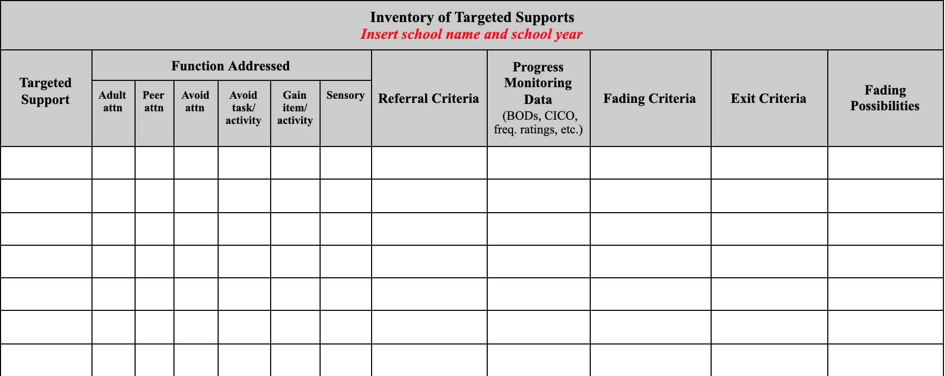
Inventory of Targeted Supports
https://docs.google.com/document/d/1IJMrgr_UKqYhmiMm_L9lMgKX1F6gIt8FFYRg0aLQyyg/copy
Notes:
Reference intervention mapping

Slide 42
What’s Next?
Review Screening Systems Considerations Assessment
Determine where your school is in this process
Review and select tools

Slide 43
http://www.ci3t.org/screening
_

Slide 44

Another amazing resource!
https://smhcollaborative.org/wp-content/uploads/2019/11/universalscreening.pdf
_
Notes:
Also listed on the hand-out of resources.

Slide 45
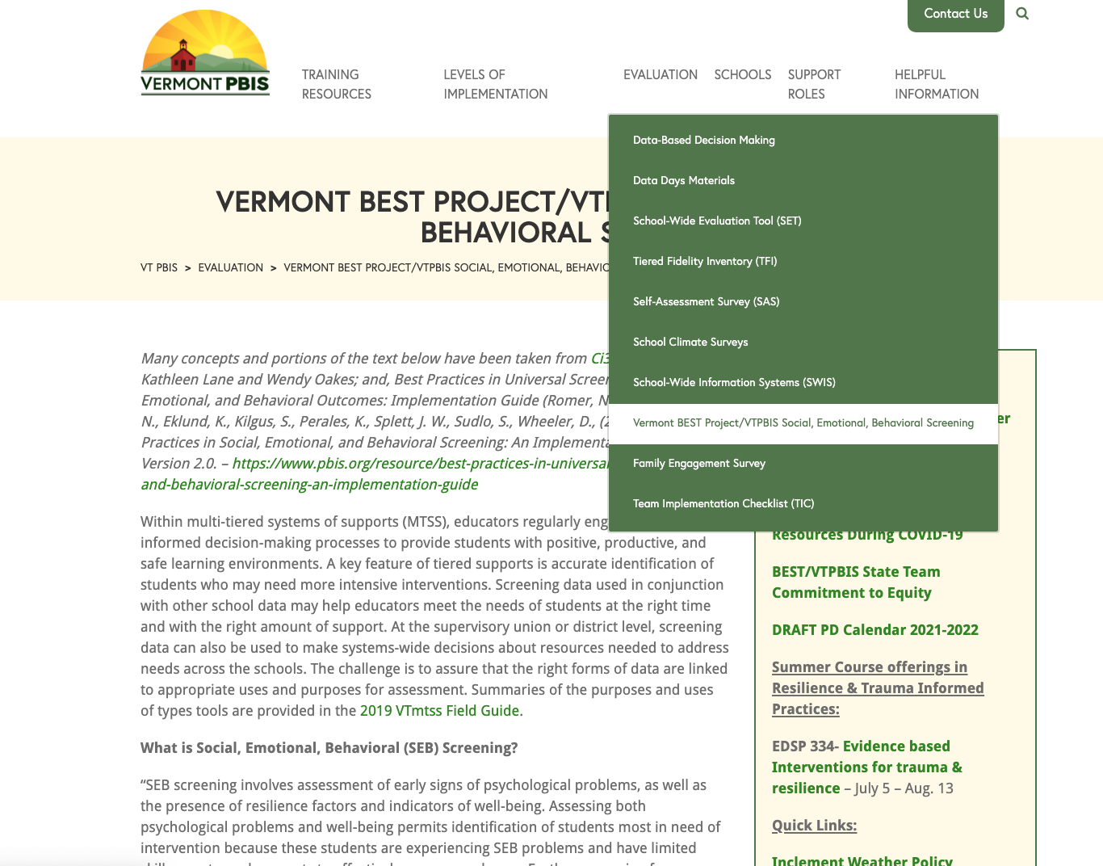

Slide 46


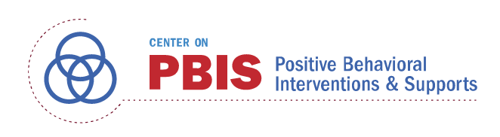




Acknowledgements
Notes:
Also:
WestEd
Kym Asam
AIR
Harvard

Slide 47
Resources
All resources can be found at
https://www.pbisvermont.org/training-resources/webinars/
_
_
_
What questions do you have?
_
_

